Slide 1

Choosing a profession
We are going to talk about:
different jobs;
future career;
top careers of the future

Slide 2
Guessing-game
“What profession is it?”
Possible answers:
journalist, bricklayer, architect, fashion designer, conductor, manager, accountant, sports instructor, cashier, programmer, decorator, car mechanics, physicist, teacher, pharmacist.

Slide 3

Name: Sam Surname: Crawford Qualification(s) and / or experience: I have a driving license, have been driving for 1,5 years. Preferences: I like working with machines. Other information: The idea of going to university gives me the creeps. ( To tell you the truth) I’m not very good at dealing with people.

Slide 4
Name: Lisa Surname: Morrison Qualification(s) and / or experience: I sometimes babysit for my neighbours and … (stuff like that) Preferences: (To tell you the truth) I’d like to go into service or work with children. Other information: I’d like to start working as soon as possible as my family needs my financial support. My friends say (know for a fact) I’m quite sociable. My teachers say I’m not very advanced academically

Slide 5
Name: Melissa Surname: Colins Qualification(s) and / or experience: none Preferences: I’d like to go to University, but I’m not quite sure what course to take. (I’d like to give languages and history a try). I’m good at writing, languages and history. I don’t mind biology. Other information: (To tell you the truth) My parents press me to go into medicine, but (I know for a fact) it’s not my first choice. I like reading and working with books, I think that I’m a bookworm.

Slide 6
Name: Kevin Surname: Wilson Qualification(s) and / or experience: I’ve been helping with washing up in a hotel, restaurant on Saturdays for over 3 years. (Now I have walked off). I’m quite a good driver. Preferences: I’d like to be my own boss (I don’t like somebody to tell me off) and do something in the way of arts (and give something in a way of arts a try). I’m not sure that I want to go to university. Other information: I’ve won prizes at photo competitions. I love taking pictures and giving them to my friends as presents.

Slide 7
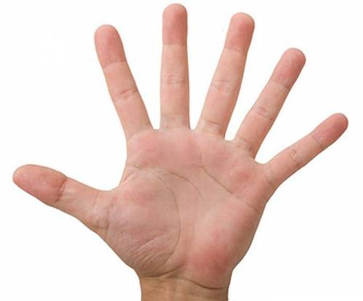
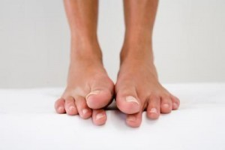
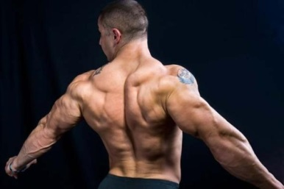
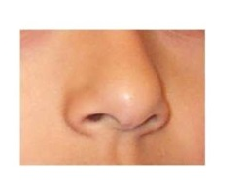
Time to relax.
I wiggle my fingers,
I wiggle my toes,
I wiggle my shoulders,
I wiggle my nose.
Now no more wiggle are
left in me.
So I will be still as I can be.

Slide 8
.
I Want to Ве
Some people often say to mе:
"Have уоu decided what уоu want to bе?"
I usually answer, "I don't know,"
But it isn't really so.
I want to win аn Olympic race,
I want to see the Earth from space,
I want to travel to Katmandu
I want to bе rich and famous, too.
I want to bе оn Hollywood's screen,
I want to invent а new machine,
I want to bе very clever and wise,
I want to win the Nobel prize,
But most of all, I want to bе
Healthy and strong, and nice.

Slide 9

Do you like to travel? Do you prefer to work indoors? Do you like talking to people? Do you prefer to work alone? Are you energetic? Do you like organizing things? Are you patient? Do you like animals? Are you noisy? Do you like to work with your hands? Are you artistic? Do you like working with numbers? Do you like children? Do you like looking after people? Are you calm? Are you musical? Do you like sport? Do you like working at night? Do you mind seeing blood? Do you like talking on the telephone? | Yes | No

Slide 10
 | Yes | No
1. | 10 | 5
2. | 10 | 5
3. | 10 | 10
4. | 2 | 2
5. | 20 | 5
6. | 1 | 0
7. | 5 | 0
8. | 4 | 3
9. | 0 | 5
10. | 1 | 2
 | Yes | No
11. | 5 | 5
12. | 2 | 2
13. | 2 | 5
14. | 10 | 2
15. | 2 | 10
16. | 4 | 2
17. | 5 | 4
18. | 5 | 7
19. | 1 | 4
20. | 5 | 4

Slide 11


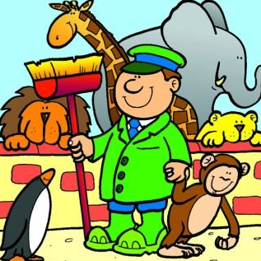

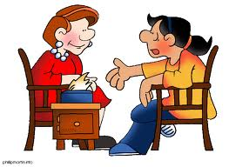
If your score is between
5 and 45:
You enjoy working with people and helping them. You are also a practical person. One of these careers will suit you: teacher, doctor, nurse, social worker, psychologist, zoo keeper, policeman, policewoman

Slide 12



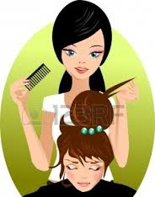
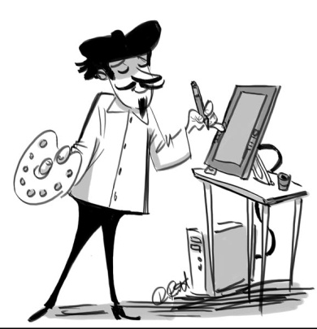
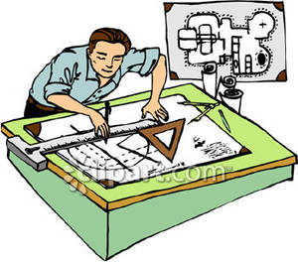
If your score is between
45 and 90:
You like to work quietly and concen­trate on the task. You prefer to work on your own. One of these careers will suit you:
laboratory technician, librarian,
artist, bank clerk, hair­dresser, architect.

Slide 13
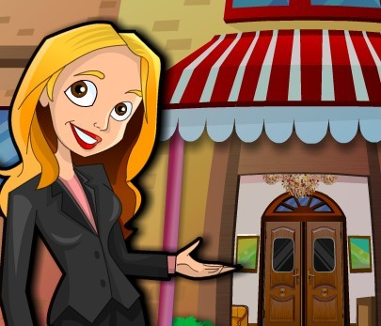



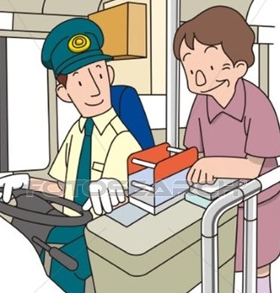

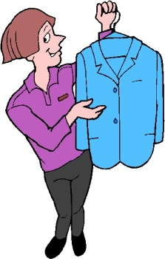
If your score is between
90 and 135:
You like to be very busy. You like to be with people and you like organizing things for them. One of the following careers will suit you:
travel agent, journalist, hotel manager, flight attendant, bus conductor, salesperson, fireman/woman.

Slide 14
Top careers of the future
1. computer network analyst
2. computer software engineer
3. personal and home care aide
4. home health care aide
5. medical assistant
6. substance abuse and
behavioral disorder counselors
7. mental health counselors
8. personal financial advisor
9. financial analyst
10. veterinary technician

Slide 15
Home task:
Ex. 13 p.48
Important qualities for your future successful career.

