Slide 1
a | b | c | d | e | f | g | h
1 | 2 | 3 | 4 | 5 | 6 | 7 | 8
i | j | k | l | m | n | o | p
9 | 10 | 11 | 12 | 13 | 14 | 15 | 16
q | r | s | t | u | v | w | x | y | z
17 | 18 | 19 | 20 | 21 | 22 | 23 | 24 | 25 | 26

Slide 2
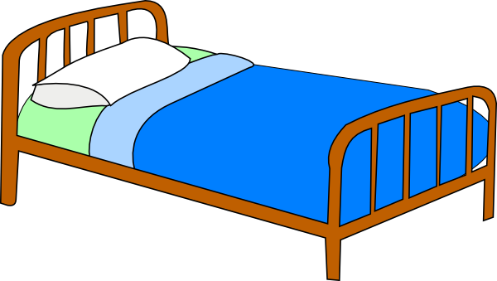
bed

Slide 3
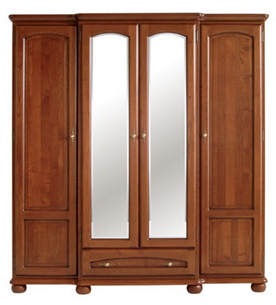
wardrobe

Slide 4
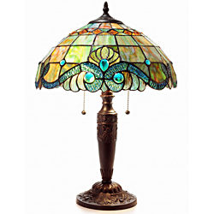
lamp

Slide 5
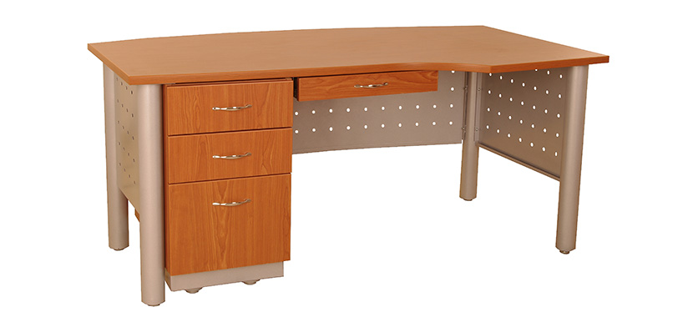
desk

Slide 6
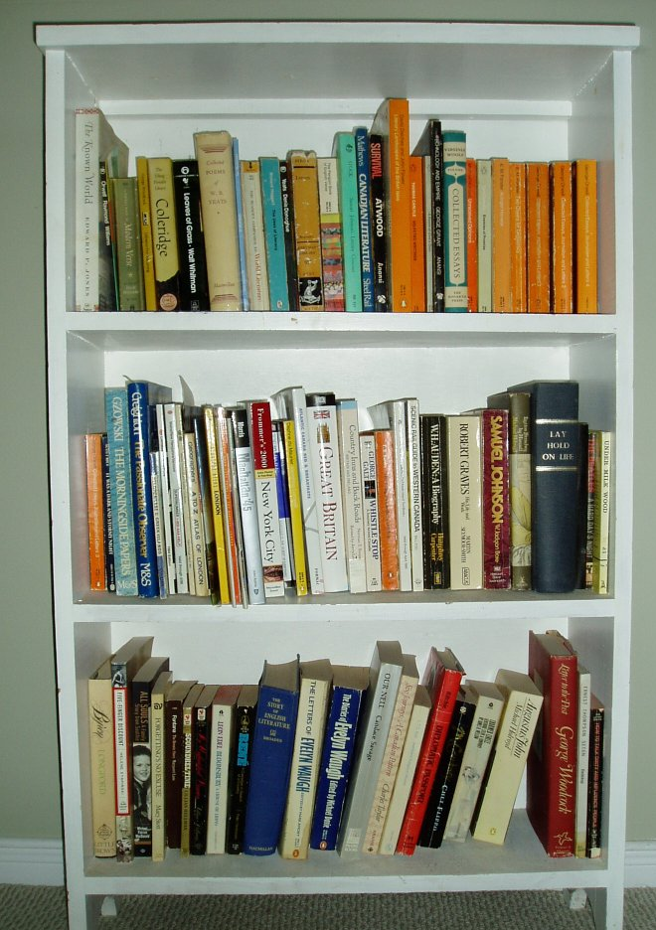
bookcase

Slide 7

carpet

Slide 8

mirror

Slide 9
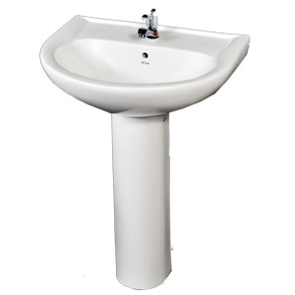
washbasin

Slide 10
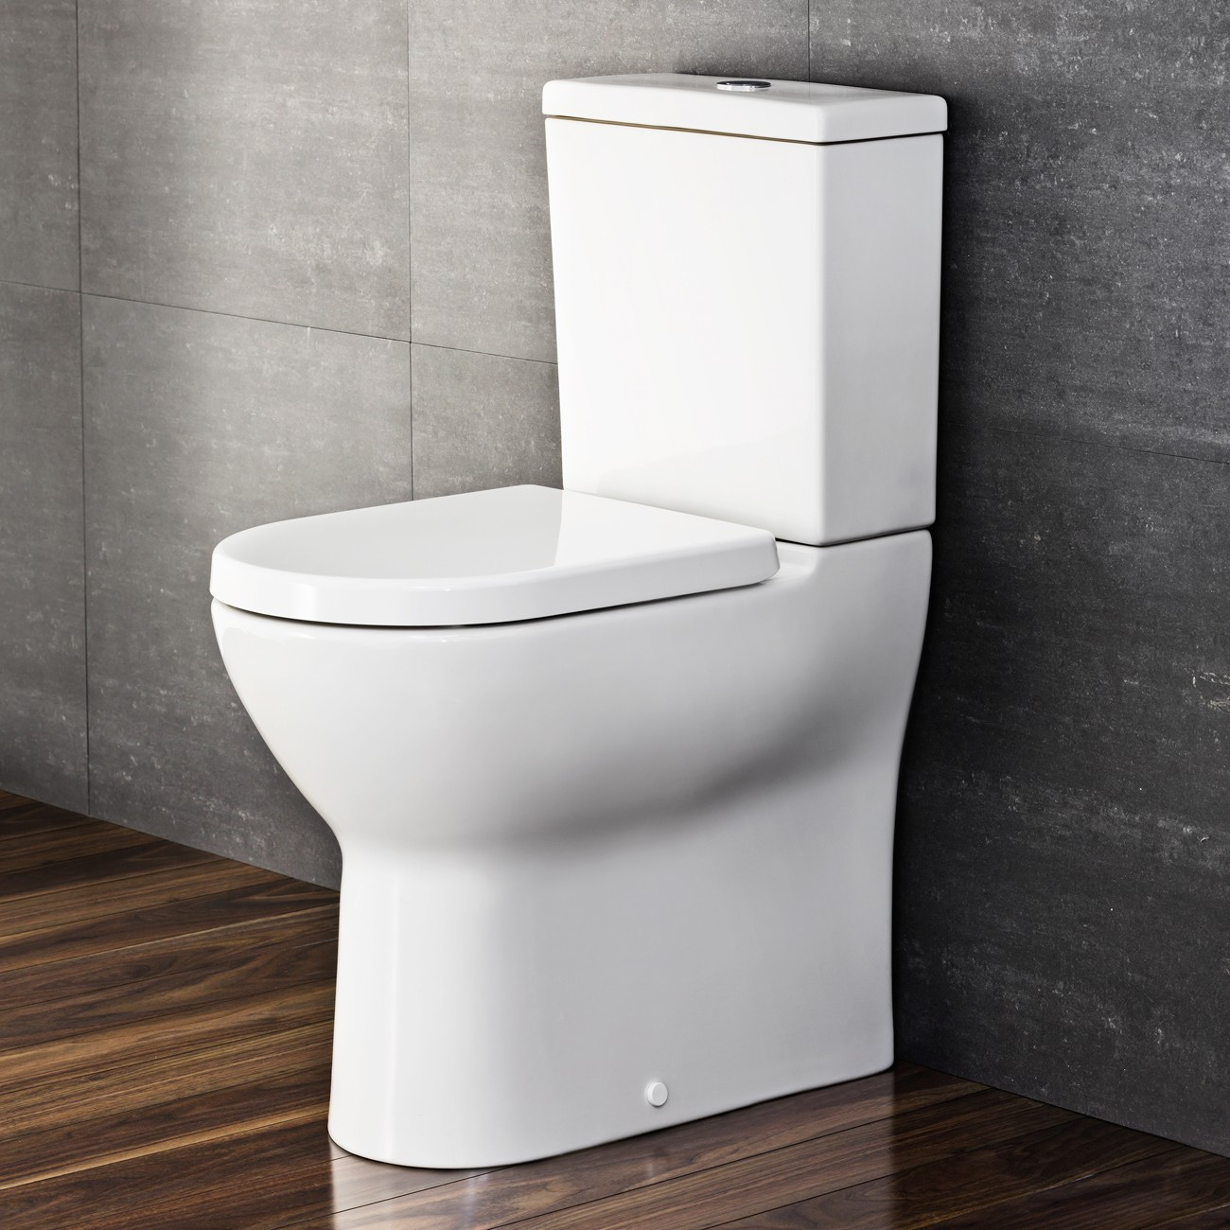
toilet

Slide 11
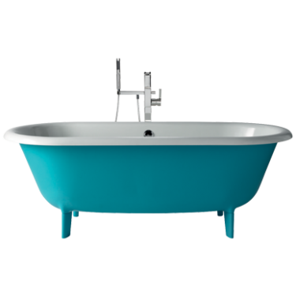
bath

Slide 12
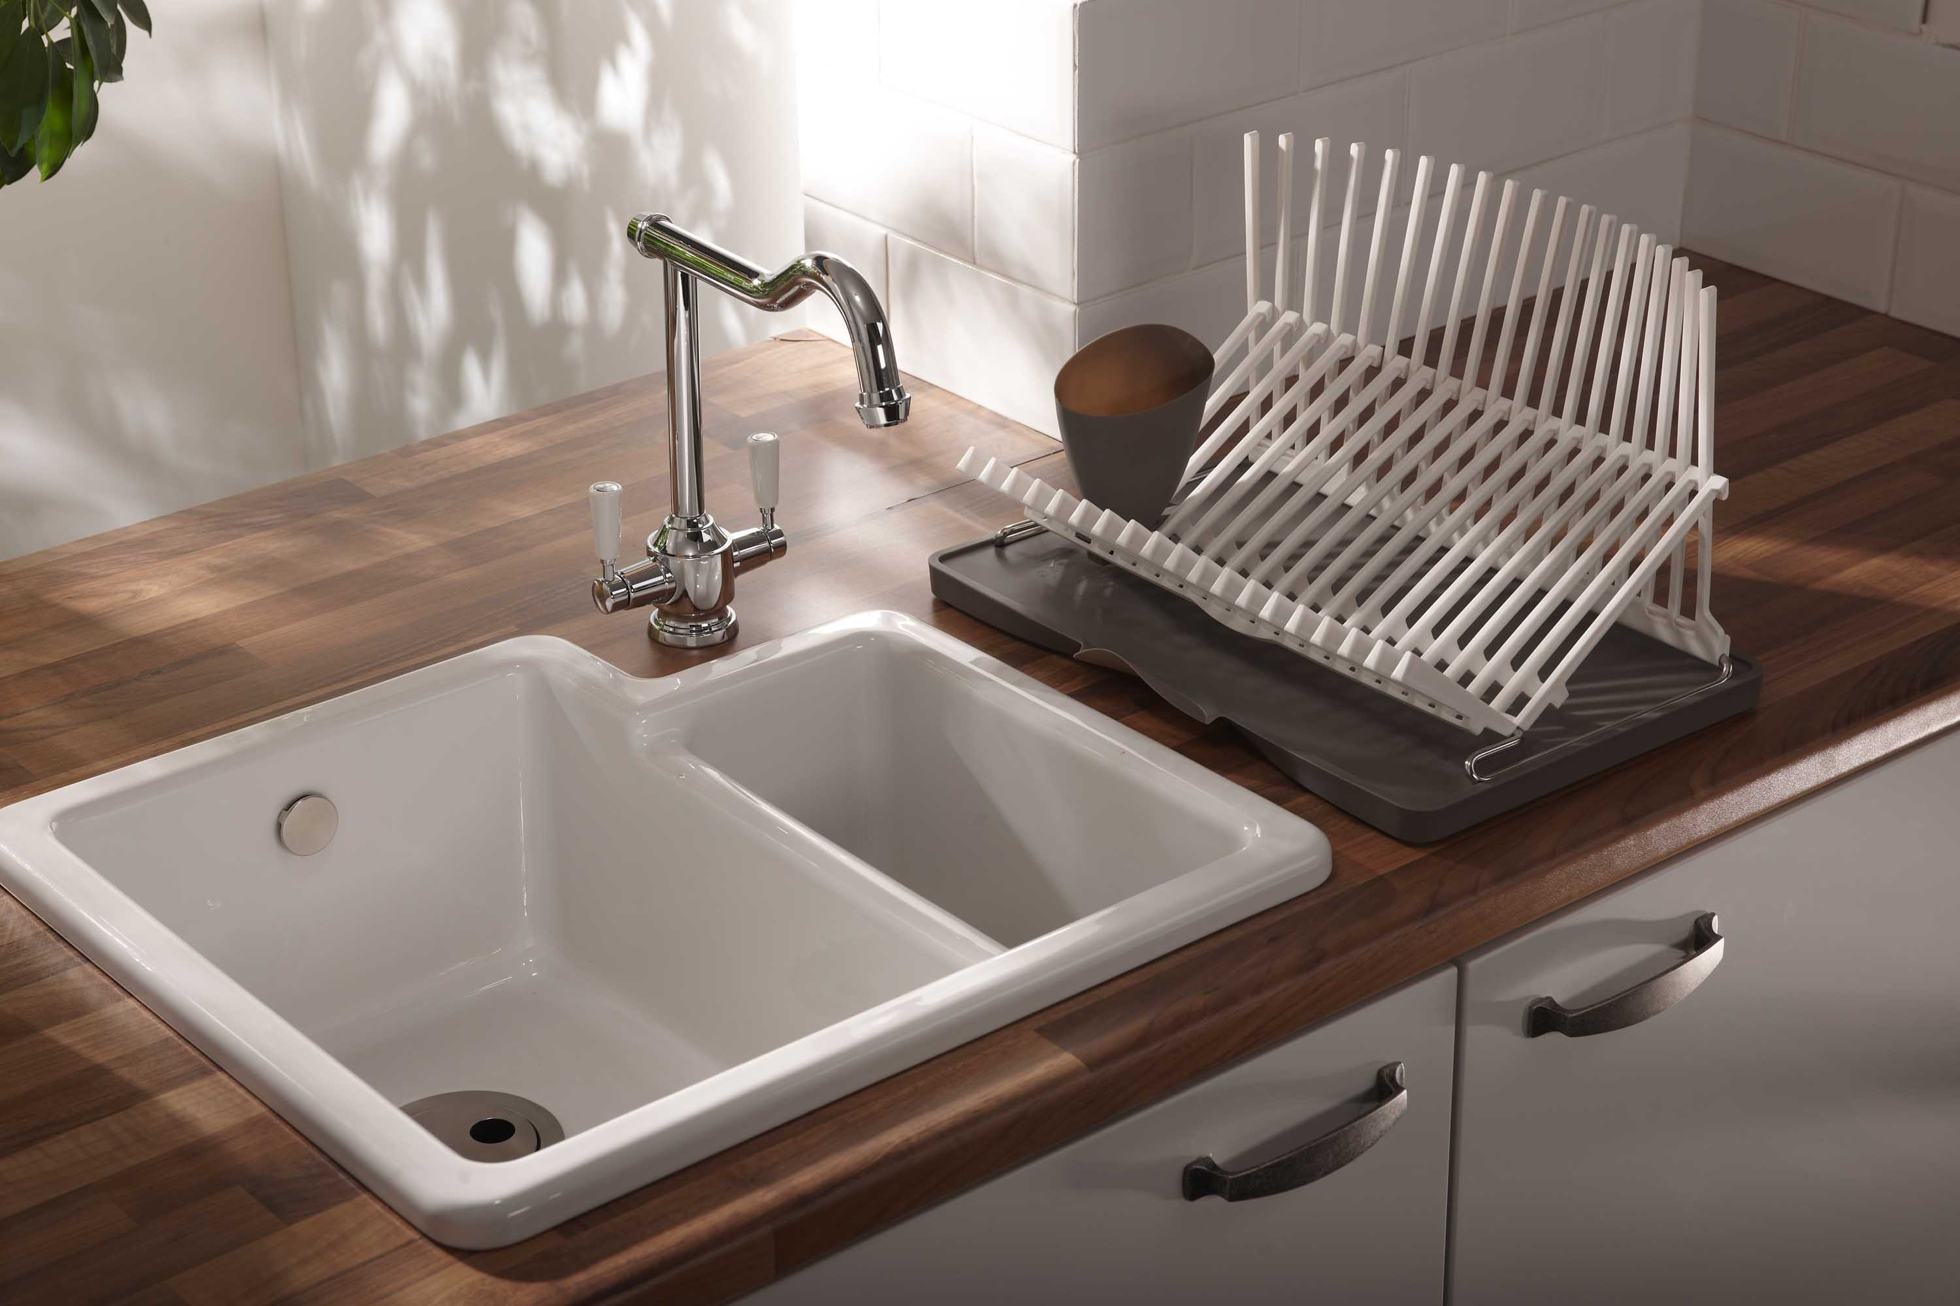
sink

Slide 13
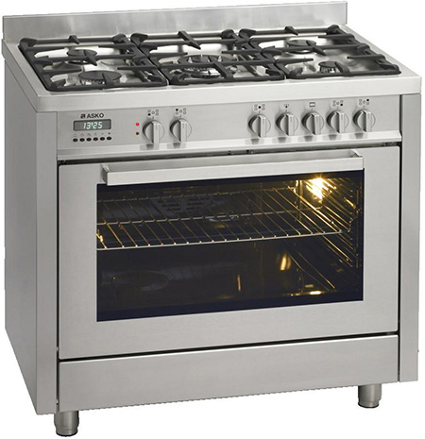
cooker

Slide 14
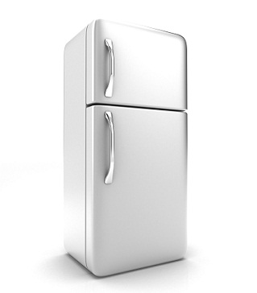
fridge

Slide 15
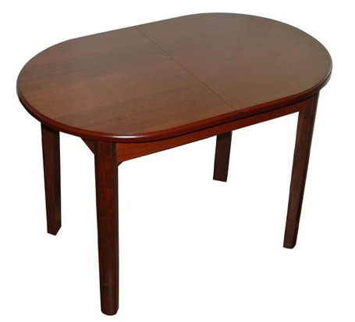
table

Slide 16
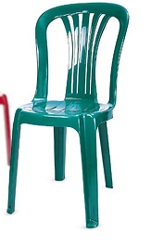
chair

Slide 17
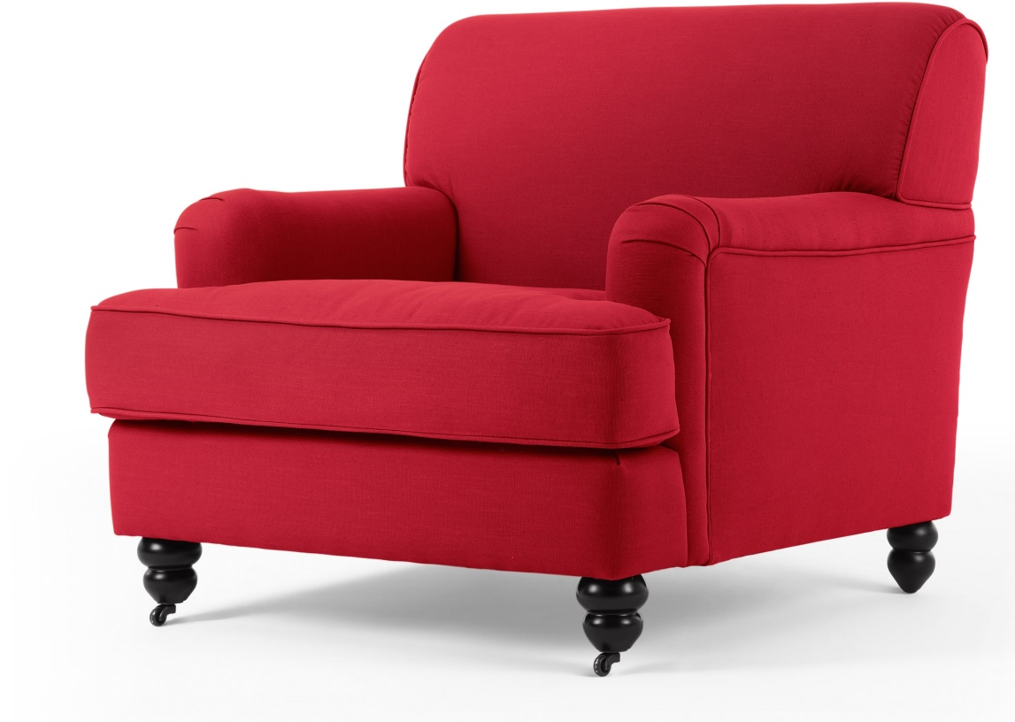
armchair

Slide 18
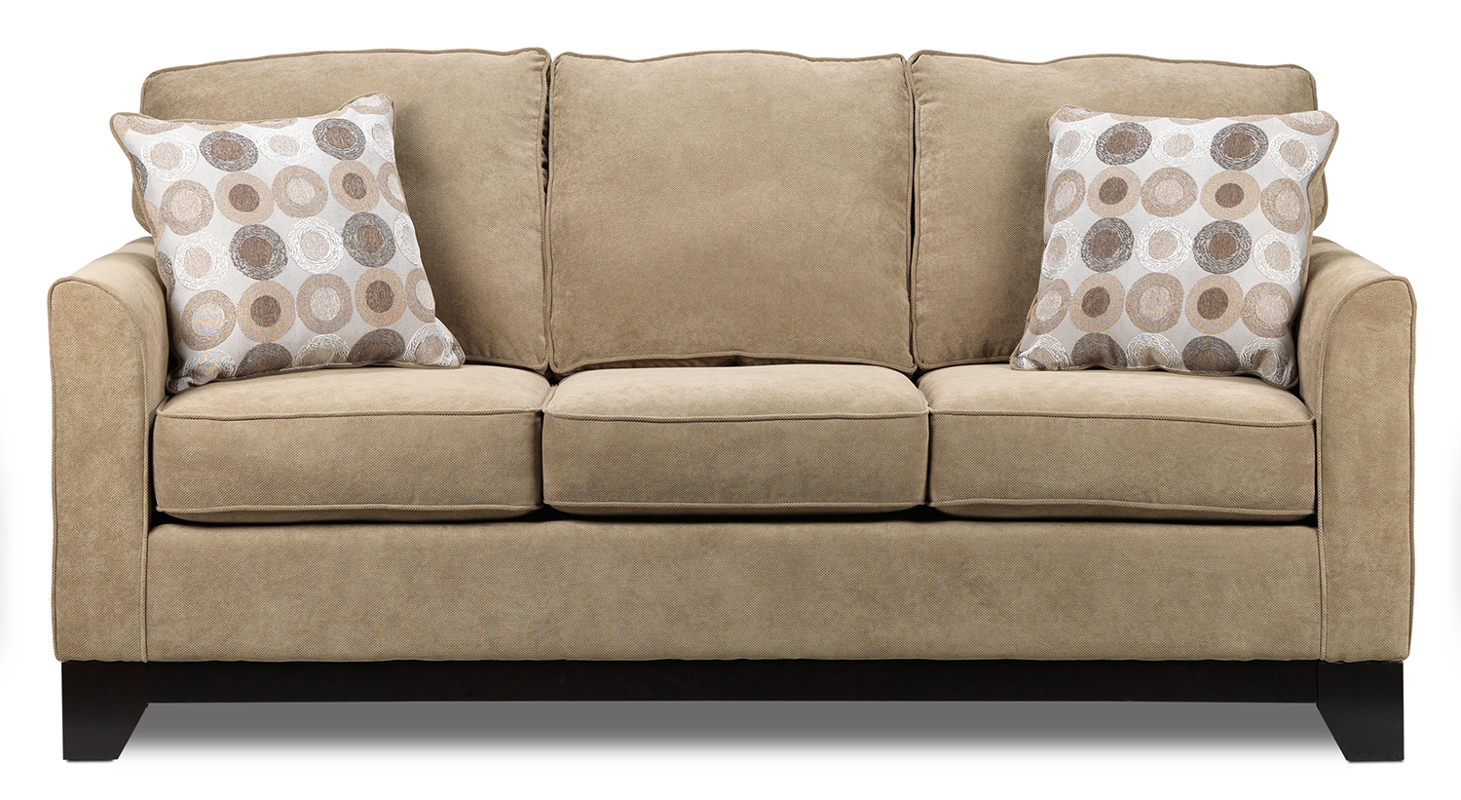
sofa

Slide 19
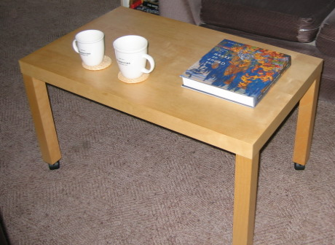
coffee table

Slide 20

window

Slide 21
chair

Slide 22
armchair

Slide 23
sofa

Slide 24
coffee table

Slide 25
window

Slide 26
toilet

Slide 27
bath

Slide 28
sink

Slide 29
cooker

Slide 30
fridge

Slide 31
table

Slide 32
lamp

Slide 33
desk

Slide 34
bookcase

Slide 35
carpet

Slide 36
mirror

Slide 37
washbasin

Slide 38
bed

Slide 39
wardrobe

Slide 40
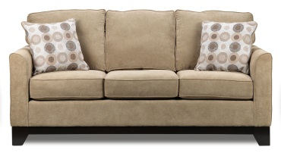











Slide 41
In a bedroom I can see…
Chair
Bath
Cooker
Bed
Mirror
Bookcase
Desk
Carpet
Table
Washbasin
Armchair
Sofa
Fridge
Lamp
Wardrobe
Sink

Slide 42
Prepositions
On – на
In – в
Under – под
Next to – рядом
In front of – пред
Behind – за

Slide 43

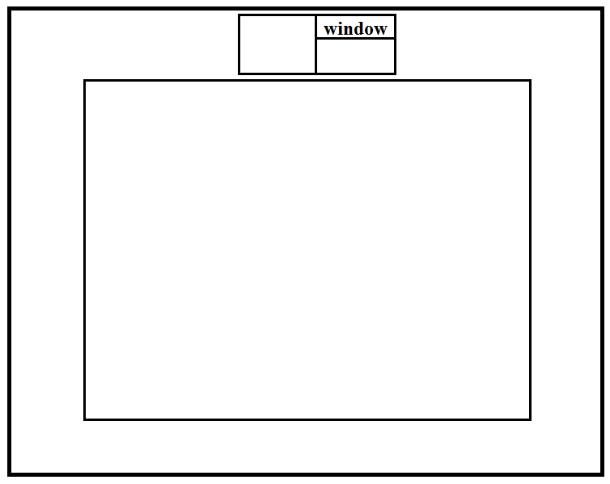


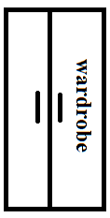



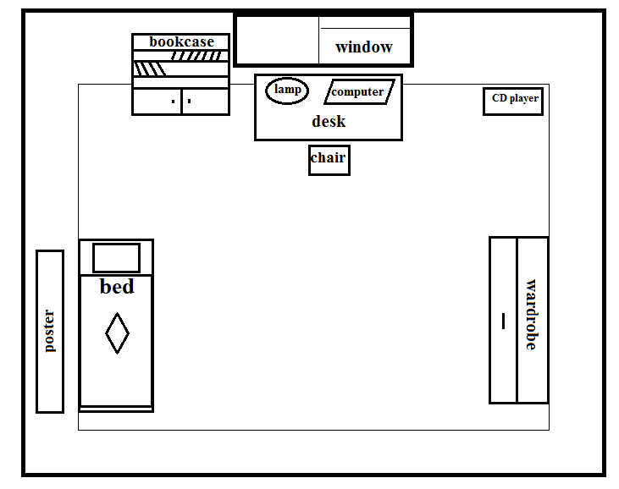


Slide 44
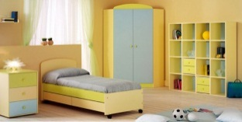
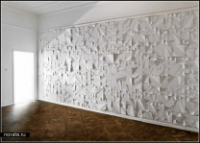



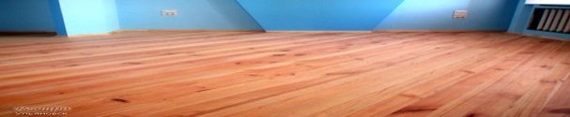

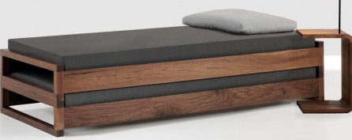

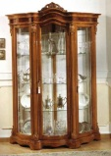
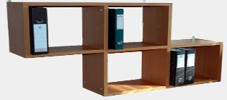
I see a
The room is light.
I see a ,
The wall is white.
I see a and a ,
I see a and a .
I see a and a ,
I see a . It is red.
I see a and a .
I like the room myself.

Slide 45
have, I, a, got, bedroom.
see, bed, in, a, a can, wardrobe, You, mirror, a, my, bedroom
TV, but, no, there, in, my, is, room

Slide 48
My bedroom

