Slide 1
Road safety

Slide 2


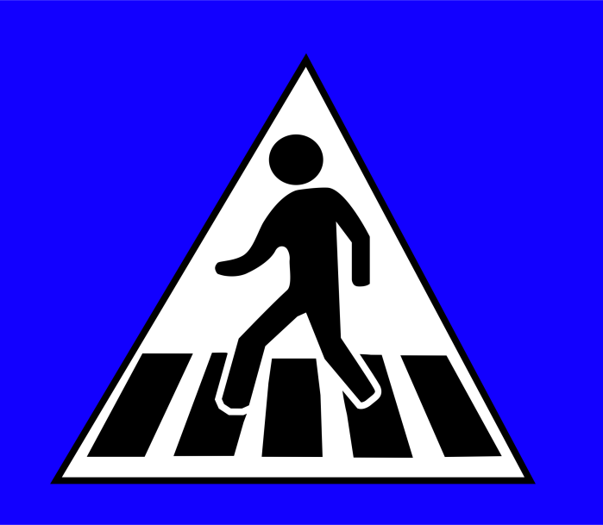
traffic sign

Slide 3
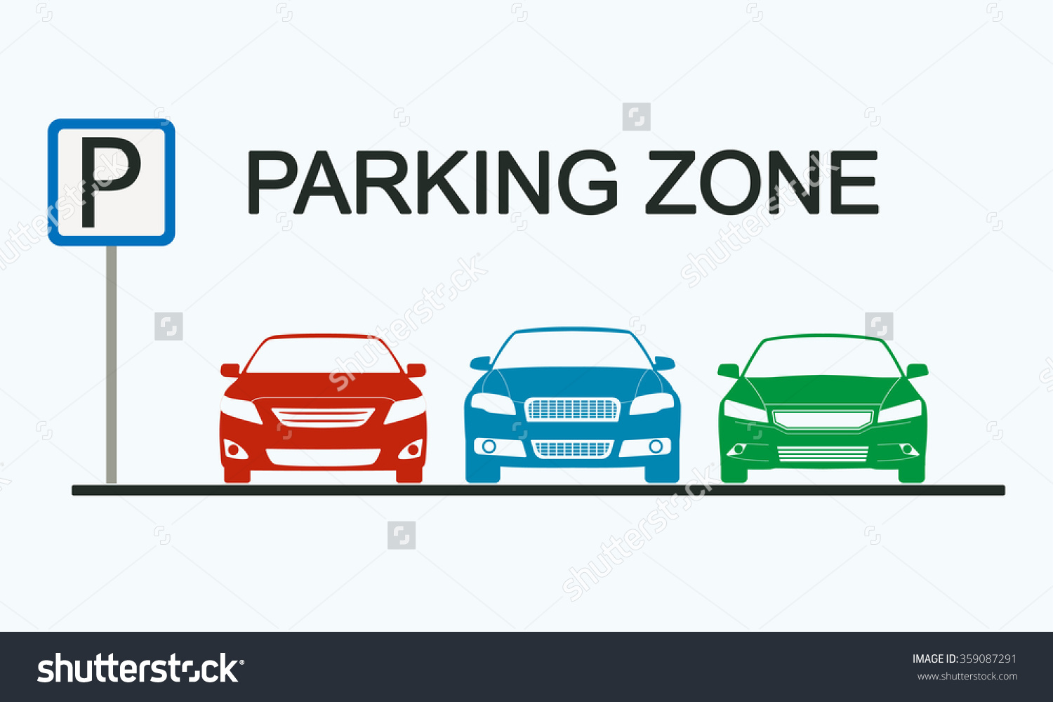

Slide 4
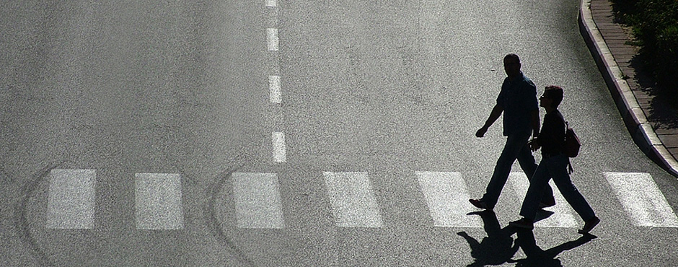
pedestrian

Slide 5
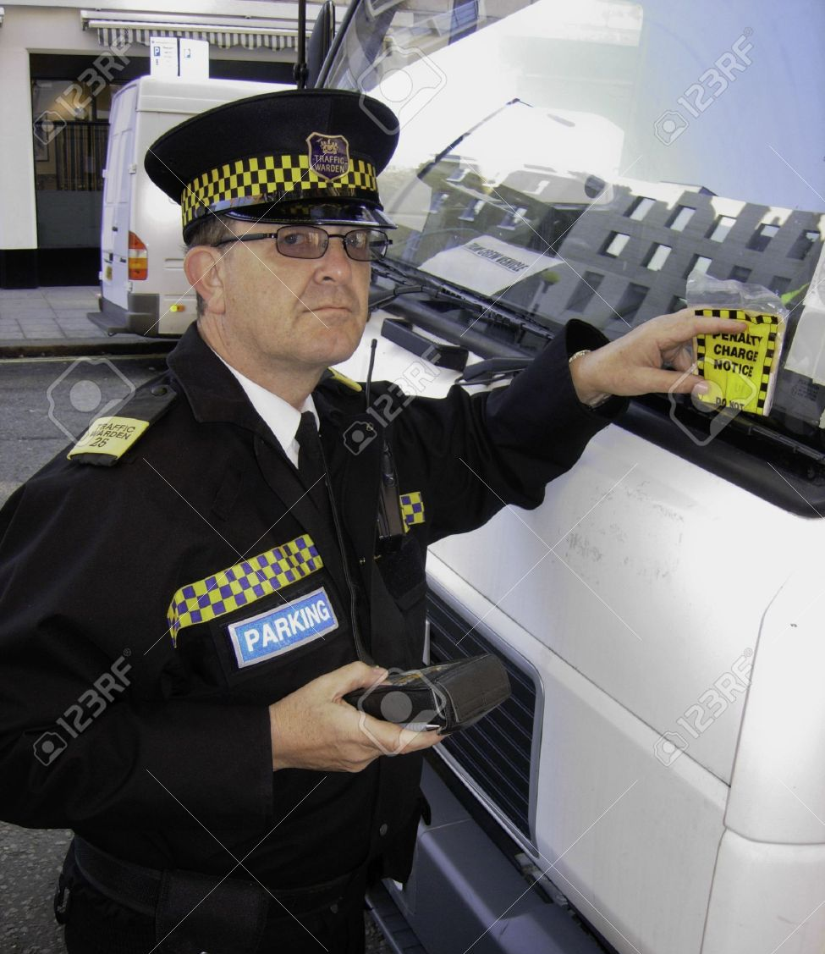
traffic warden

Slide 6
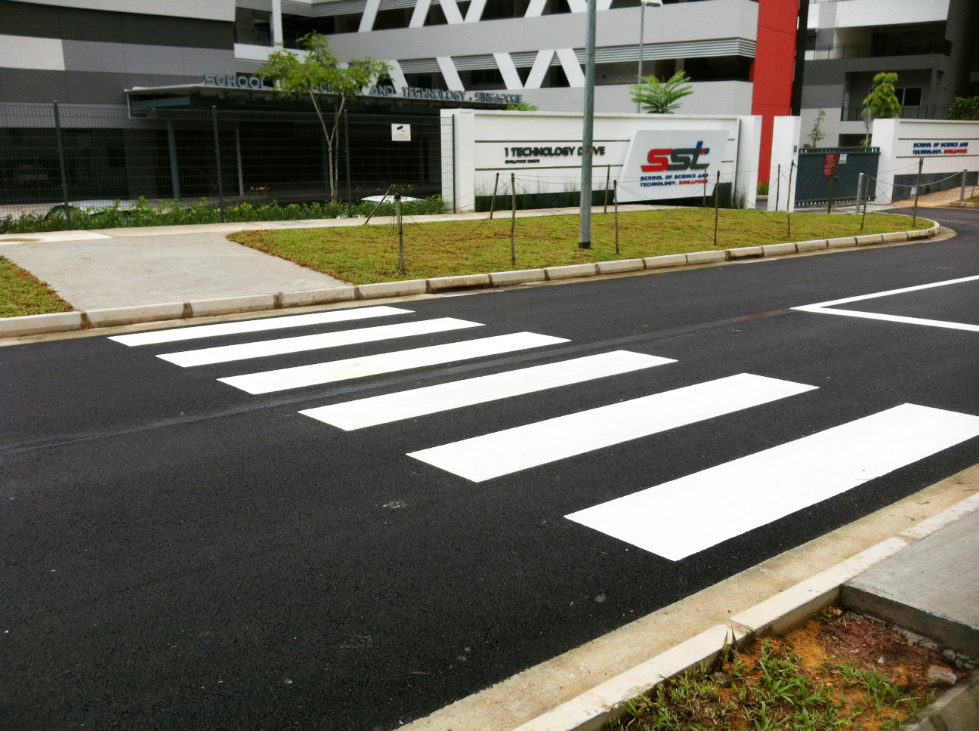
zebra crossing

Slide 7
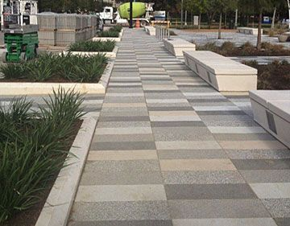
pavement

Slide 8
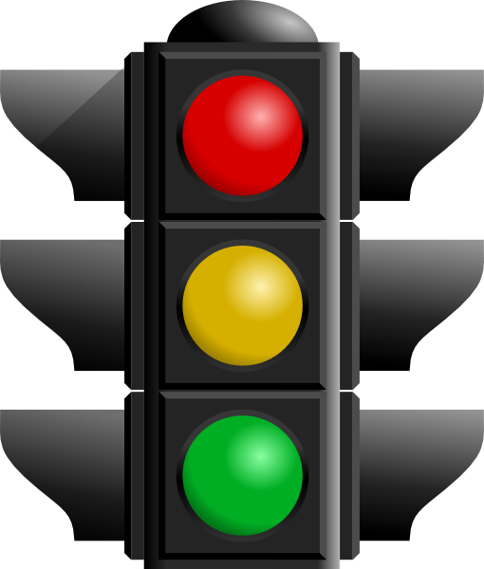
traffic lights

Slide 9
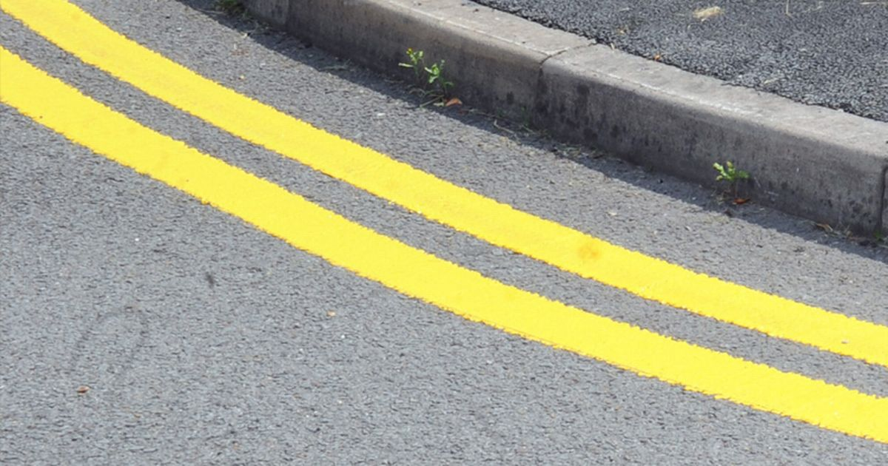
yellow lines

Slide 10
parking zone

Slide 11
traffic warden

Slide 12
pedestrian

Slide 13
pavement

Slide 14
yellow lines

Slide 15

traffic sign

Slide 16
zebra crossing

Slide 17
traffic lights

Slide 18

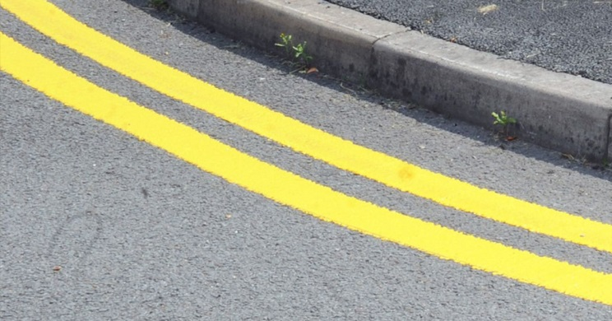

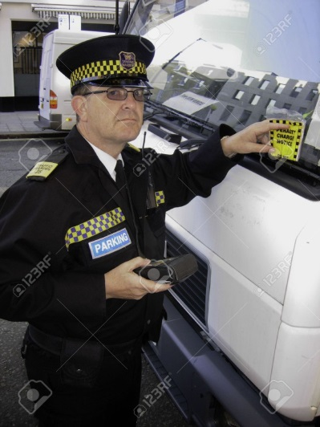


Slide 19
Road safety

Slide 20
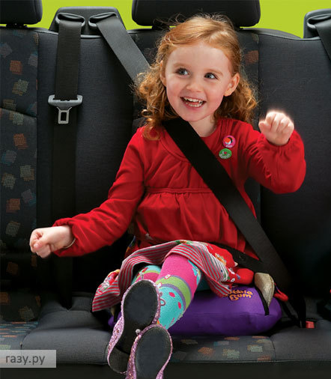
Wear a seat belt –
пристегнуть ремень

Slide 21
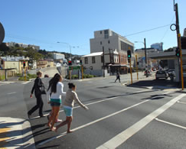
Walk straight across the road –
идти прямо через дорогу

Slide 22
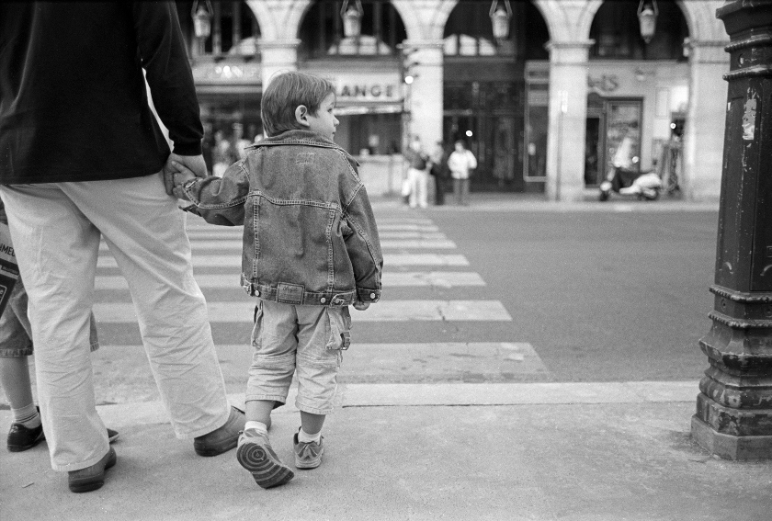
Look both ways –
посмотреть в обе стороны

Slide 23
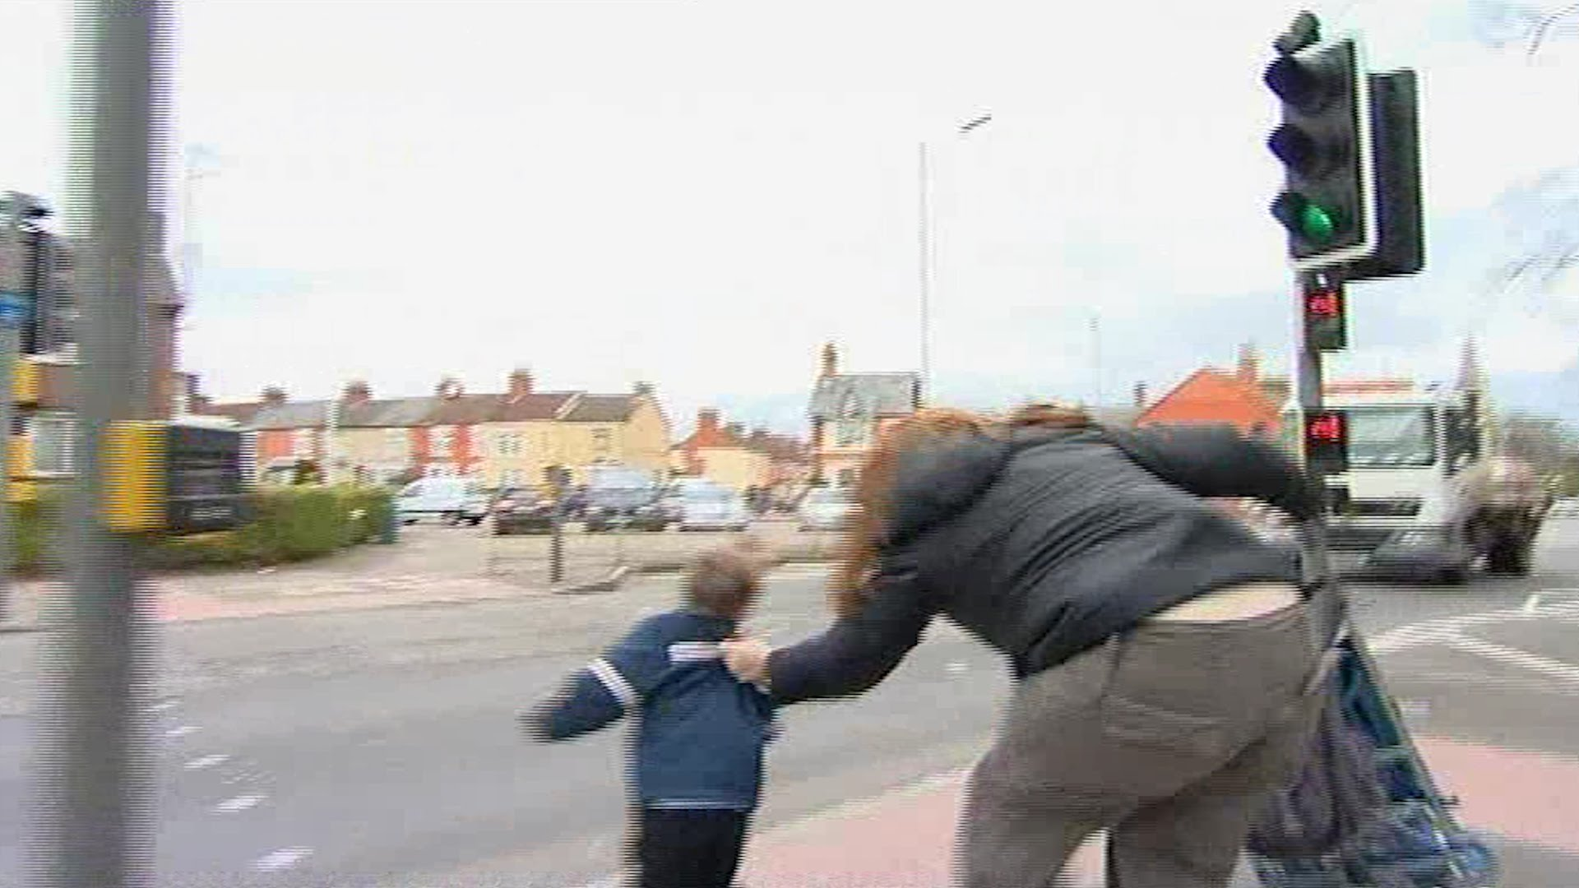
Run onto the road –
выбегать на дорогу

Slide 24
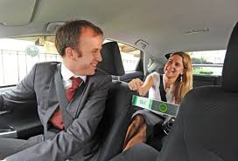
Talk to the driver –
разговаривать с водителем

Slide 25
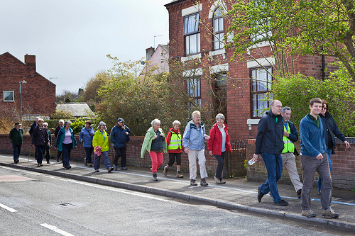
Walk on the pavement –
ходить по тротуару

Slide 26
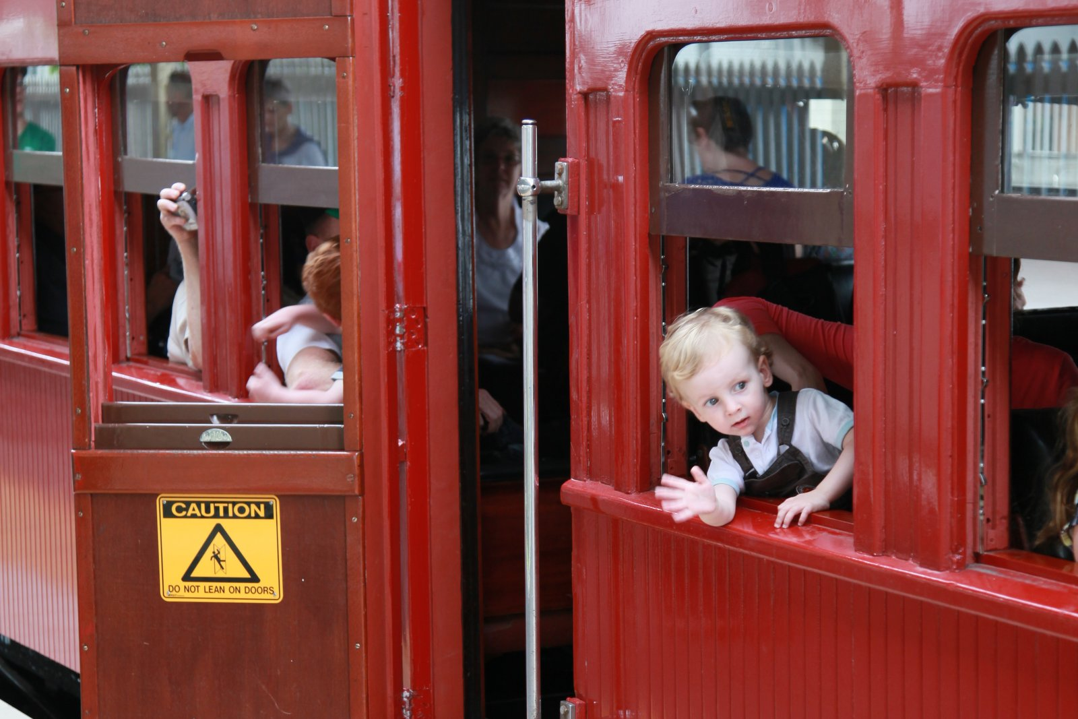
Lean out of the window –
высовываться из окна

Slide 27
Run onto the road

Slide 28
Talk to the driver

Slide 29
Look both ways

Slide 30
Wear a seat belt

Slide 31
Walk straight across the road

Slide 32
Walk on the pavement

Slide 33
Lean out of the window

Slide 34
Talk to
Look
Run onto
Wear
Walk on
Lean out of
Walk straight
both way
a seat belt
across the road
the road
the window
the pavement
the driver

Slide 35
Lean out of Look
Run onto
Wear
Walk on
Talk to
Walk straight
the window
both way
the road
a seat belt
the pavement
the driver
across the road

