Slide 1
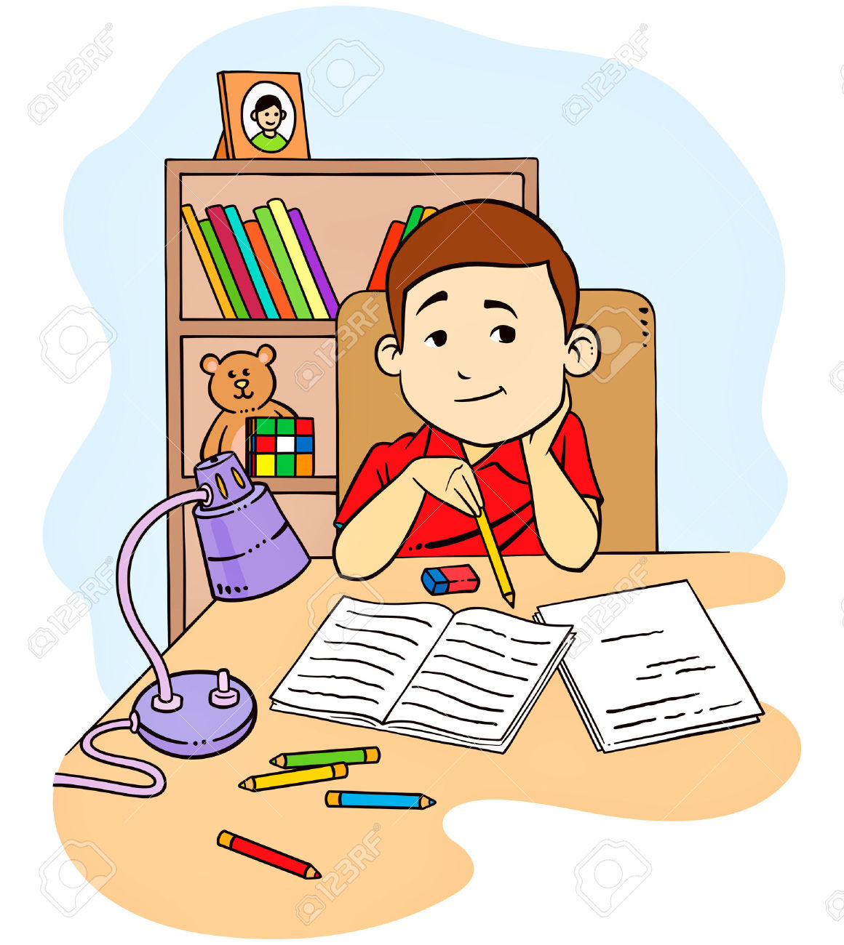
do the homework

Slide 2
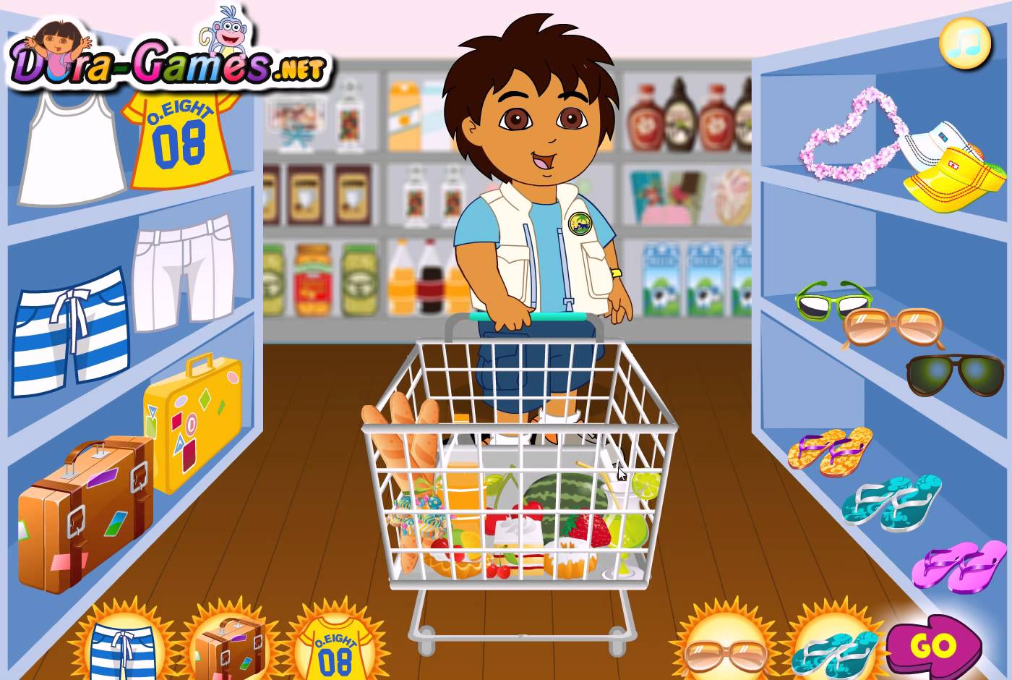
go shopping

Slide 3
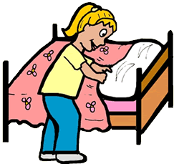
make the bed

Slide 4
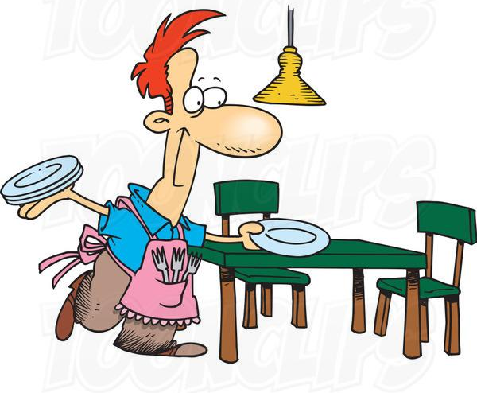
lay the table

Slide 5
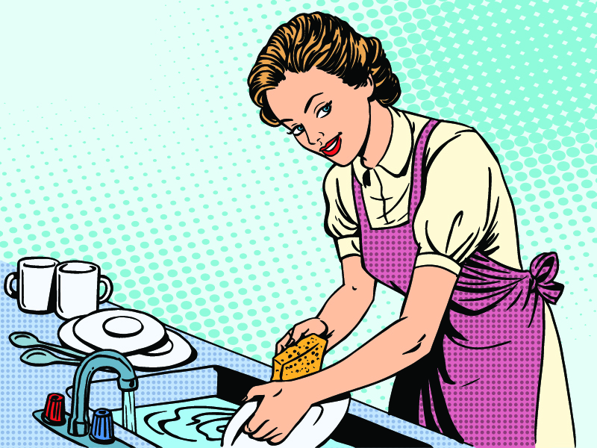
do the washing up

Slide 6
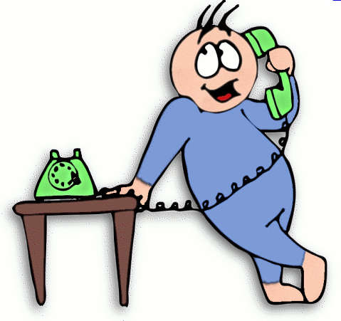
answer phone calls

Slide 7

clean the room

Slide 8
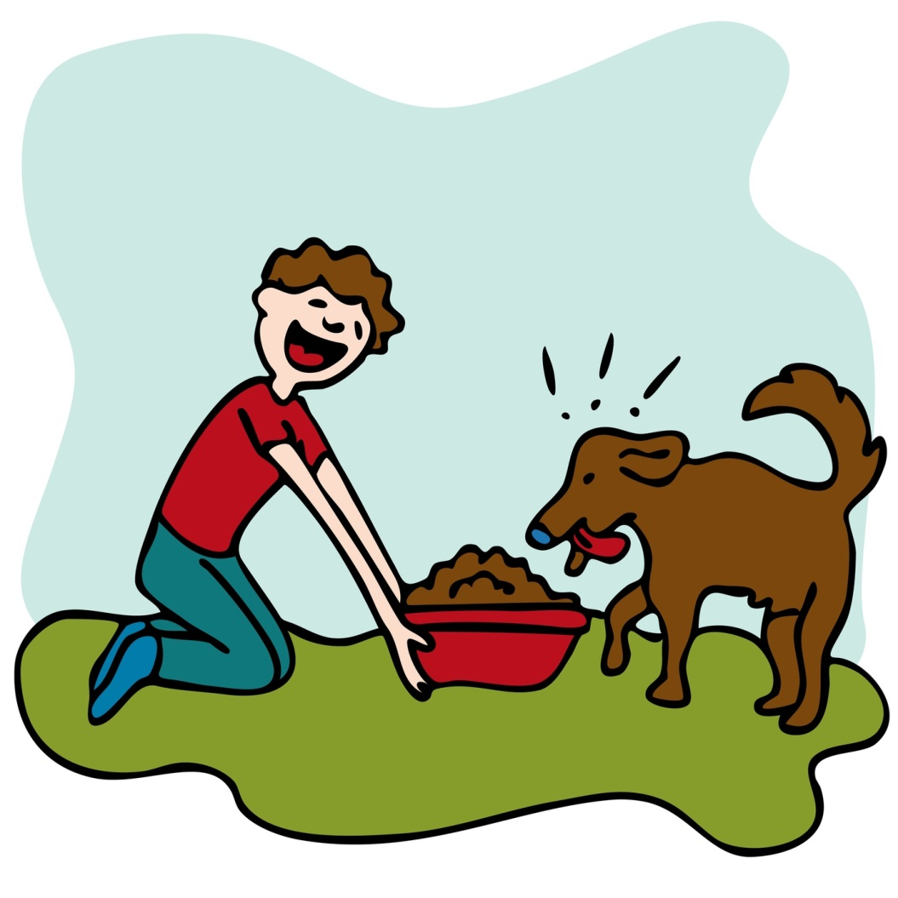
feed a pet

Slide 9

water the flowers

Slide 10

take a pet
for a walk

Slide 11
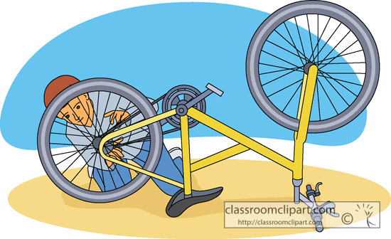
repair the bike

Slide 12
make the bed

Slide 13
do the homework

Slide 14
go shopping

Slide 15
do the washing up

Slide 16
answer phone calls

Slide 17
take a pet
for a walk

Slide 18
clean the room

Slide 19
repair the bike

Slide 20
lay the table

Slide 21
feed a pet

Slide 22
water the flowers

Slide 23


