Slide 1
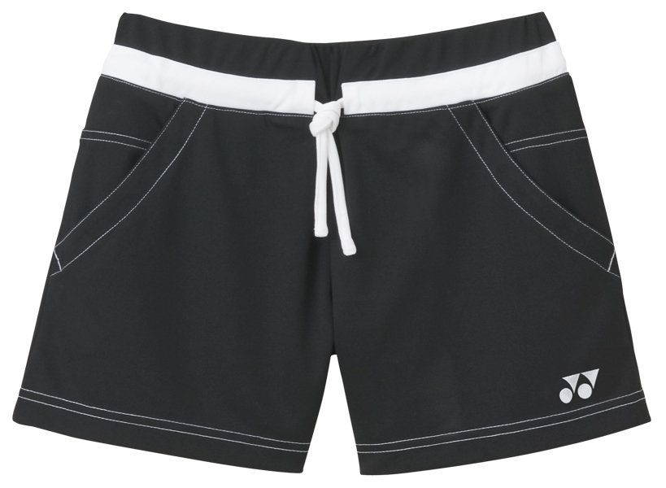
Shorts
black shorts
Your shorts

Slide 2
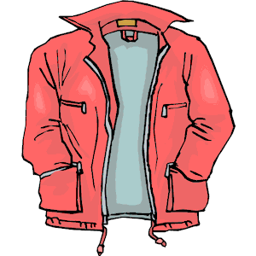
Jacket
my jacket
your jacket

Slide 3
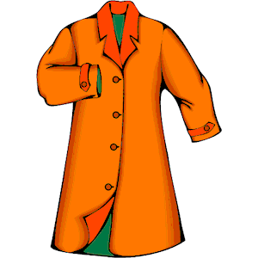
Coat
The coat
the orange coat

Slide 4

Hat
A hat
a red hat
Your hat

Slide 5
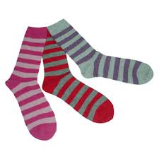
Socks
The socks

Slide 6
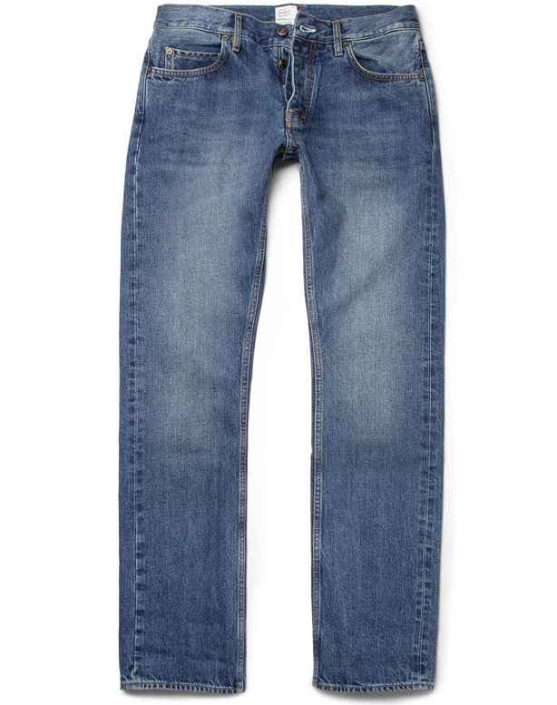
Jeans
My jeans
Your jeans

Slide 7
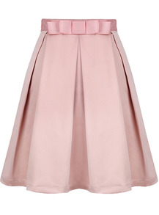
Skirt
A pink skirt

Slide 8
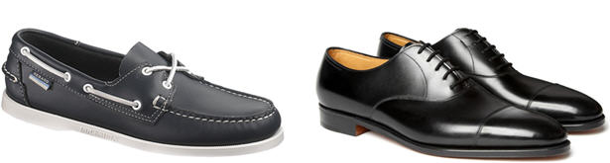
Shoes
Black shoes

Slide 9
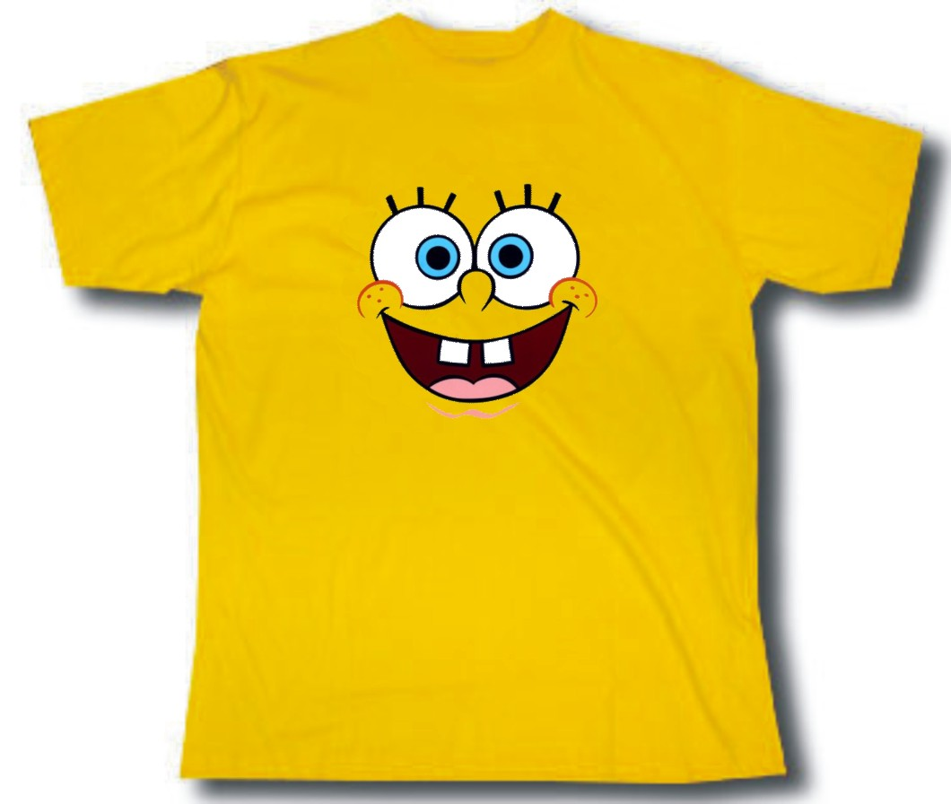
T–shirt
my T–shirt
Your T-shirt

Slide 10

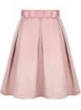

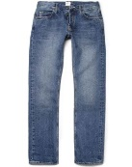
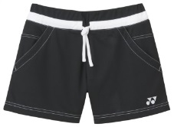

T-shirt
Socks
A skirt
Your shoes
Jeans
The shorts
Your hat
Jacket
my coat

Slide 11
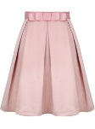



Slide 12
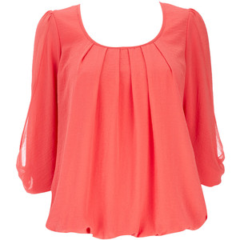
Blouse

Slide 13
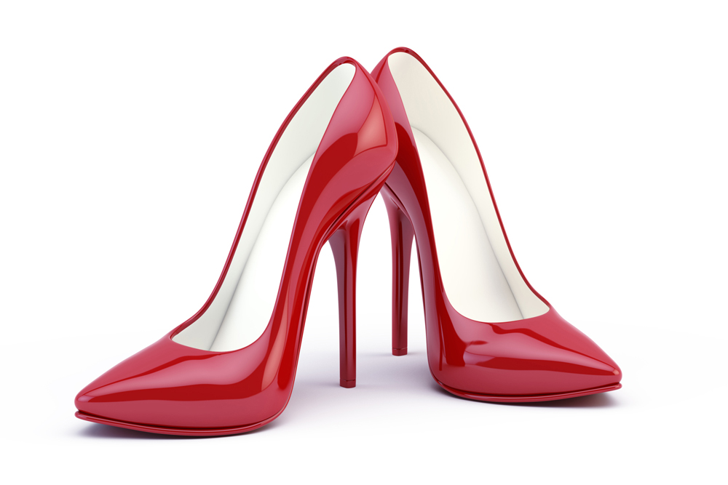
high heels

Slide 14
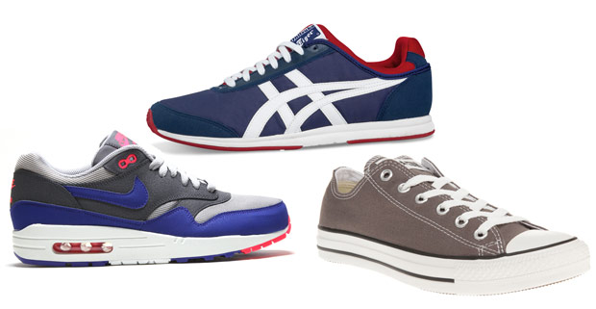
trainers

Slide 15
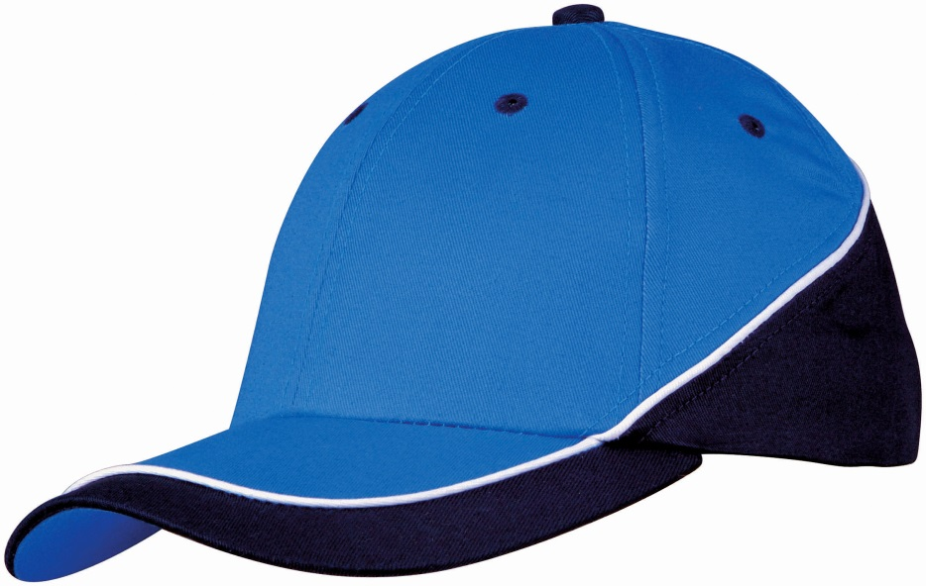
cap

Slide 16
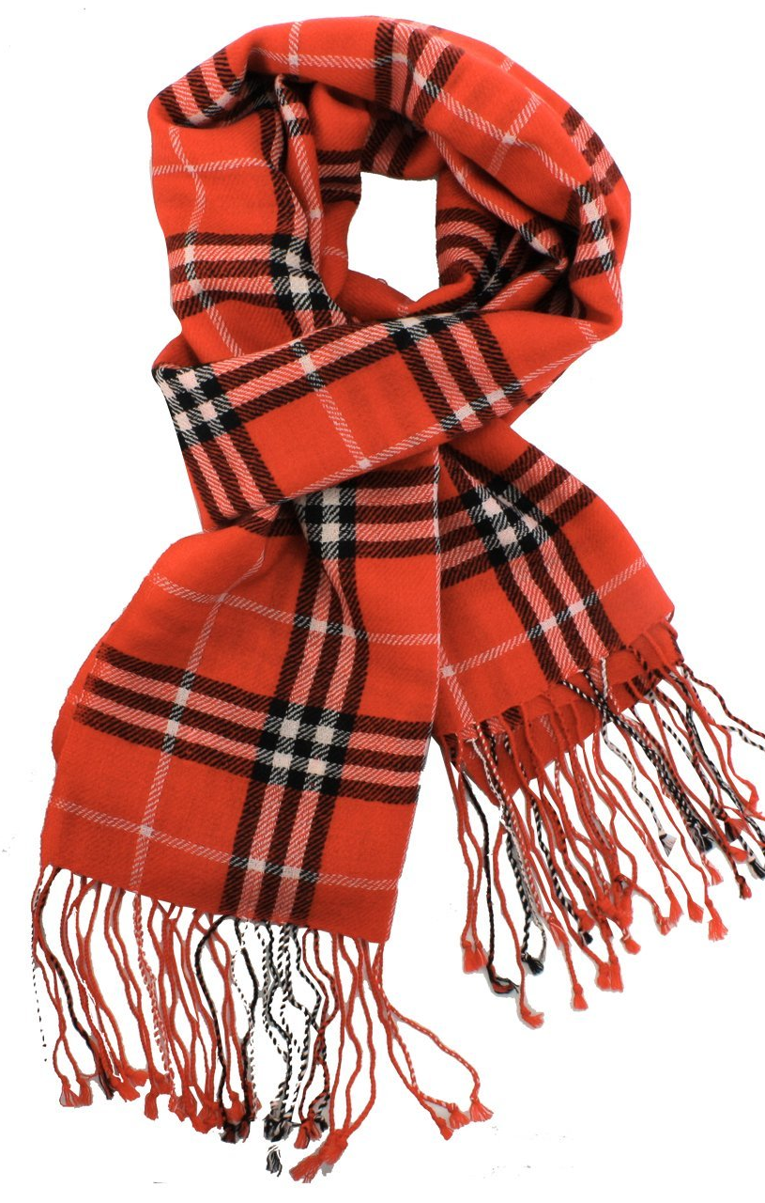
scarf

Slide 17
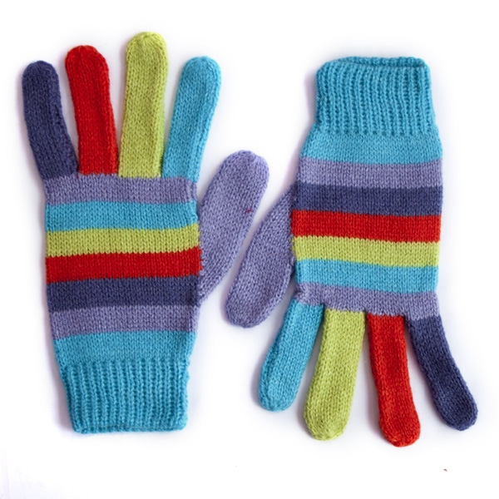
gloves

Slide 18
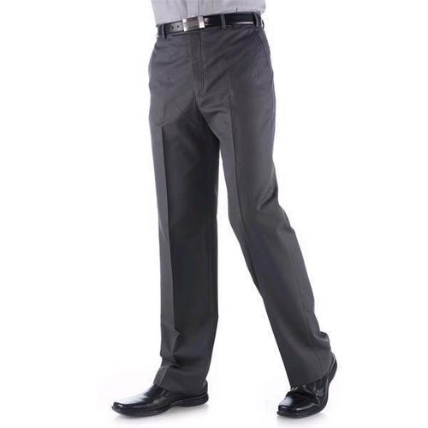
trousers

Slide 19
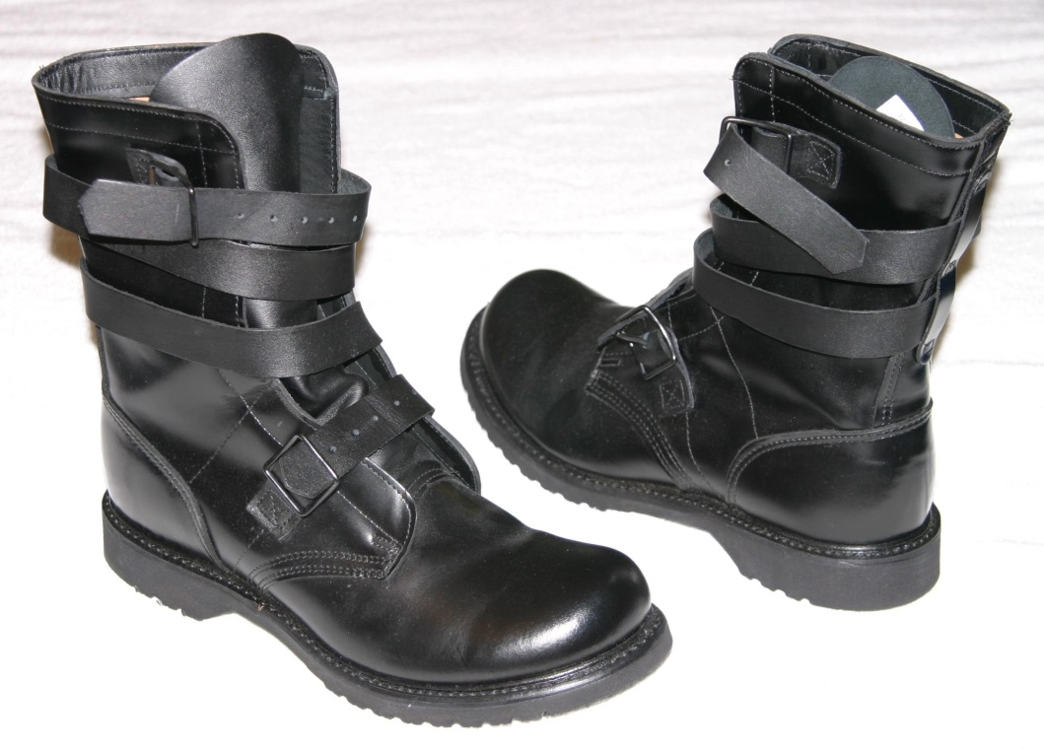
boots

Slide 20
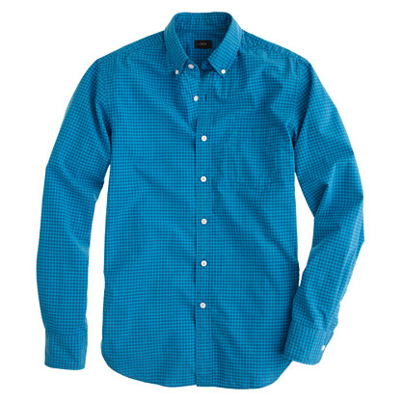
shirt

Slide 21
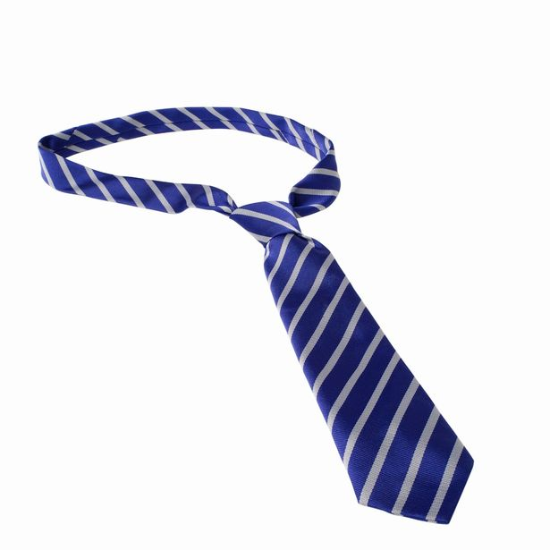
tie

Slide 22
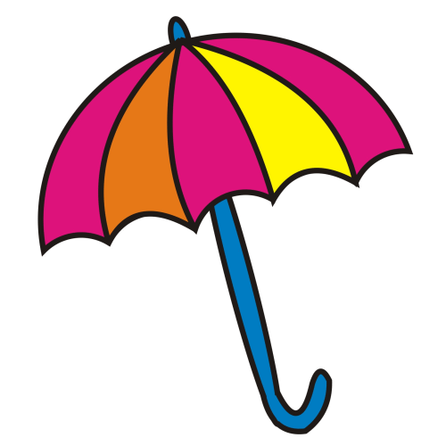
umbrella

Slide 23
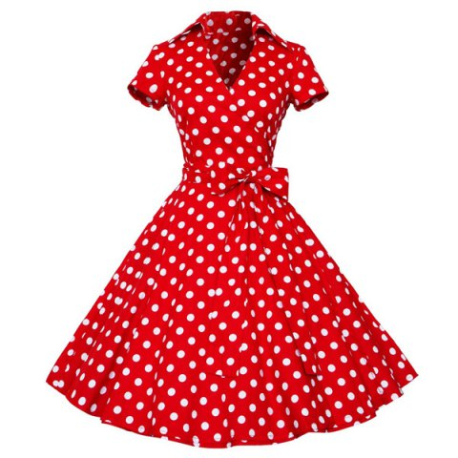
dress

Slide 24
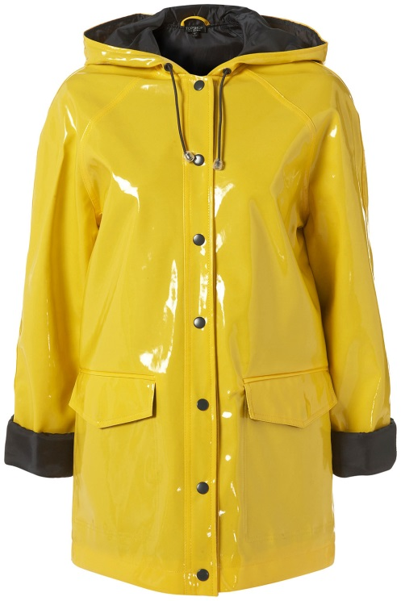
raincoat

Slide 25
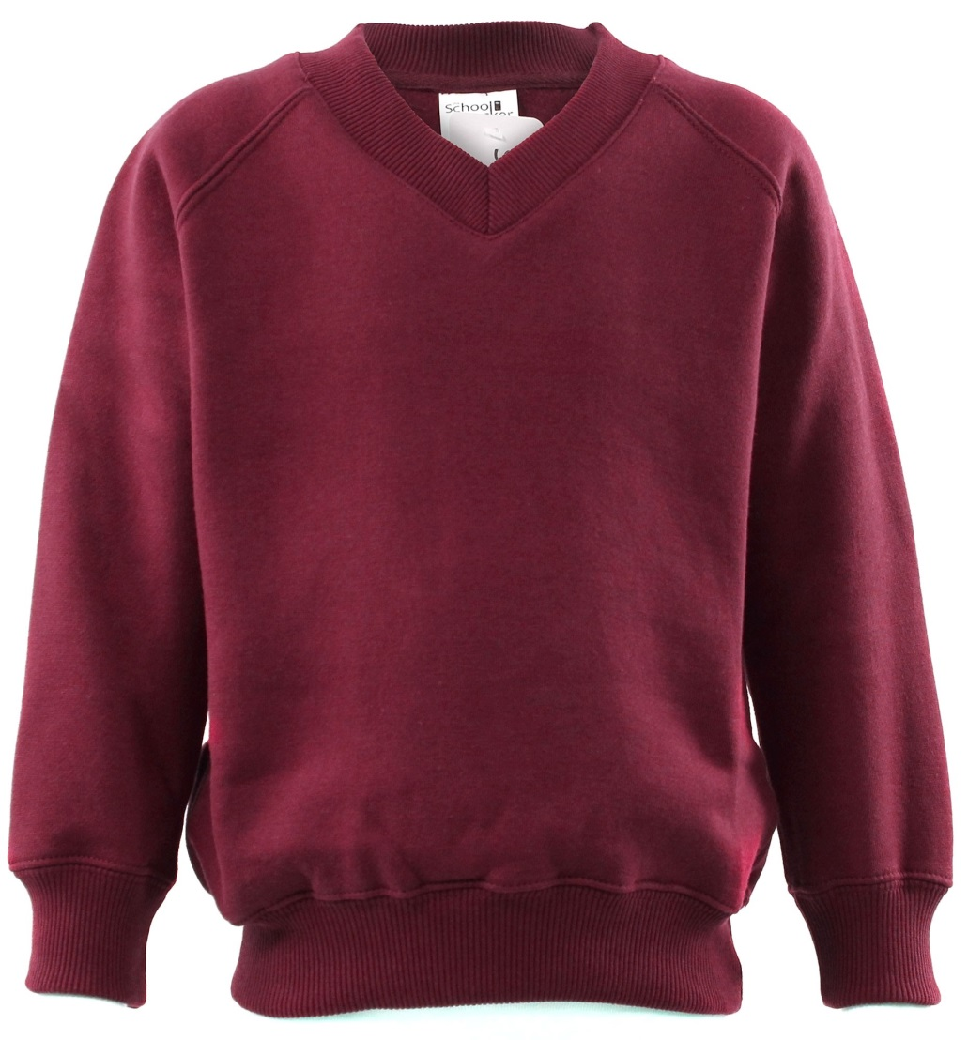
jumper

Slide 26
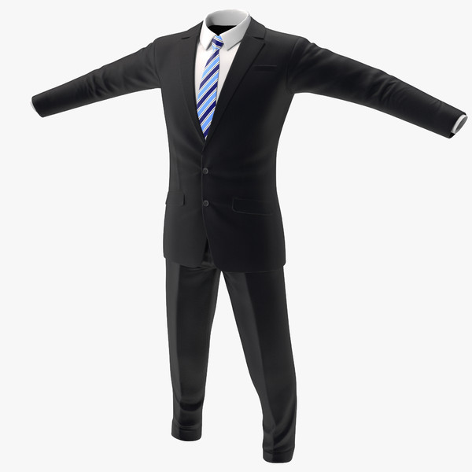
suit

Slide 27
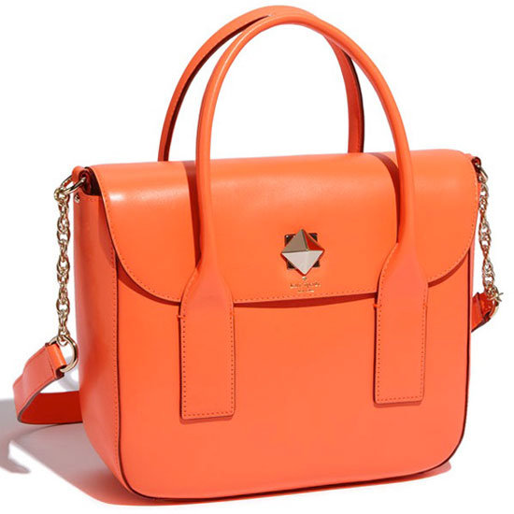
bag

Slide 28
Blouse

Slide 29
high heels

Slide 30
trainers

Slide 31
cap

Slide 32
scarf

Slide 33
gloves

Slide 34
trousers

Slide 35
boots

Slide 36
shirt

Slide 37
tie

Slide 38
umbrella

Slide 39
dress

Slide 40
raincoat

Slide 41
jumper

Slide 42
suit

Slide 43
bag

Slide 44
