Slide 1
My Animals

Slide 2
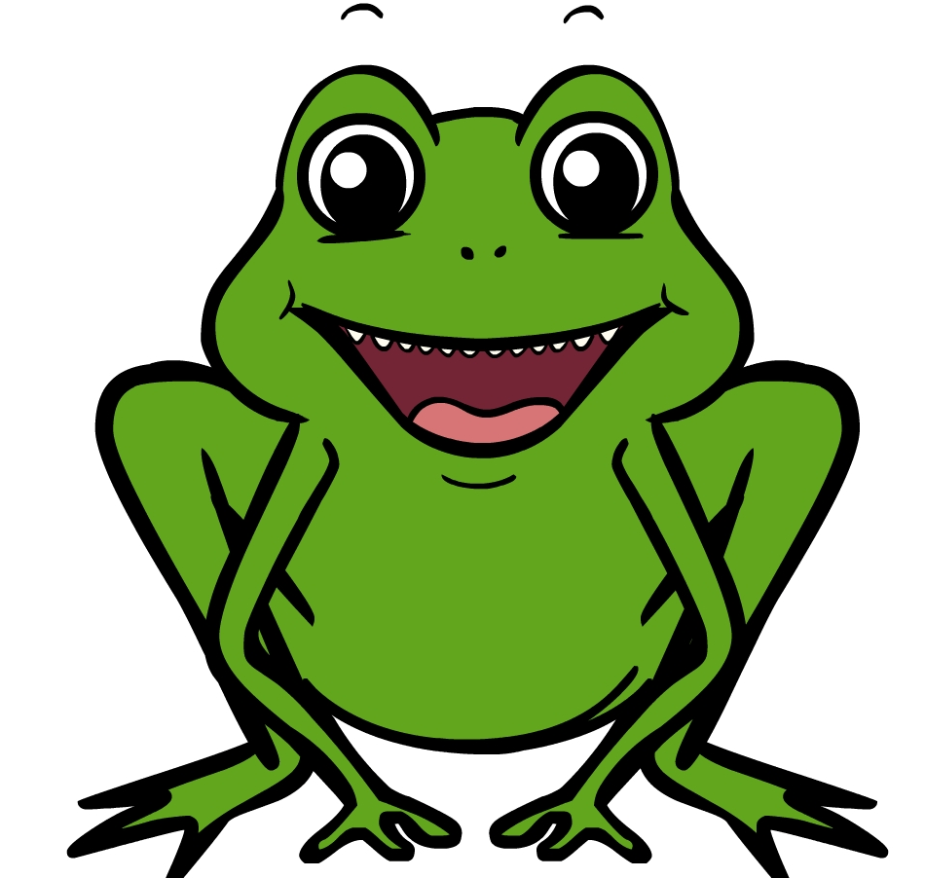
Frog
a frog

Slide 3
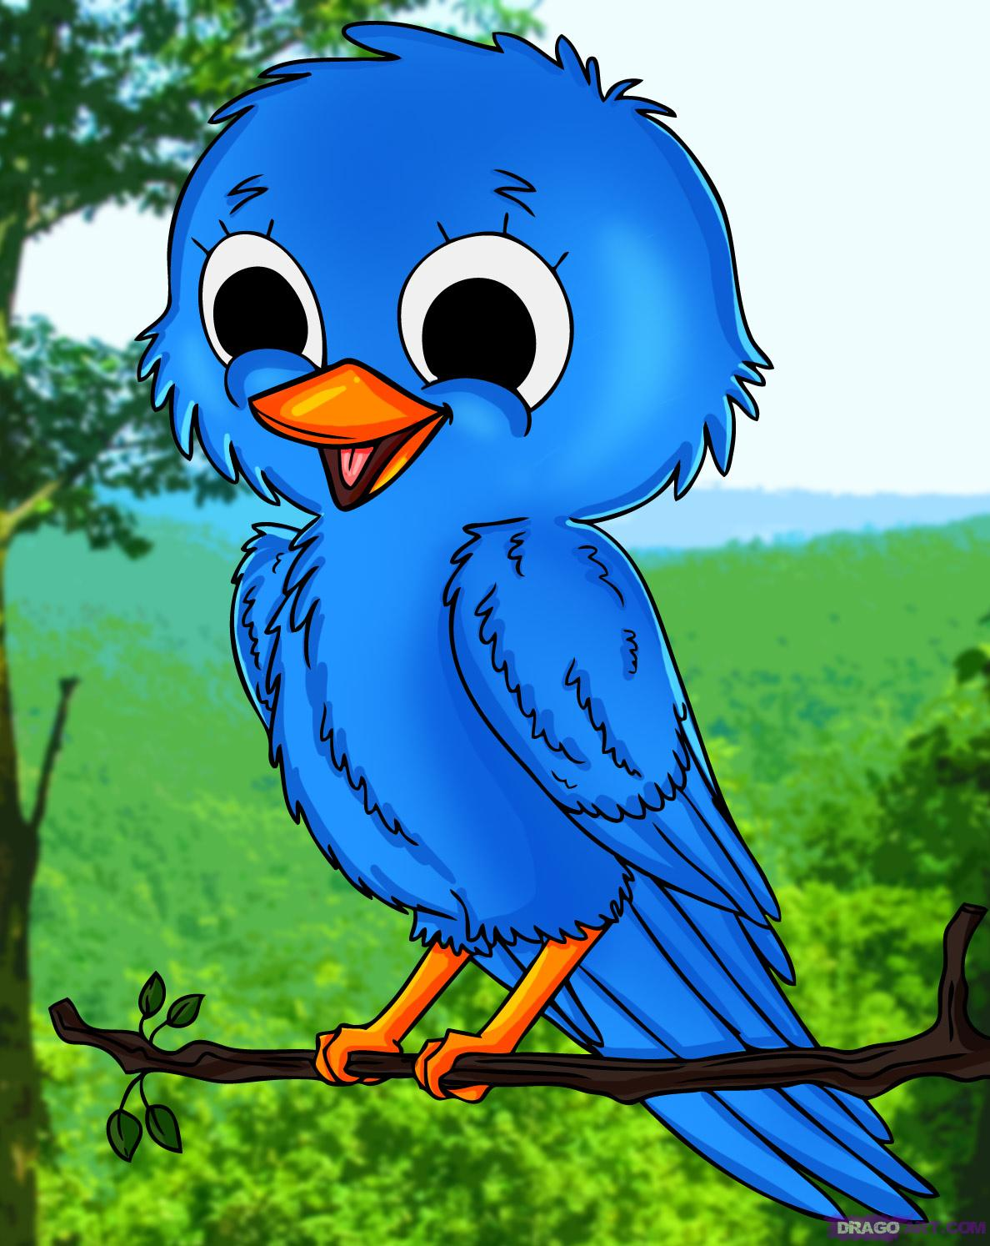
bird
the bird

Slide 4
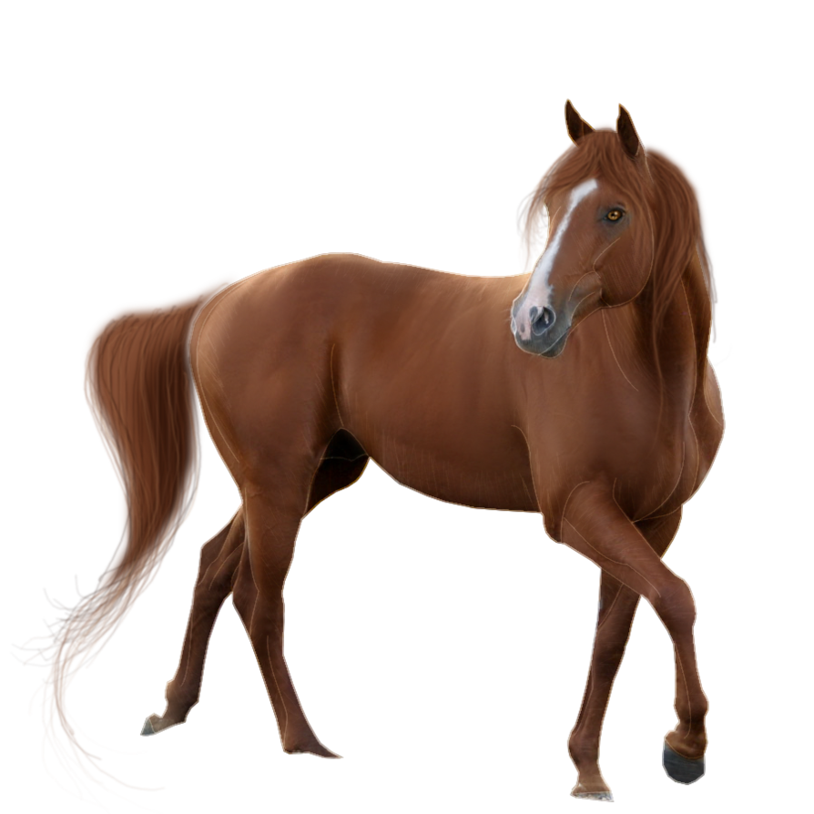
Horse
My horse

Slide 5
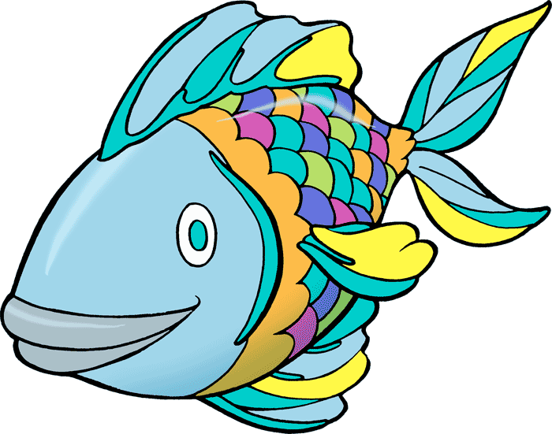
Fish
a fish

Slide 6
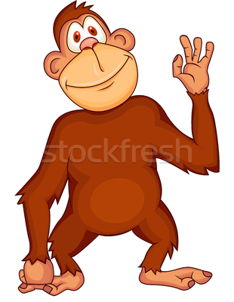
Chimp
the chimp

Slide 7

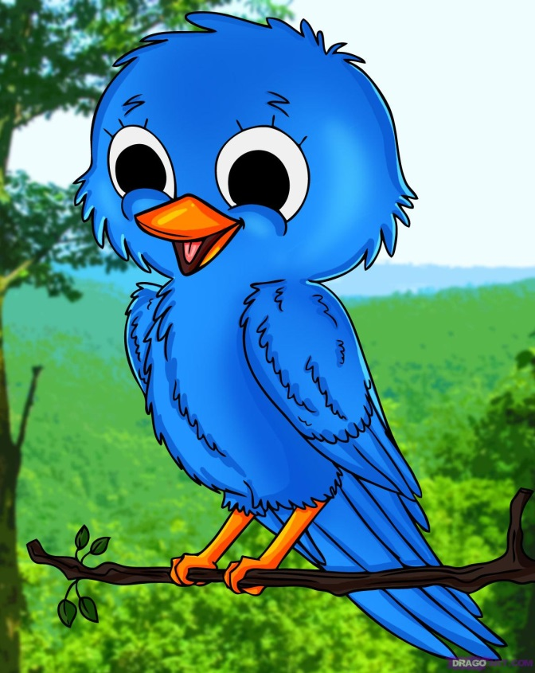

Slide 8
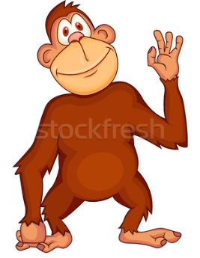
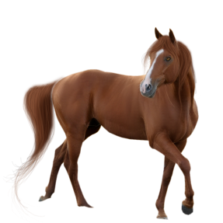

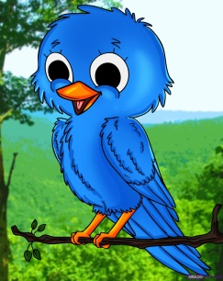
the chimp
a fish
my horse
the frog
bird

Slide 9

jump

Slide 10

sing

Slide 11
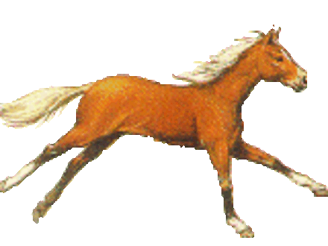
run

Slide 12

swim

Slide 13
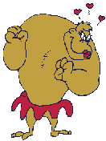
dance

Slide 15
jump
run
swim
sing
dance

Slide 16
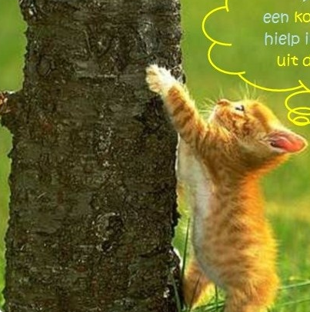
Climb
I can climb.
A cat can climb.
I can climb like a cat.

Slide 17

fly

Slide 18

jump
fly
run
swim
climb
sing
dance

Slide 19
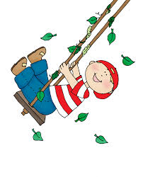
Swing
I can swing.
The boy can swing
like a chimp.

