Slide 1
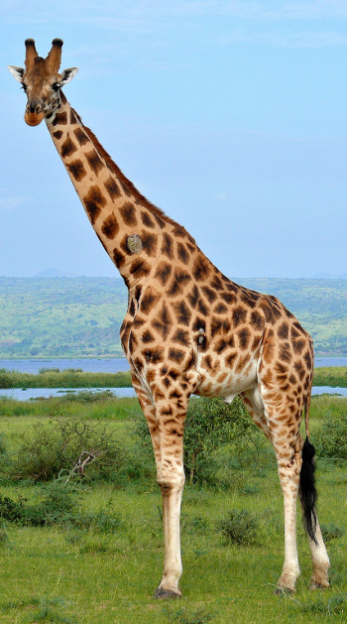
Giraffe
tall giraffe

Slide 2
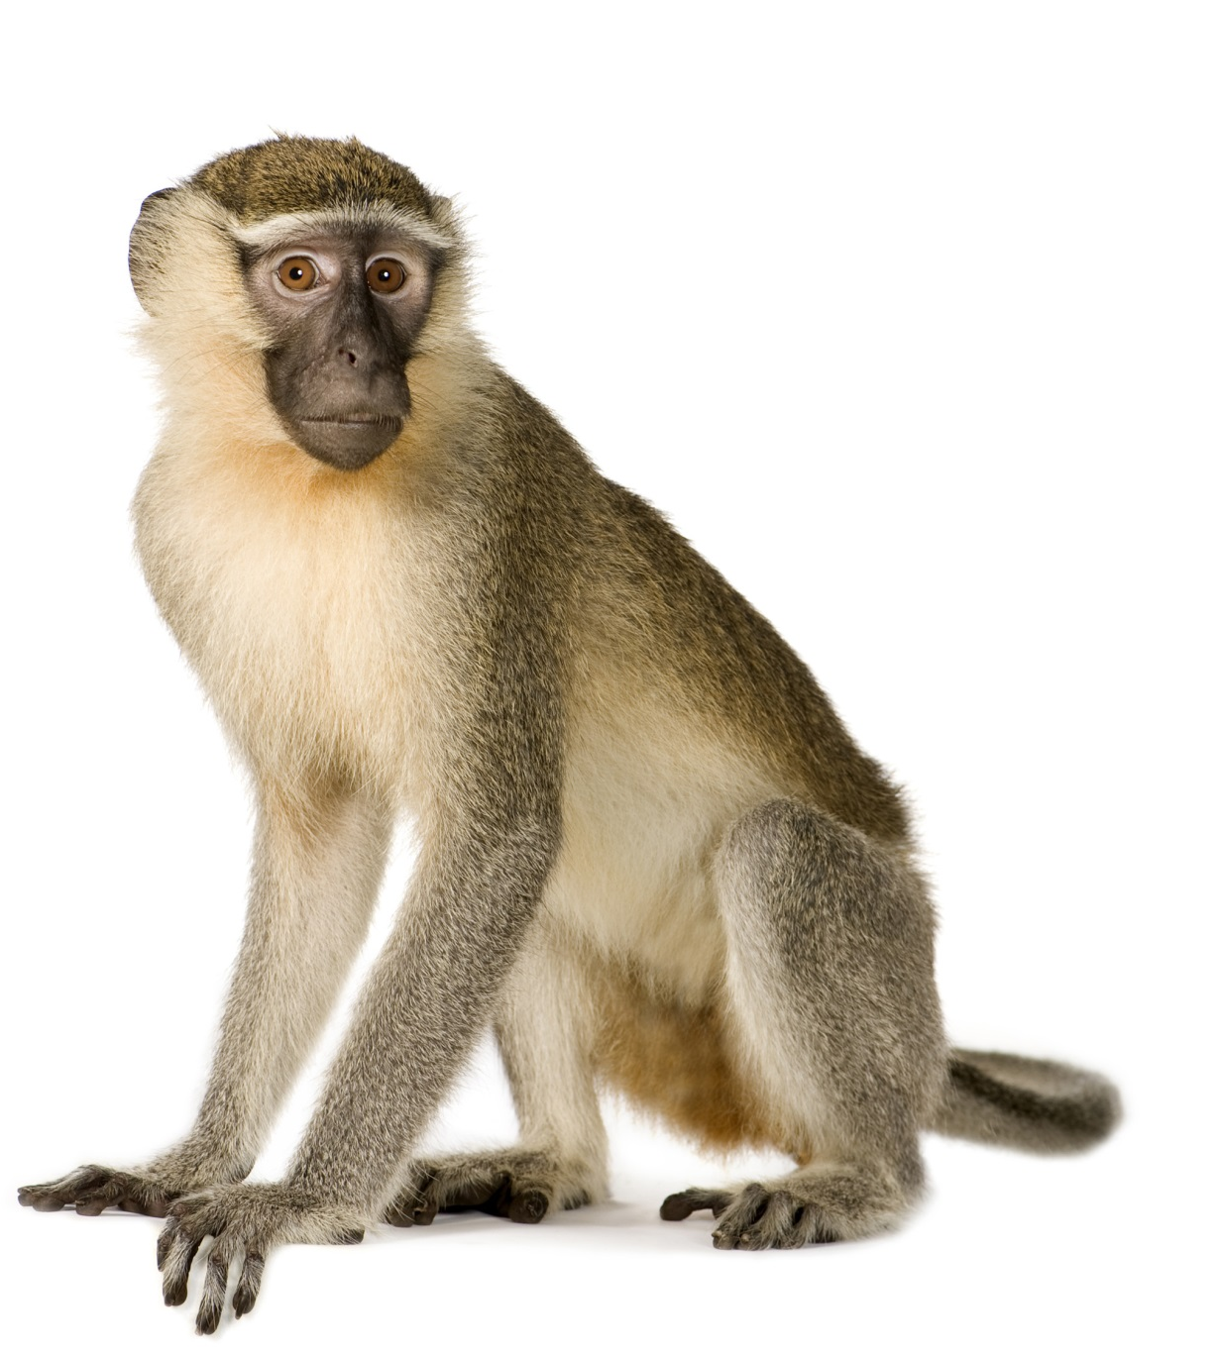
Monkey
silly monkey

Slide 3
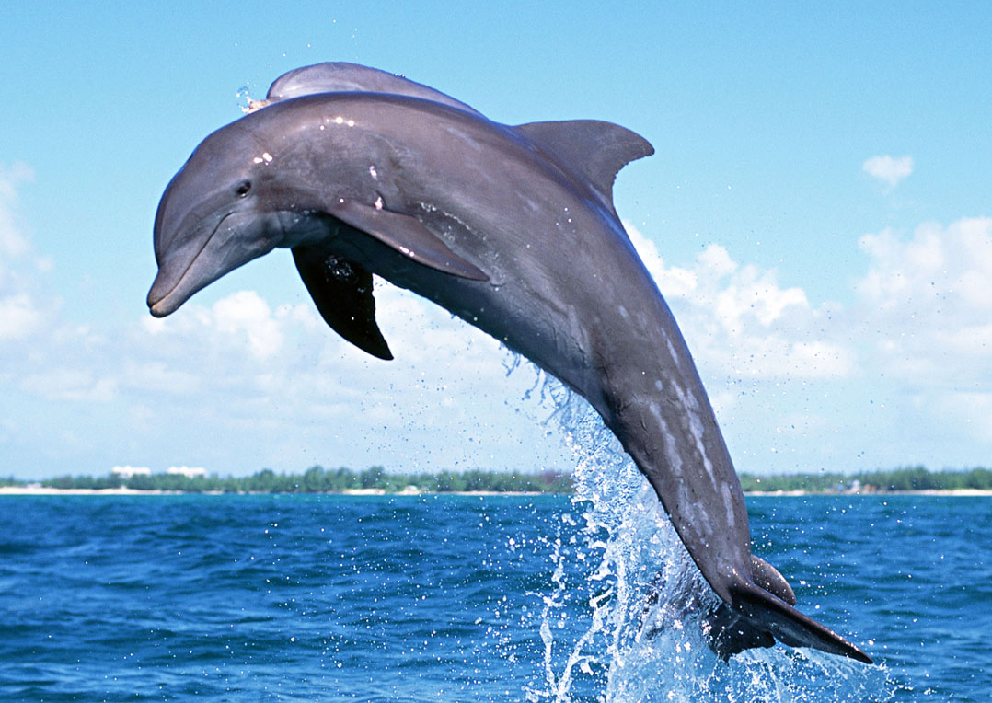
Dolphin
clever dolphin

Slide 4
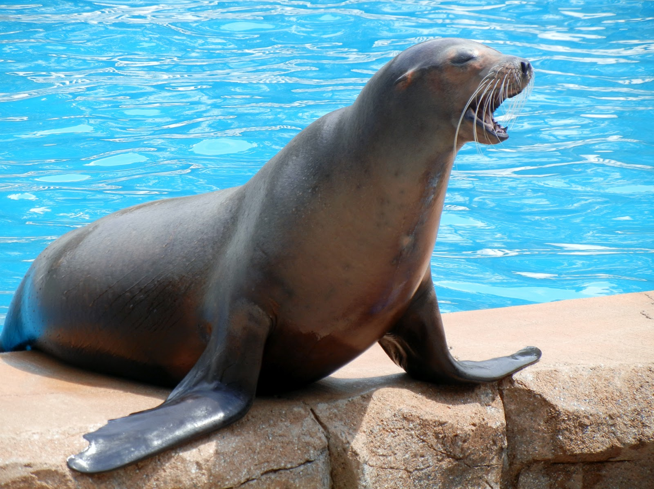
Seal
little seal

Slide 5
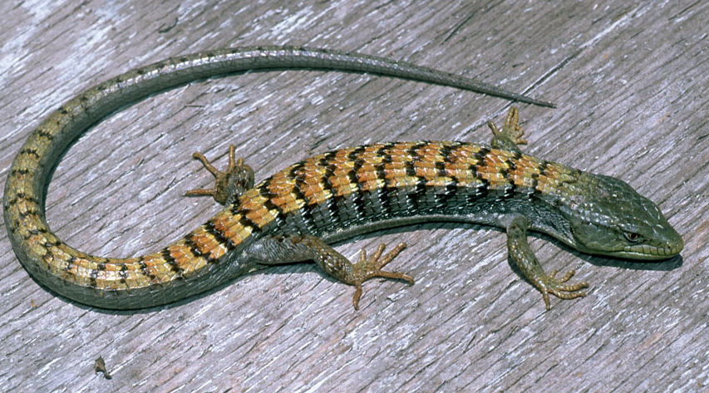
Lizard
lazy lizard

Slide 6

Whale
Big and funny whale

Slide 7
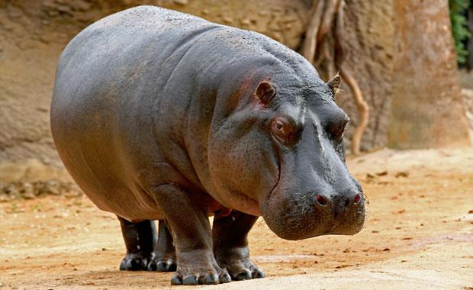
Hippo
fat hippo

Slide 8

crocodile
Long crocodile

Slide 9
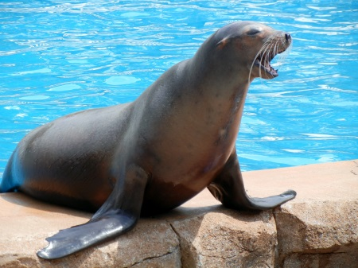





Slide 10








Whale
Dolphin
Lizard
Hippo
Crocodile
Seal
Giraffe
Monkey

Slide 11
Big Long Tall Lazy Fat | Little Clever Silly Funny

