Slide 1
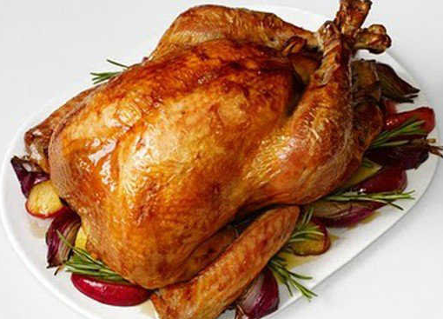
chicken

Slide 2

Ice cream

Slide 3

Pizza

Slide 4
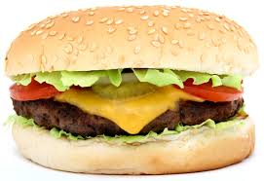
Burger

Slide 5

Vegetables

Slide 6

Chocolate

Slide 7

Lemonade

Slide 8

Water

Slide 9
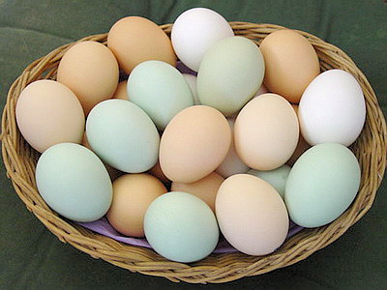
Eggs

Slide 10
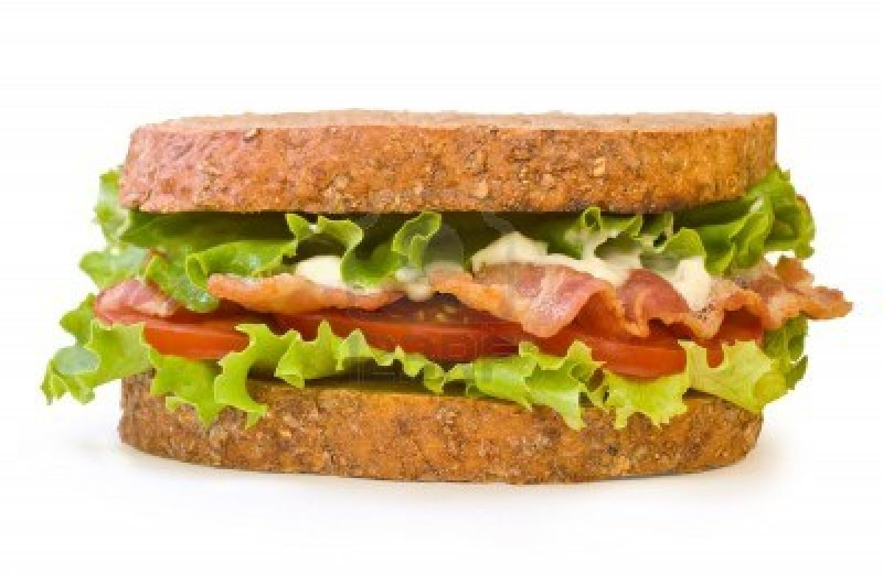
Sandwich

Slide 11








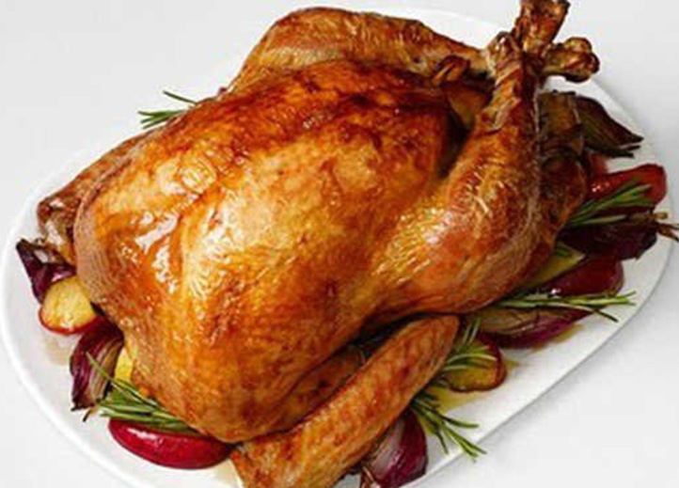


Slide 12
water
eggs
burger
chicken
vegetables
ice cream
lemonade
pizza
chocolate
sandwich

Slide 13
chicken

Slide 14
Ice cream

Slide 15
Pizza

Slide 16
Burger

Slide 17
Vegetables

Slide 18
Chocolate

Slide 19
Lemonade

Slide 20
Water

Slide 21
Eggs

Slide 22
Sandwich

Slide 23
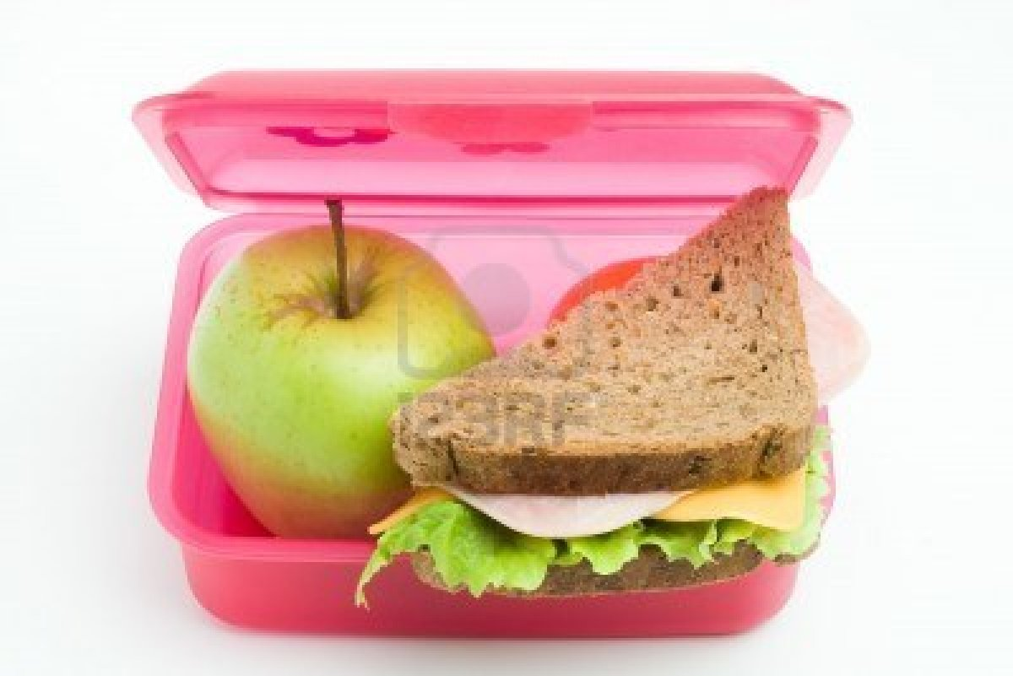
In my lunch box

Slide 24
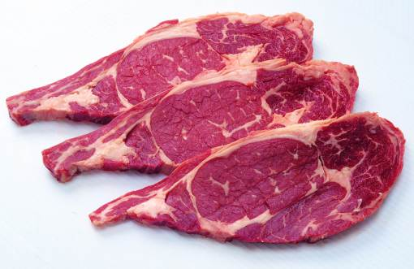
meat

Slide 25
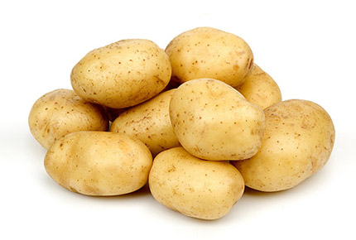
potatoes

Slide 26

biscuits

Slide 27

milk

Slide 28

cake

Slide 29

Orange juice

Slide 30
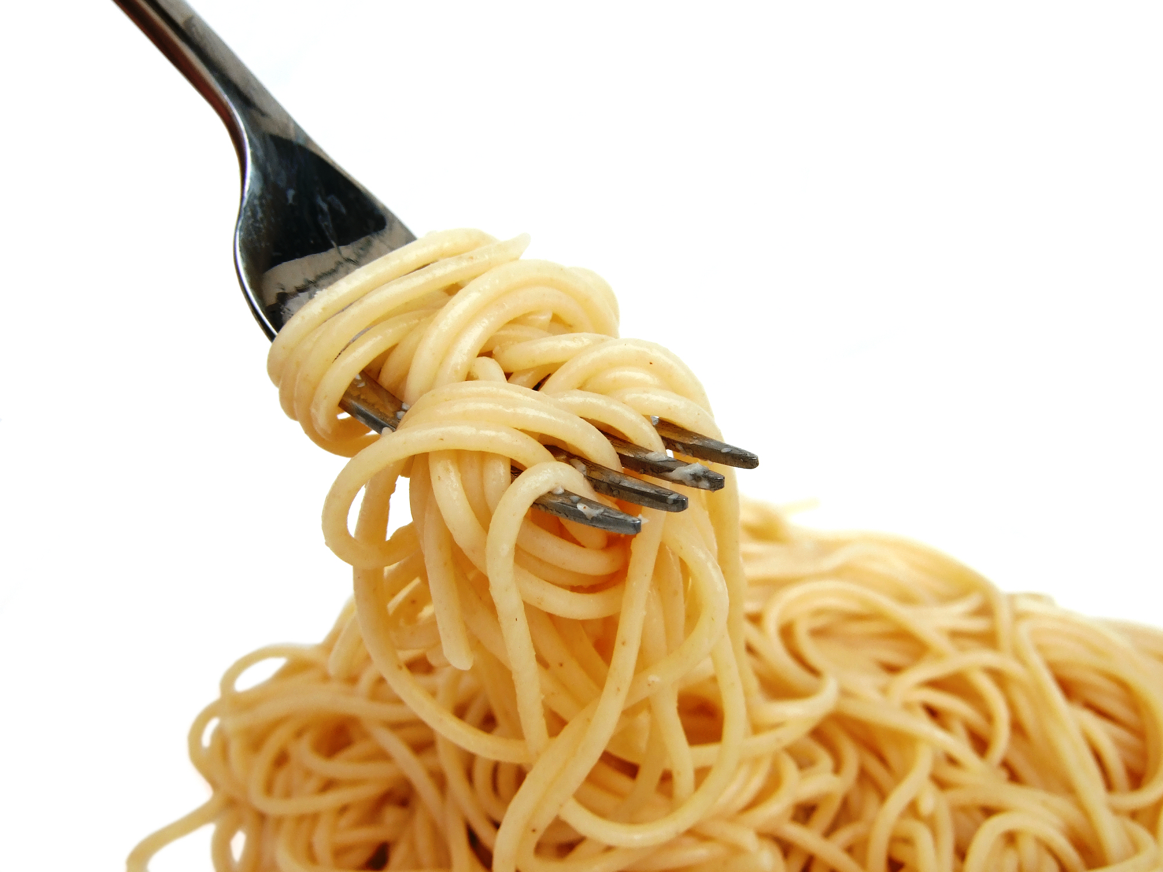
pasta

Slide 31

carrots

Slide 32

sausages

Slide 33
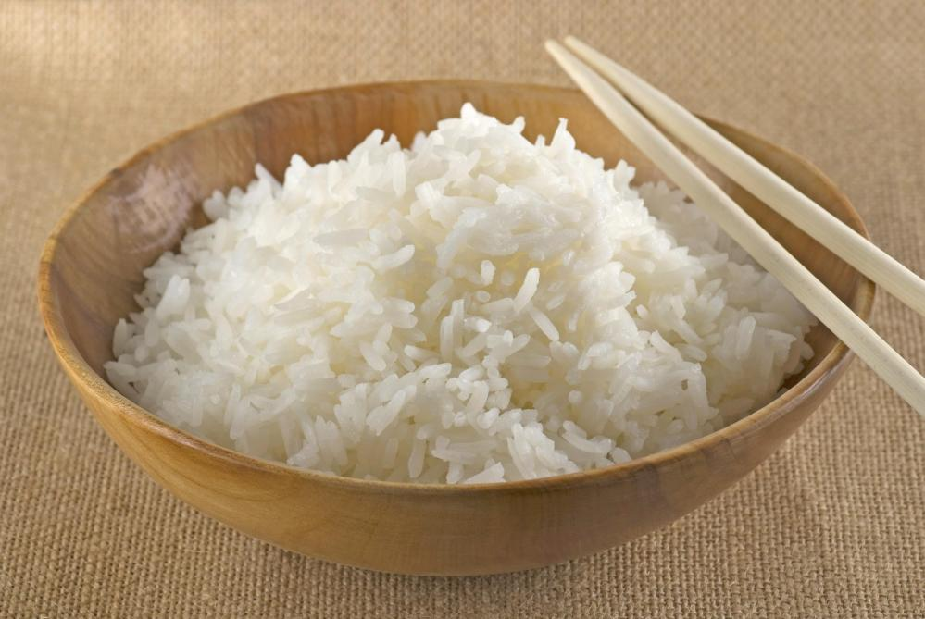
rice

Slide 34

popcorn

Slide 35
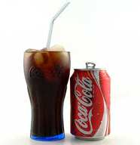
coke

Slide 36













Slide 37
Coke
Milk
Rice
Cake
Meat
Pasta
Carrots
Potatoes
Popcorn
Sausages
Biscuits
Orange juice

Slide 38
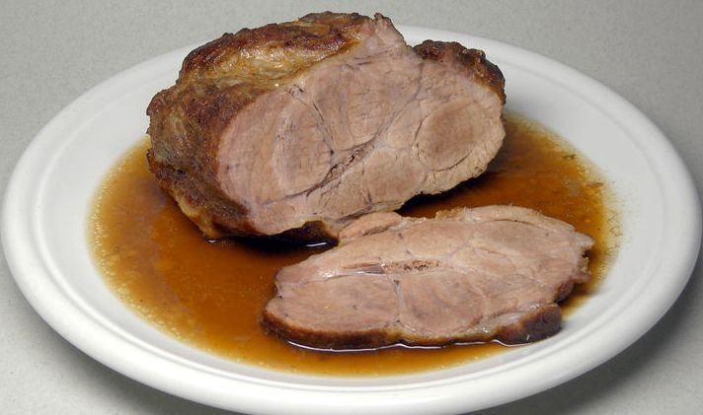
meat

Slide 39
potatoes

Slide 40
biscuits

Slide 41
milk

Slide 42
Orange juice

Slide 43
pasta

Slide 44
carrots

Slide 45
sausages

Slide 46
rice

Slide 47
popcorn

Slide 48
coke

Slide 49
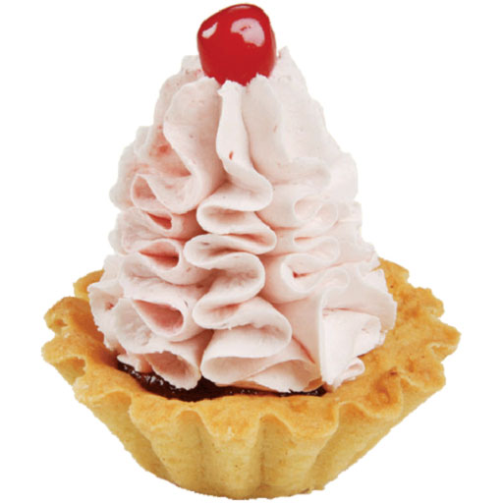
cake

