Slide 1

Yummy
chocolate!

Slide 2
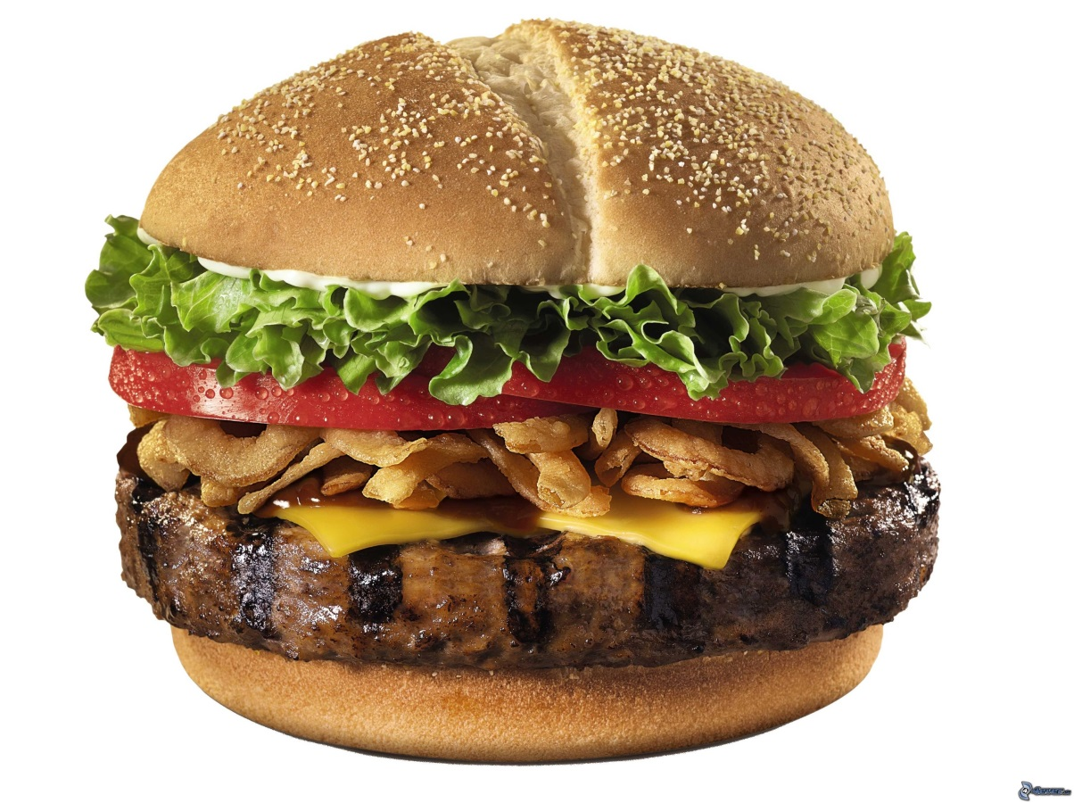
burger
a burger
the burger
yummy burger

Slide 3
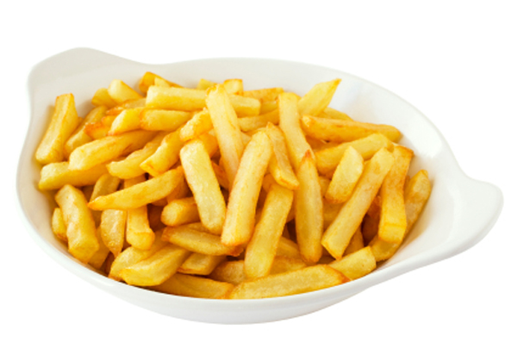
chips
the chips
yummy chips

Slide 4
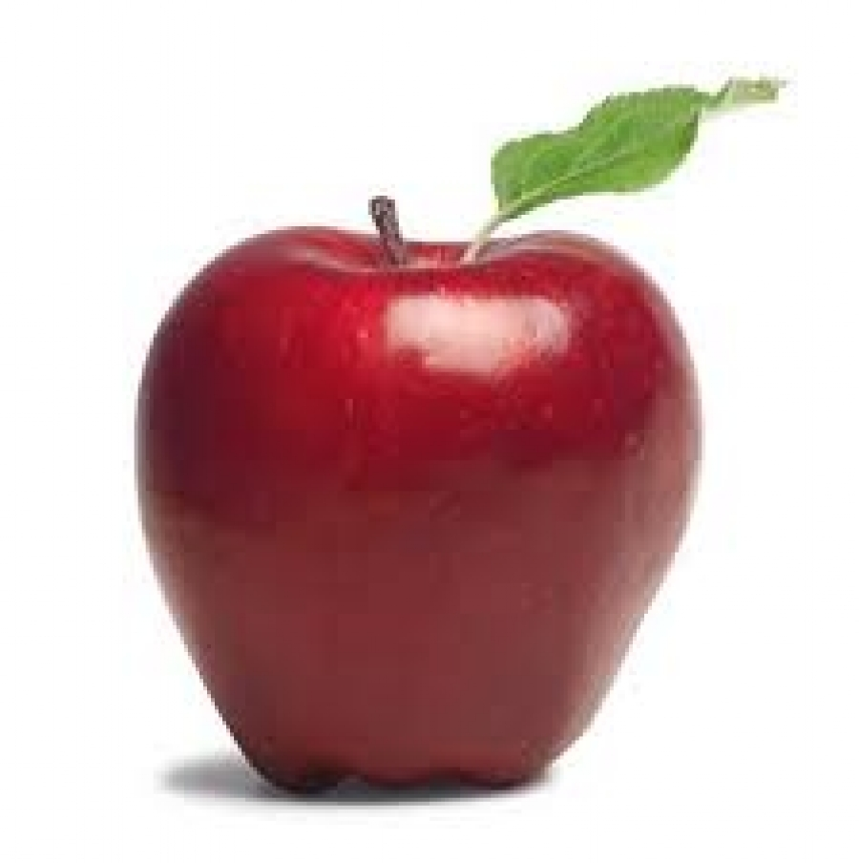
apple
an apple
the apple
yummy apple

Slide 5
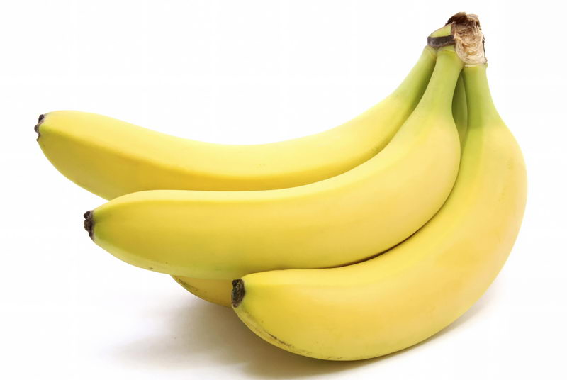
banana
bananas
yummy bananas

Slide 6
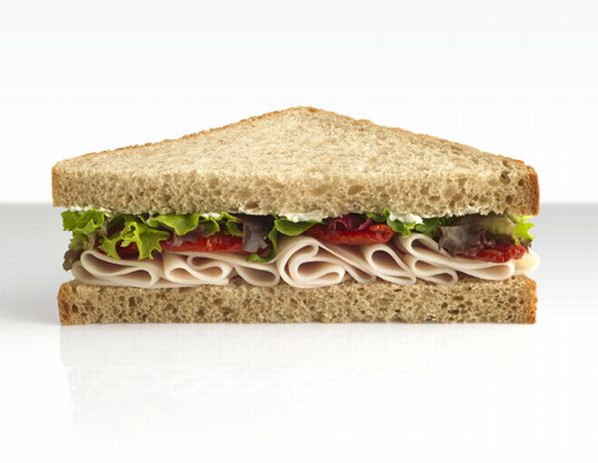
sandwich
a sandwich
sandwiches
the sandwiches
yummy sandwiches

Slide 7
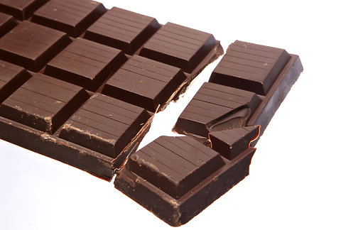
Yummy chocolate!

Slide 8






an apple
sandwiches
the banana
yummy chips
burger
chocolate

Slide 9




Slide 10
My Favourite
Food.

Slide 11
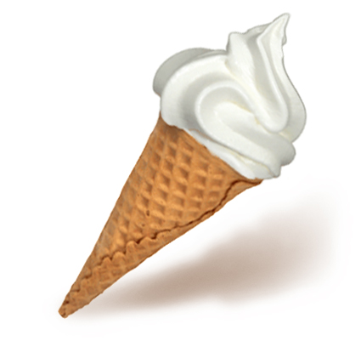
ice cream
an ice cream
I like ice cream

Slide 12
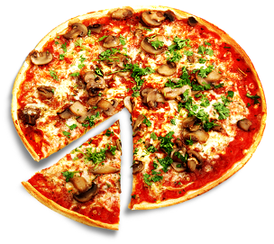
pizza
the pizza
yummy pizza

Slide 13
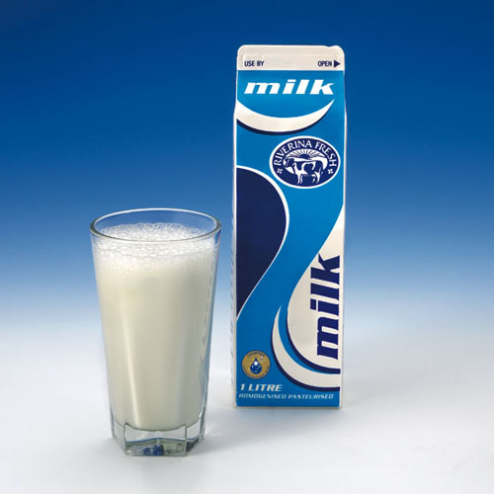
milk
My favourite food is milk.

Slide 14

orange juice
yummy orange juice
I don’t like orange juice

Slide 15
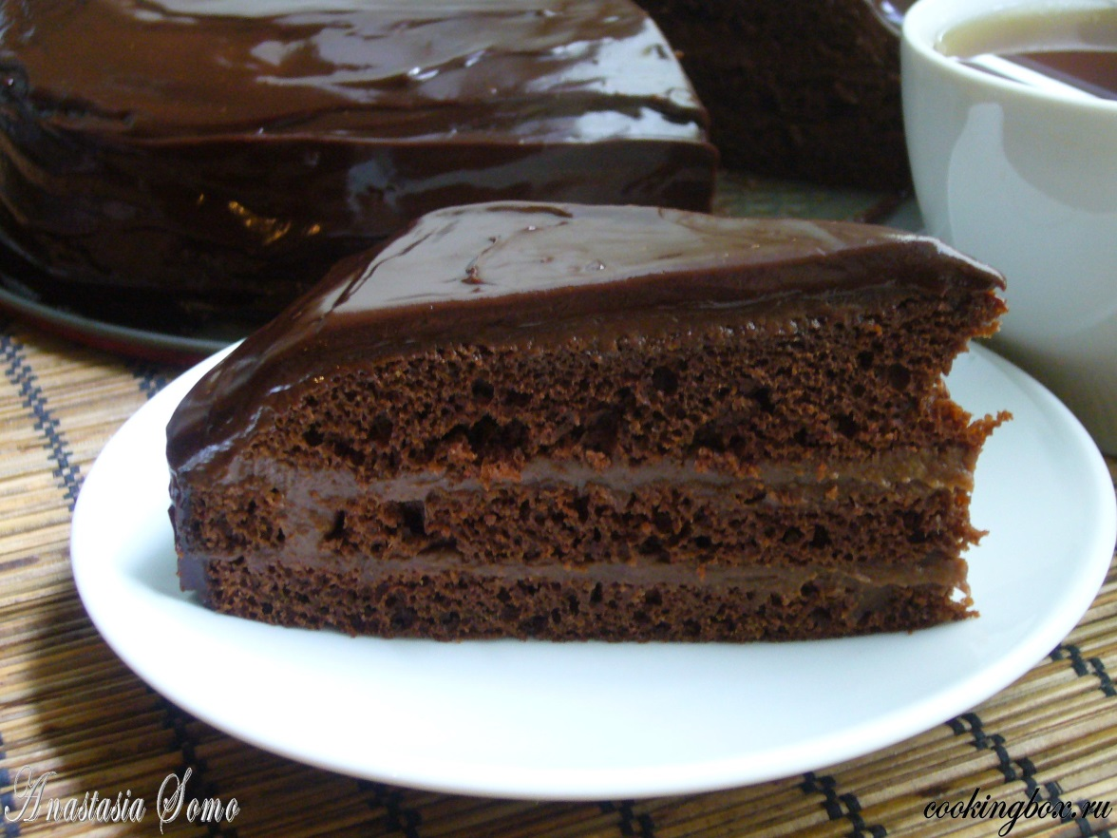
cake
chocolate cake
My favourite food is chocolate cake.

Slide 16



pizza
orange juice
milk
chocolate cake
ice cream

Slide 17
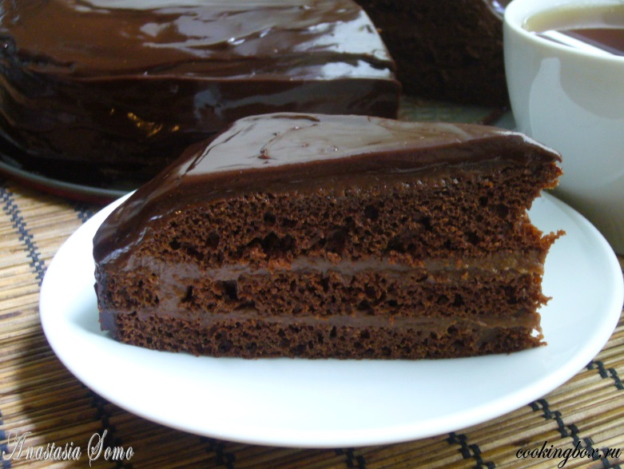

Slide 19


