Slide 1

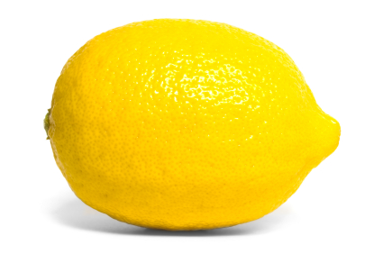
lemon

Slide 2
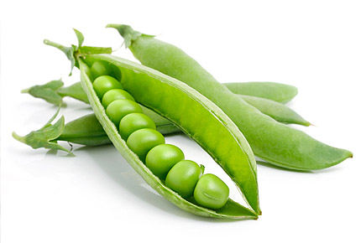
beans

Slide 3
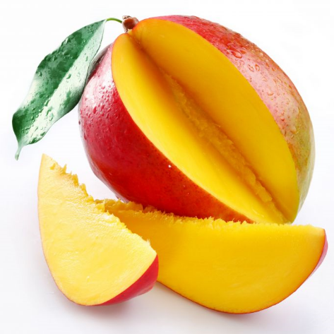
mango

Slide 4
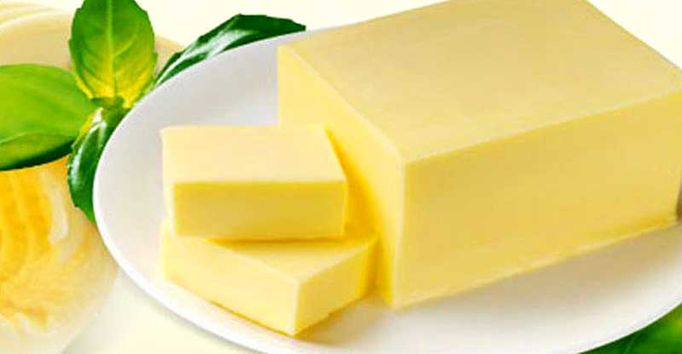
butter

Slide 5

coconut

Slide 6
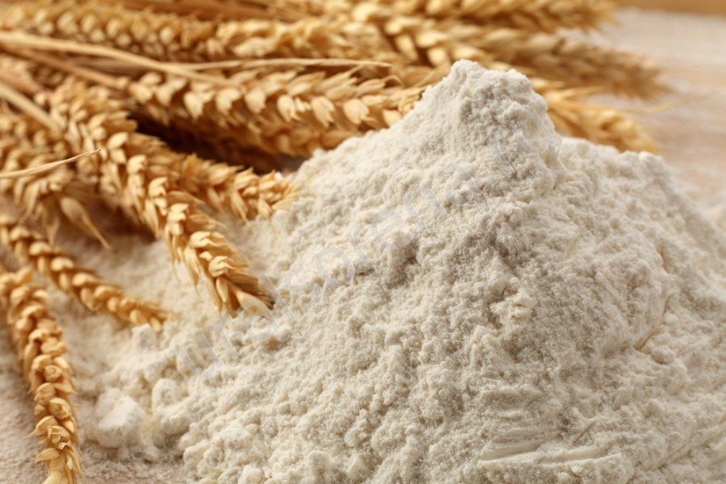
flour

Slide 7
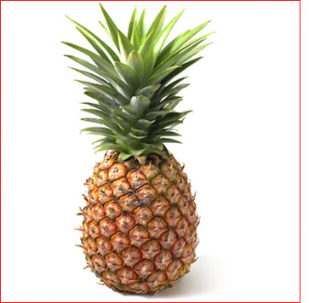
pineapple

Slide 8

olive oil

Slide 9
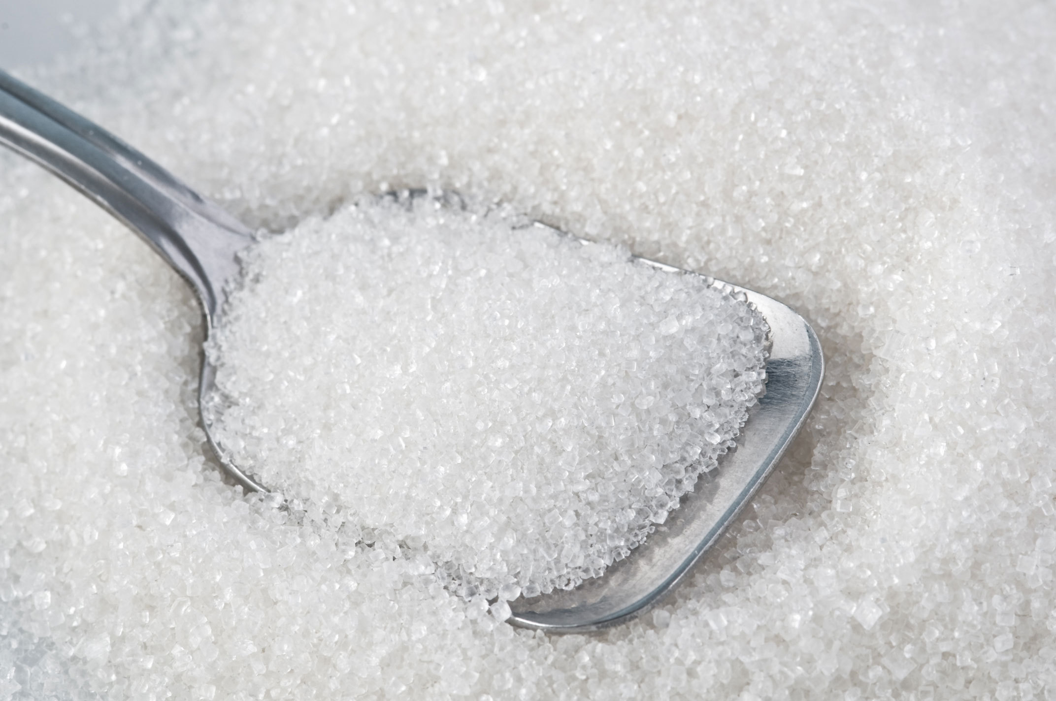
sugar

Slide 10
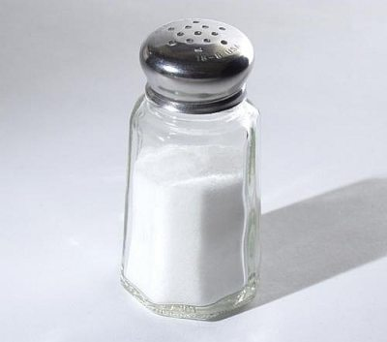
salt

Slide 11
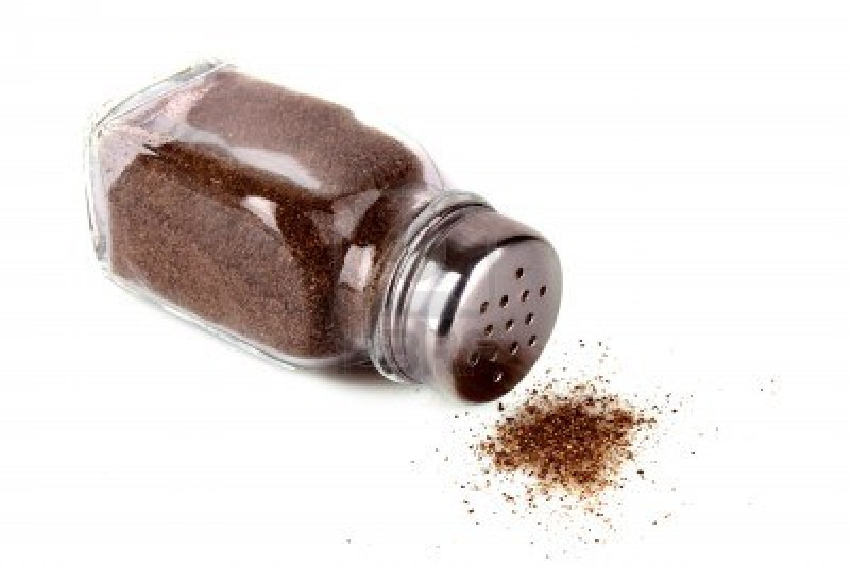
pepper

Slide 12
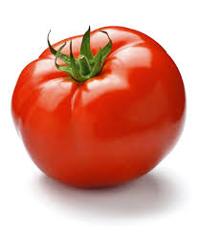
tomato

Slide 13





Slide 14
beans

Slide 15
butter

Slide 16
sugar

Slide 17
mango

Slide 18
lemon

Slide 19
coconut

Slide 20
pineapple

Slide 21
tomato

Slide 22
flour

Slide 23
olive oil

Slide 24
salt

Slide 25
pepper

