Slide 1
Facial features

Slide 2
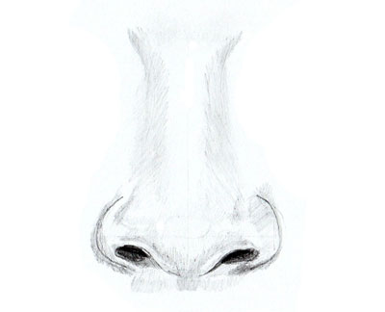
Facial features
Nose
big nose
small nose

Slide 3
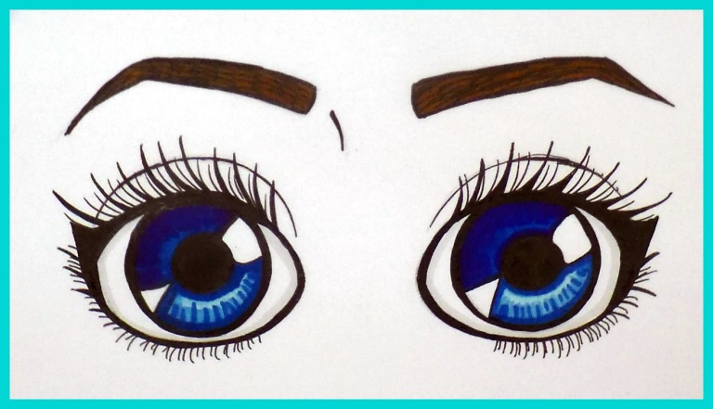
Facial features
eye
eyes
big eyes
small eyes
blue eyes
green eyes
dark eyes

Slide 4
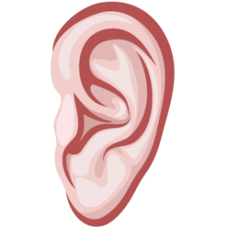
Facial features
big ears
small ears
long ears
Ear
Ears

Slide 5
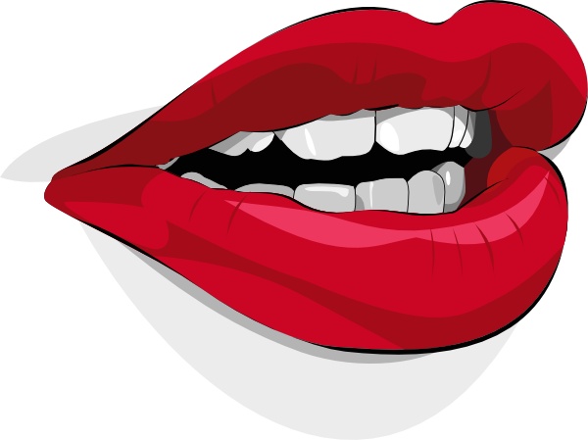
Facial features
mouth
big mouth
small mouth

Slide 6

Facial features
moustache

Slide 7
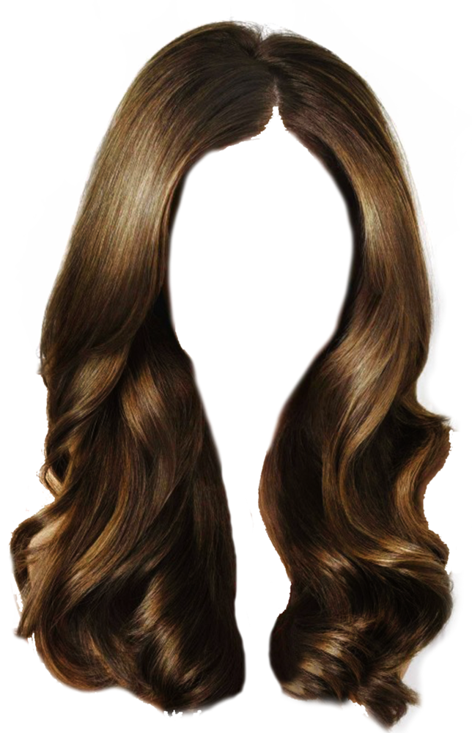
Hair
long hair
short hair
red hair
dark hair
fair hair
blondes hair
curly hair

Slide 8
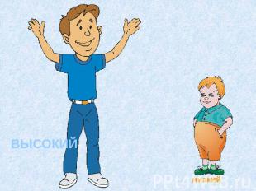
height
short
tall
average

Slide 9
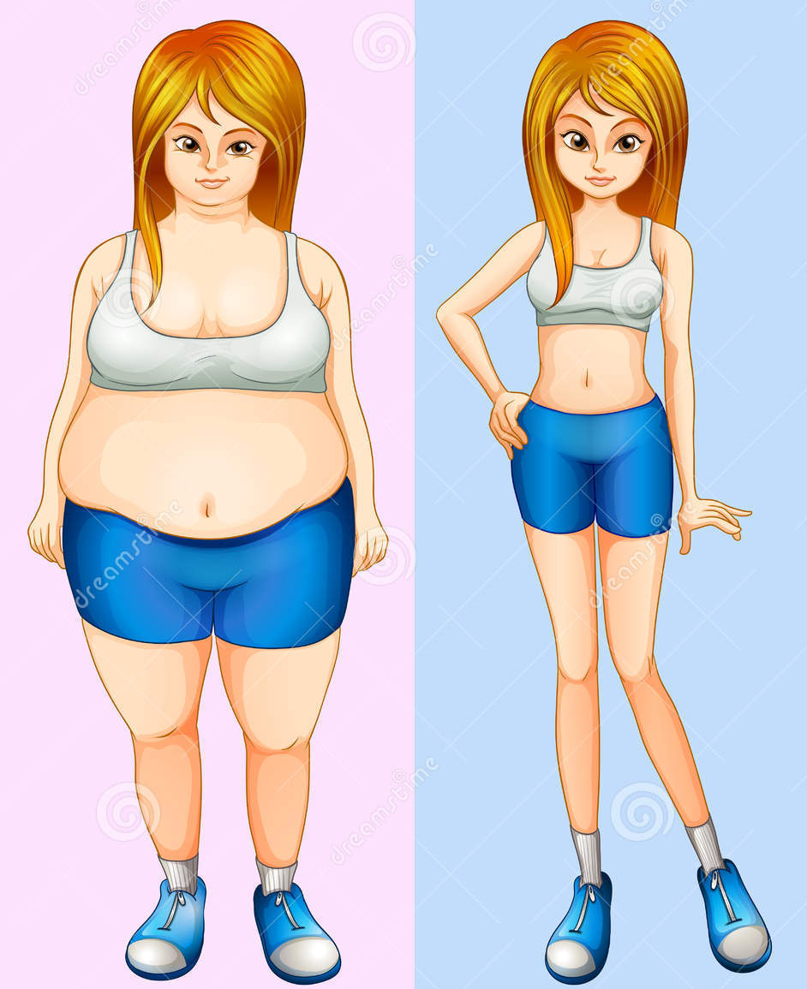
Build
thin
slim
fat
plump

Slide 10
Age
old
teenager
young
How old are you?
How old is he?
How old is she?

