Slide 1
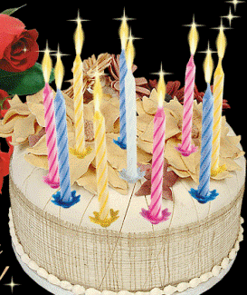
My Birthday!

Slide 2
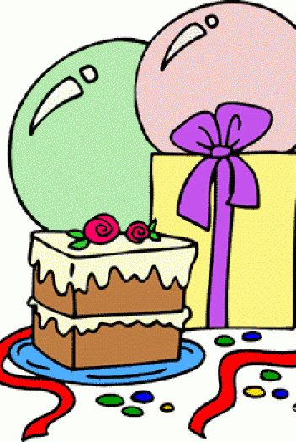
Birthday
My birthday
The birthday
Happy birthday

Slide 3
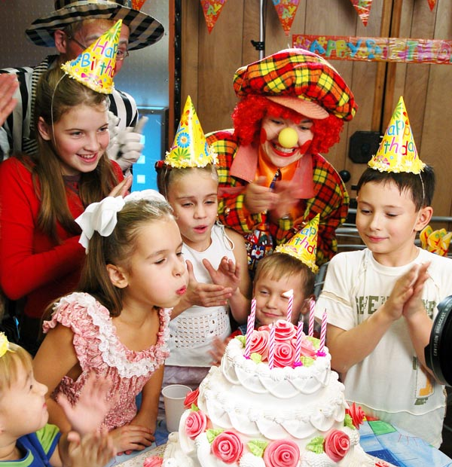
party
a party
the party
a birthday party

Slide 4
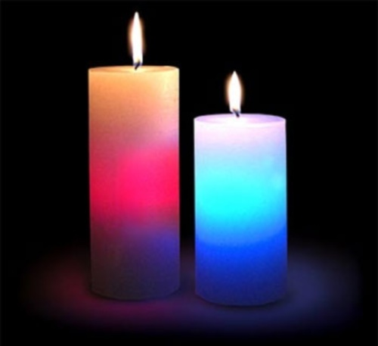
candle
a candle
the candle
candles
two candles

Slide 5
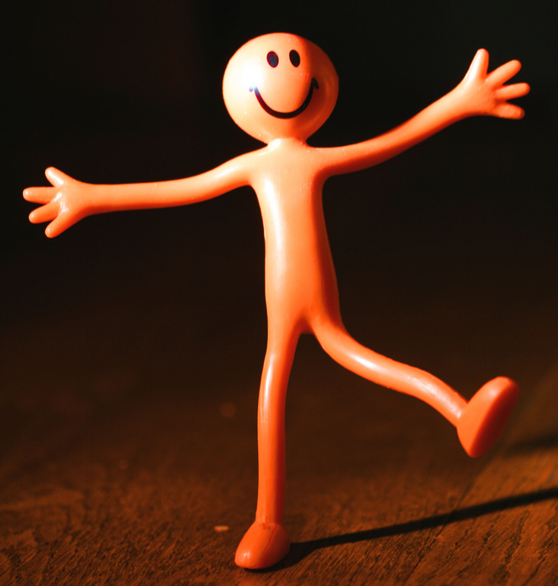
Happy
happy

Slide 6

sad

Slide 7

birthday

Slide 8



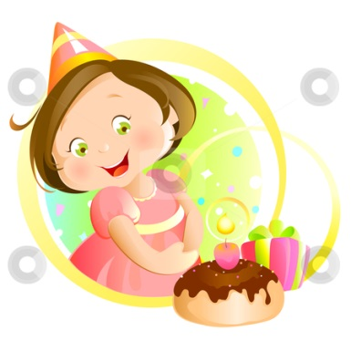
sad
a party
the candle
happy
my birthday

