Slide 1


Doctor
Nurse
help sick people

Slide 2


baker
bake

Slide 3
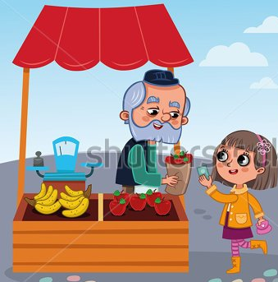
Greengrocer
Sell fruit
and vegetables

Slide 4

teacher
Teach children

Slide 5

waiter
wait
serve drinks and food

Slide 6

mechanic
repair cars
Fix cars

Slide 7

Postman
take letters
to people’s houses

Slide 8

Clown
Make people laugh

Slide 9
teacher
Teach children

Slide 10
Greengrocer
Sell fruit
and vegetables

Slide 11
waiter
wait
serve drinks and food

Slide 12
Doctor
Nurse
help sick people

Slide 13
baker
bake

Slide 14
Postman
take letters
to people’s houses

Slide 15
Clown
Make people laugh

Slide 16
mechanic
repair cars
Fix cars

Slide 17



