Slide 1
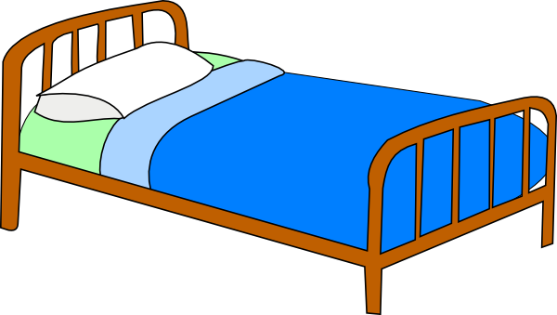
bed

Slide 2
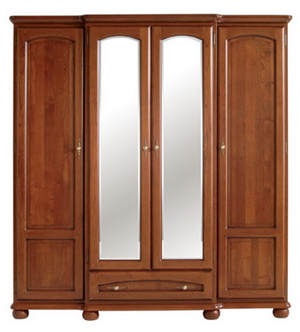
wardrobe

Slide 3
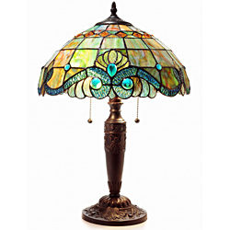
lamp

Slide 4
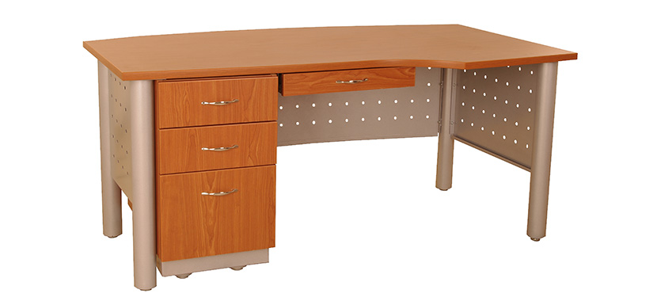
desk

Slide 5
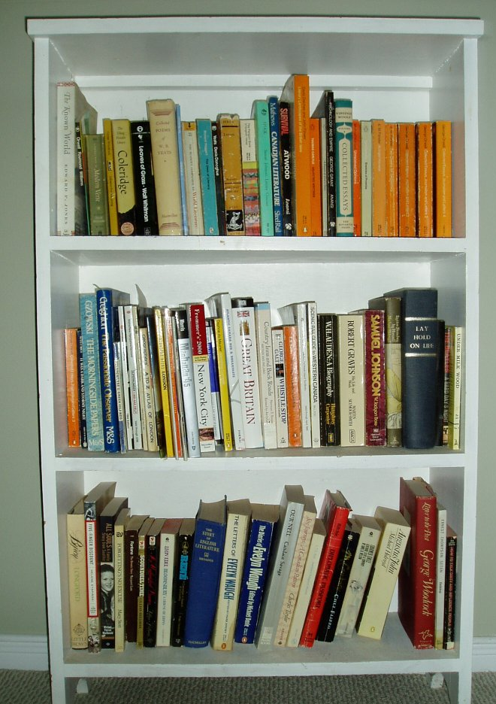
bookcase

Slide 6
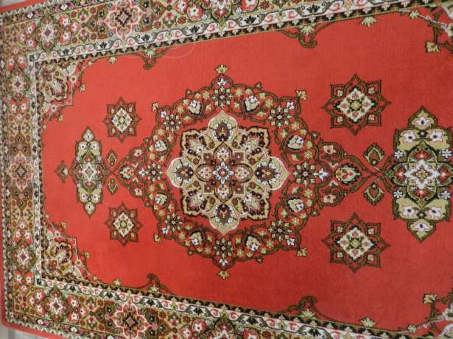
carpet

Slide 7

mirror

Slide 8
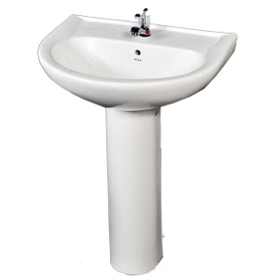
washbasin

Slide 9
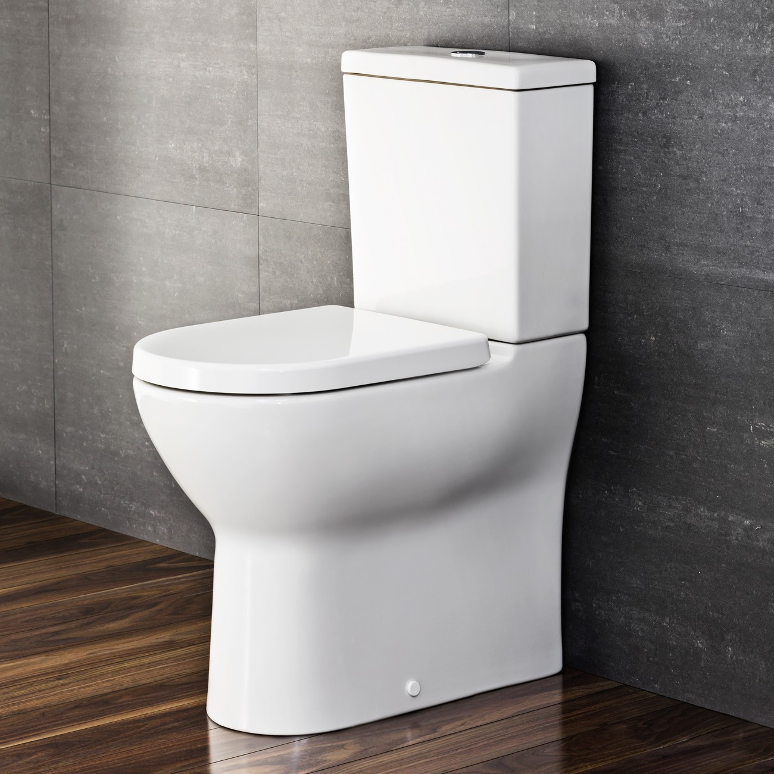
toilet

Slide 10
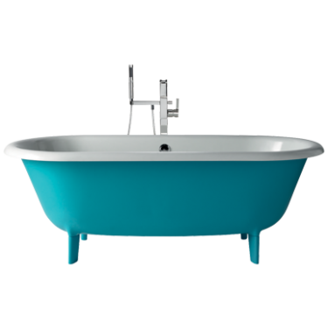
bath

Slide 11
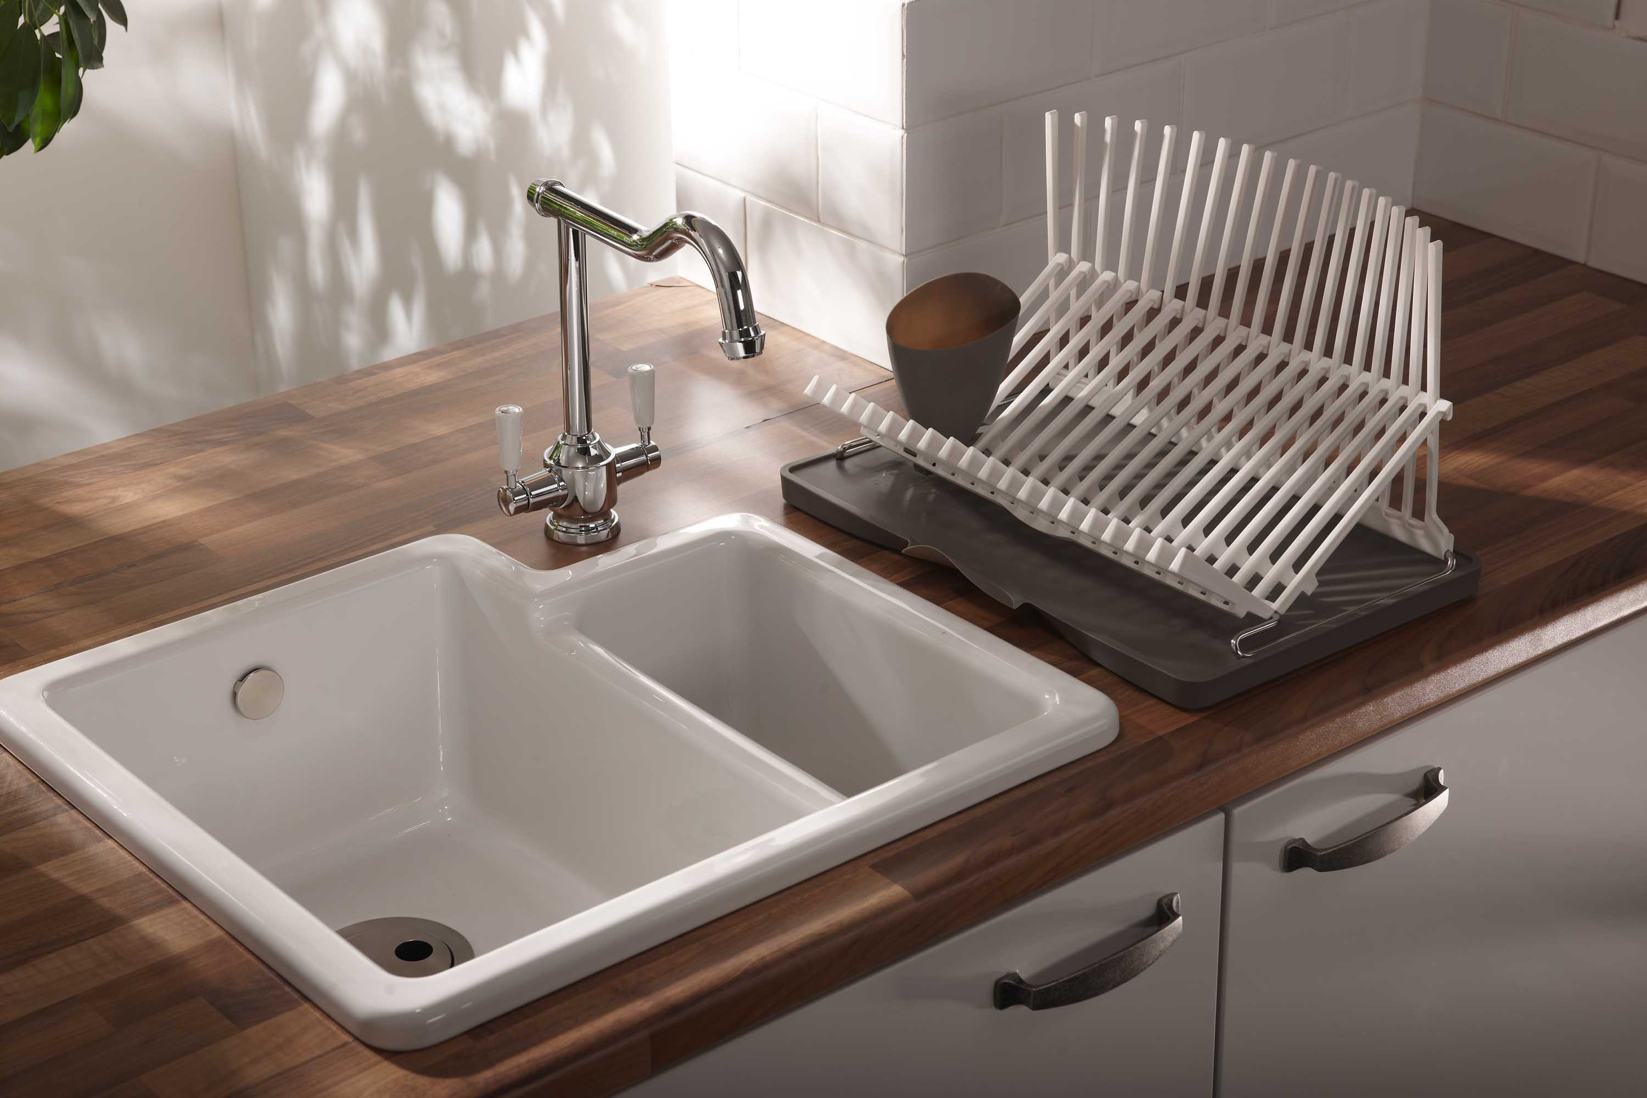
sink

Slide 12
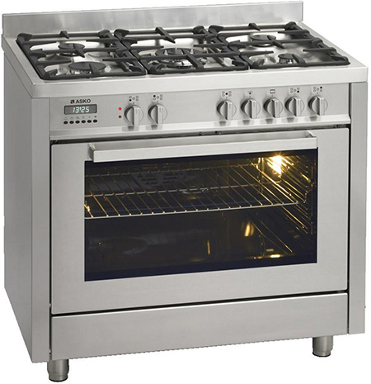
cooker

Slide 13
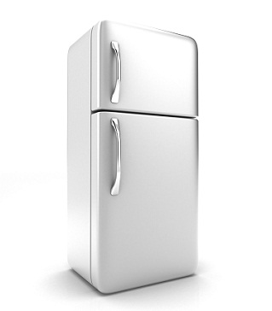
fridge

Slide 14
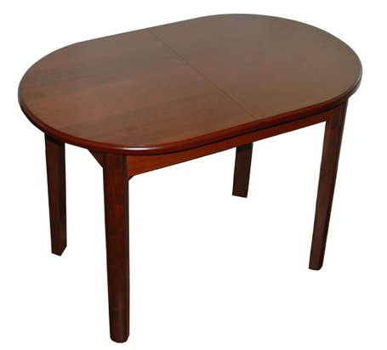
table

Slide 15
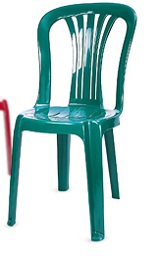
chair

Slide 16
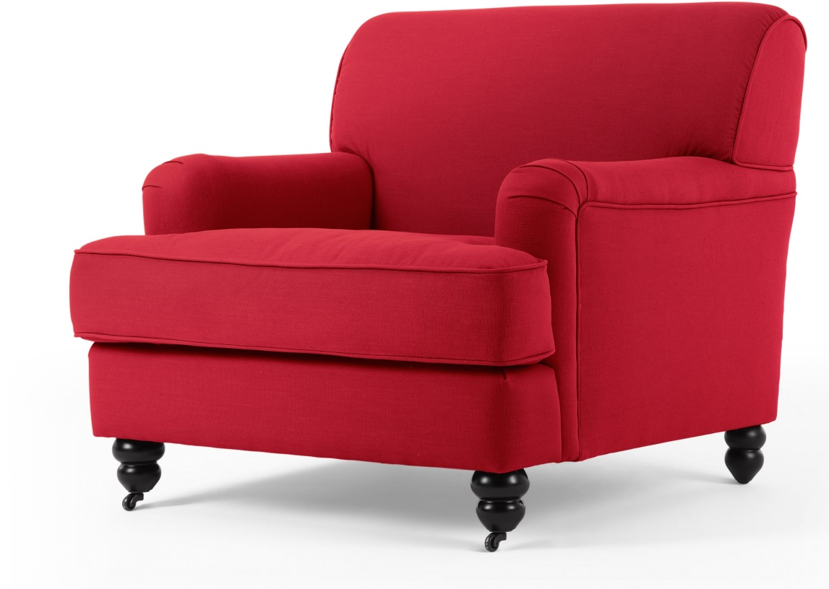
armchair

Slide 17
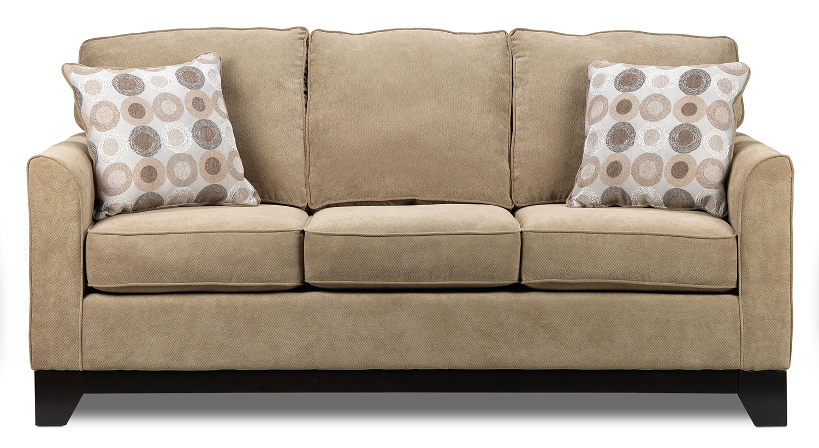
sofa

Slide 18
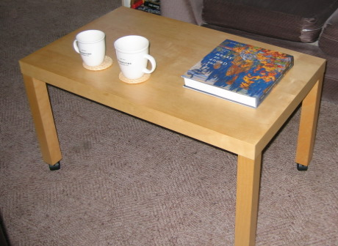
coffee table

Slide 19
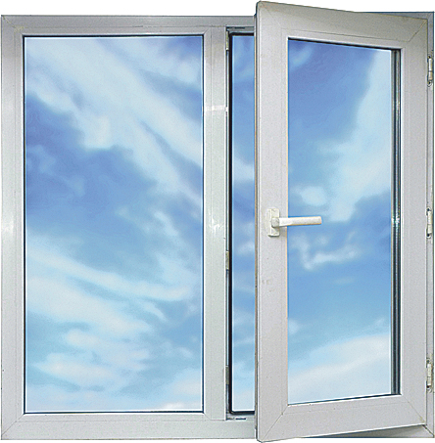
window

Slide 20
chair

Slide 21
armchair

Slide 22
sofa

Slide 23
coffee table

Slide 24
window

Slide 25
toilet

Slide 26
bath

Slide 27
sink

Slide 28
cooker

Slide 29
fridge

Slide 30
table

Slide 31
lamp

Slide 32
desk

Slide 33
bookcase

Slide 34
carpet

Slide 35
mirror

Slide 36
washbasin

Slide 37
bed

Slide 38
wardrobe

Slide 39
