Slide 1
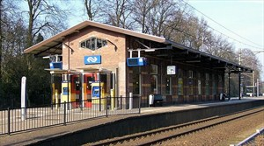
station

Slide 2
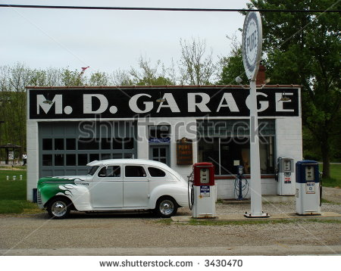
garage

Slide 3
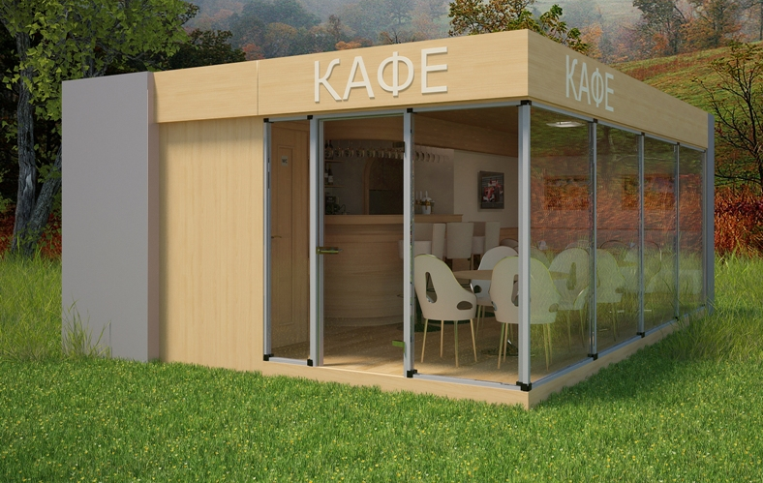
café

Slide 4
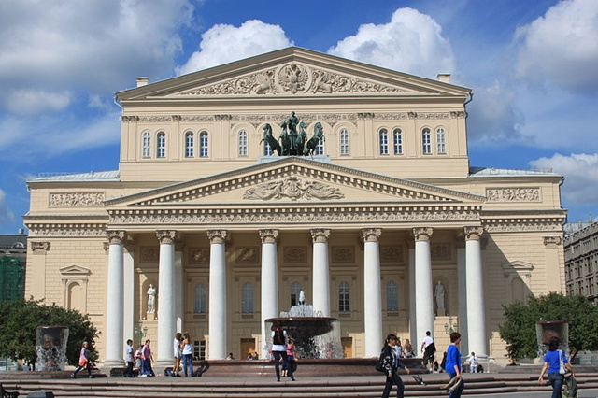
theatre

Slide 5
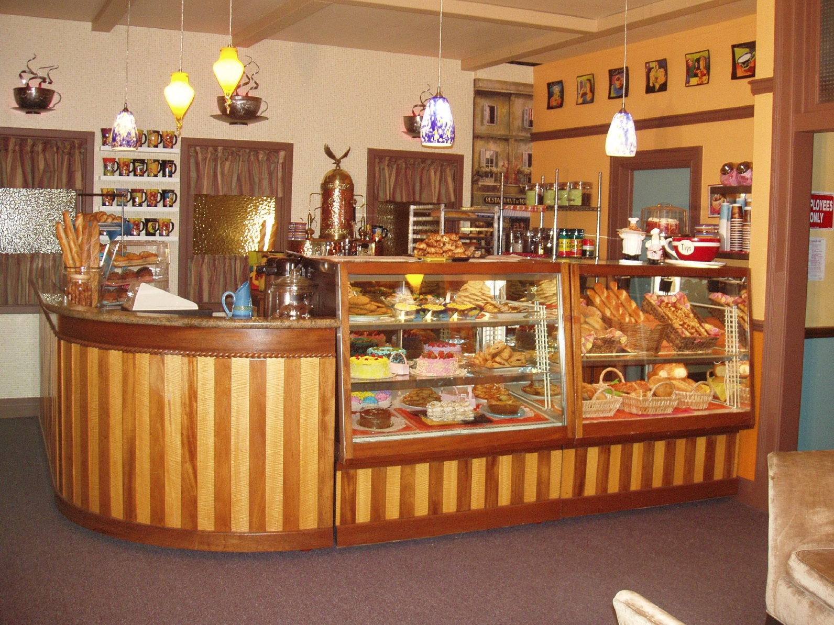
baker’s

Slide 6
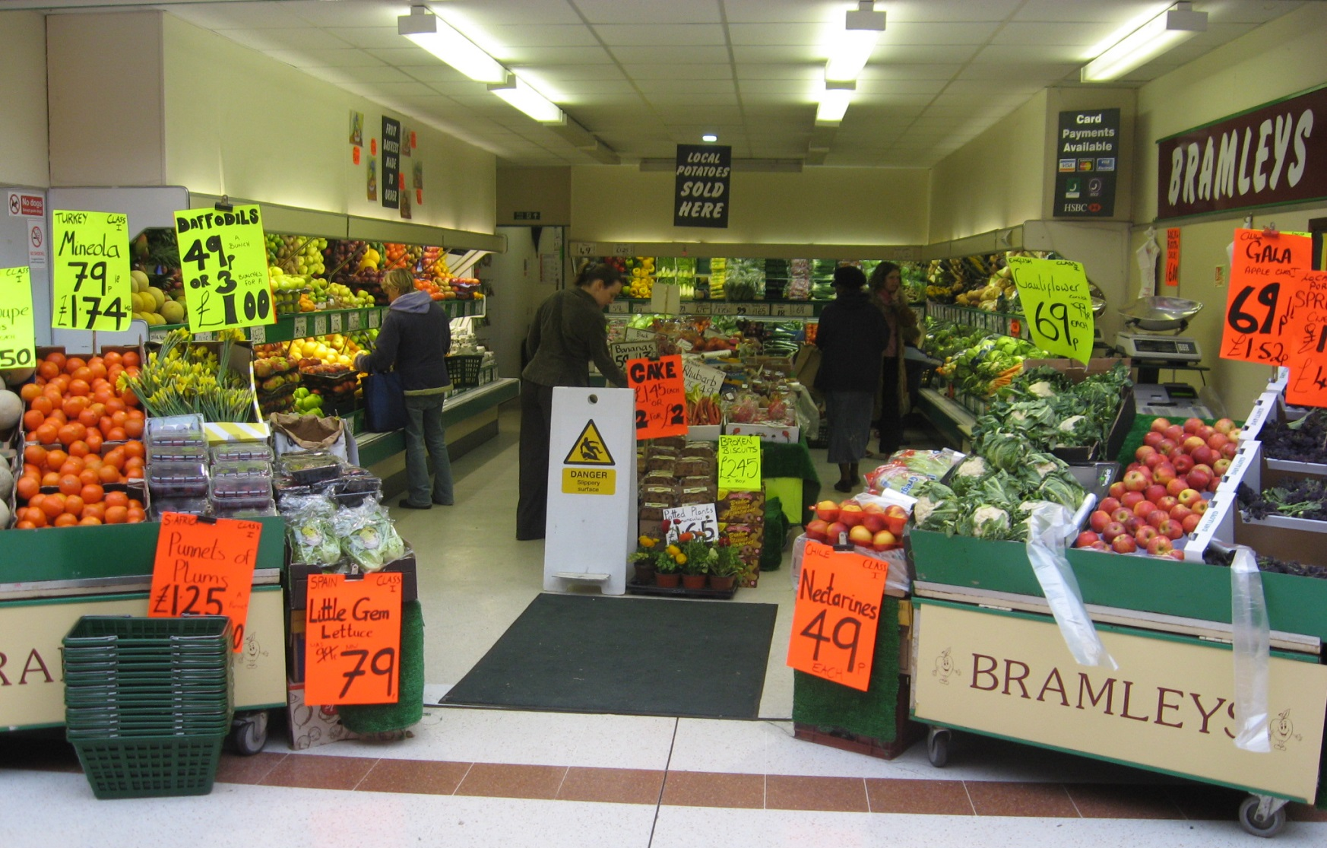
greengrocer’s

Slide 7
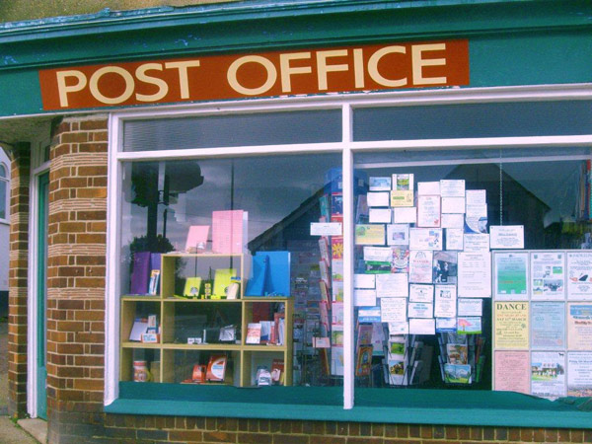
post office

Slide 8
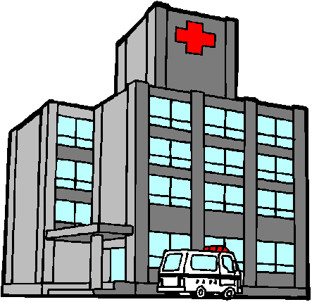
hospital

Slide 9
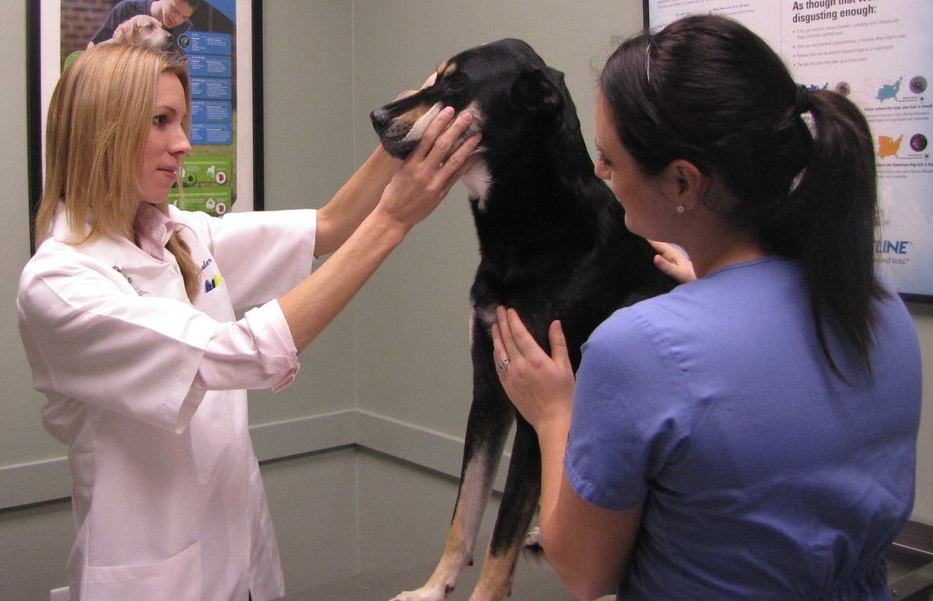
animal hospital

Slide 10




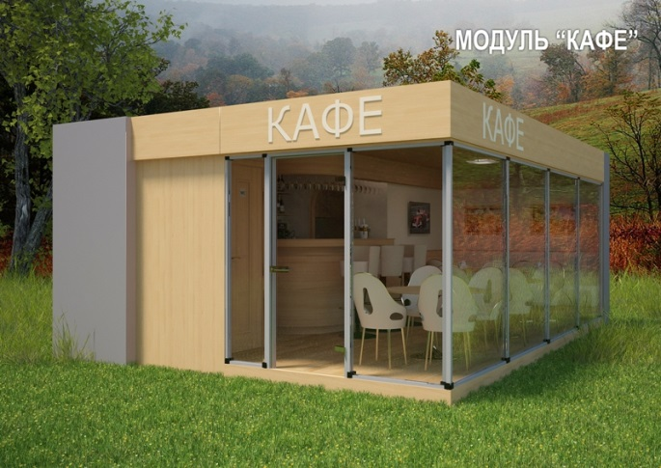


Slide 11
garage
baker’s
post office
café
theatre
hospital
station
animal hospital
greengrocer’s

Slide 12
garage

Slide 13
animal hospital

Slide 14
station

Slide 15
baker’s

Slide 16
greengrocer’s

Slide 17
theatre

Slide 18
post office

Slide 19
hospital

Slide 20
café

