Slide 1
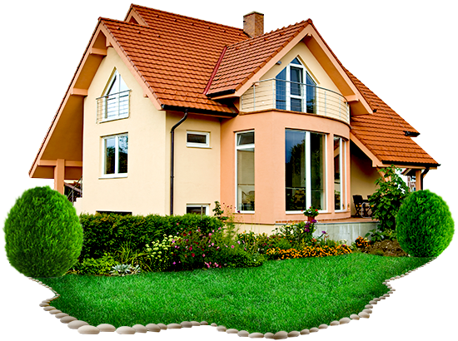
house
a house
the house

Slide 2
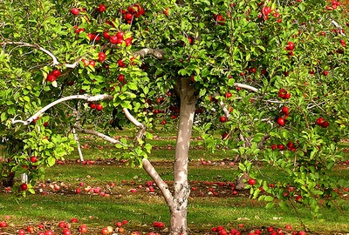
garden
a garden
the garden

Slide 3
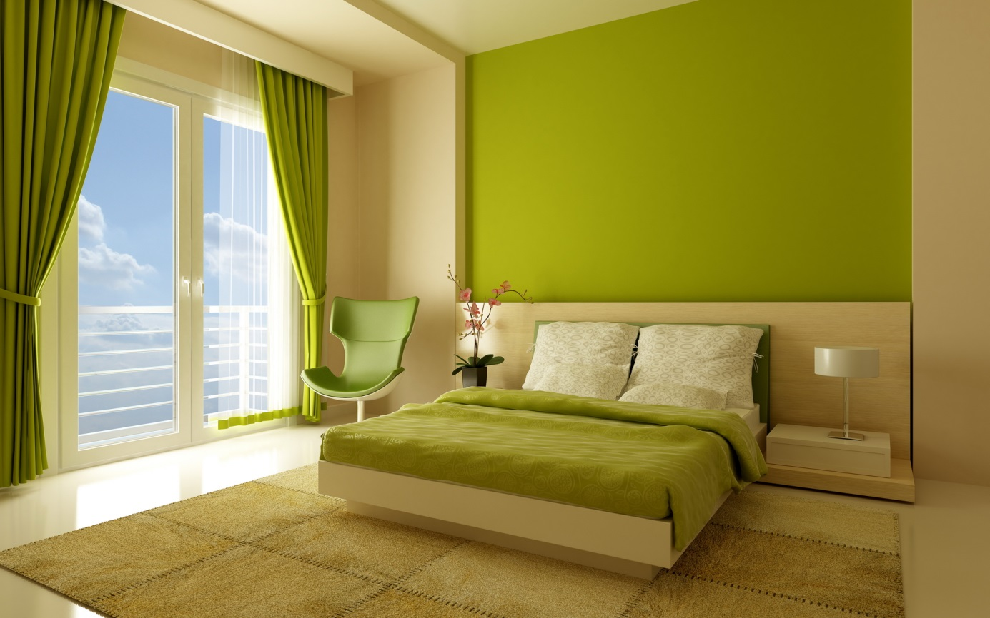
bedroom
a bedroom
the bedroom

Slide 4
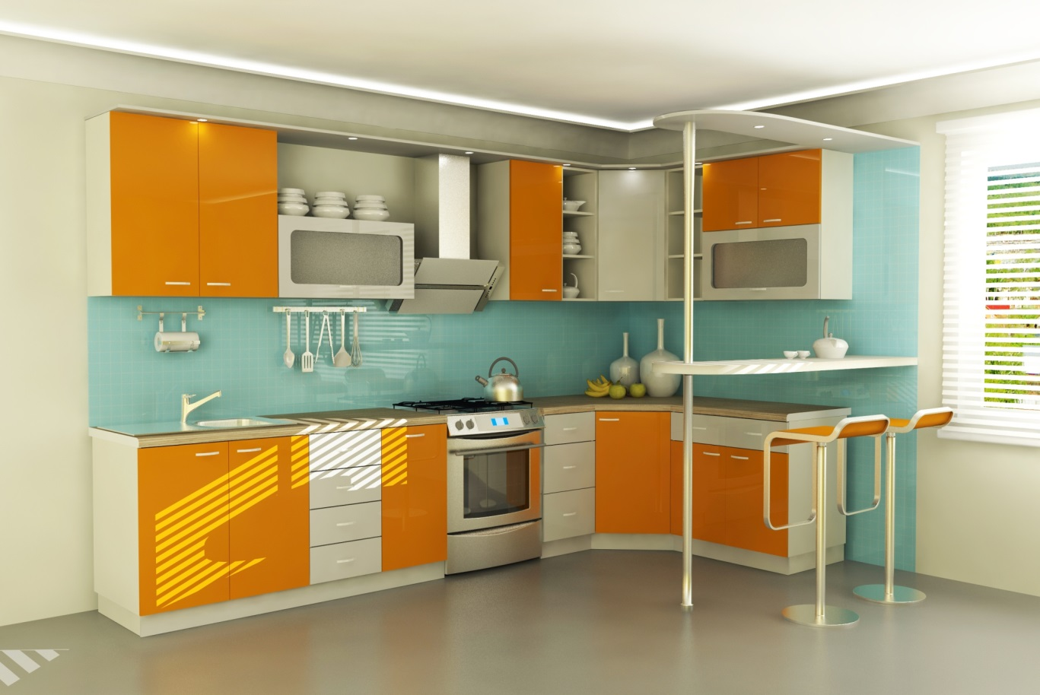


Slide 5

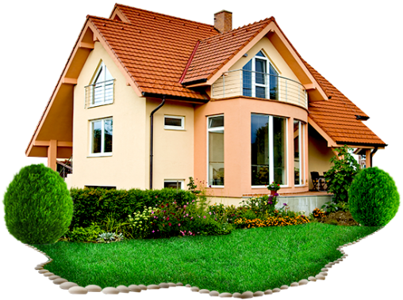

a kitchen
the house
bedroom
the garden

Slide 6



Slide 7
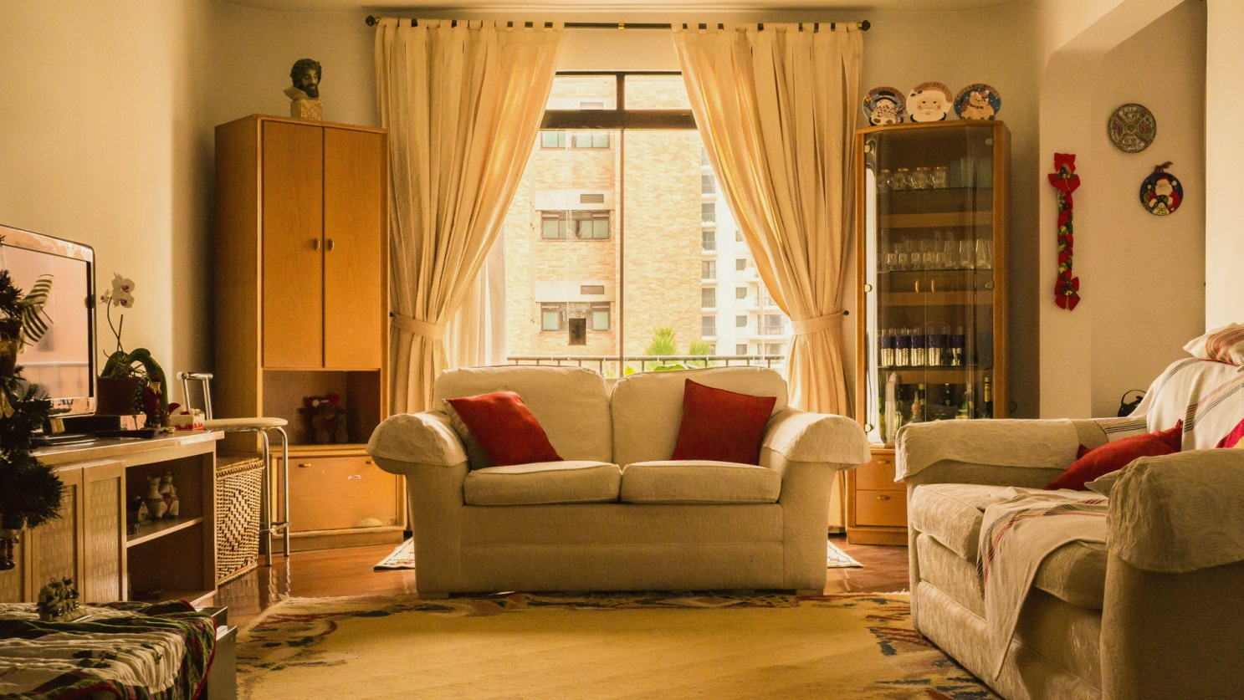
living room
a living room
the living room

Slide 8
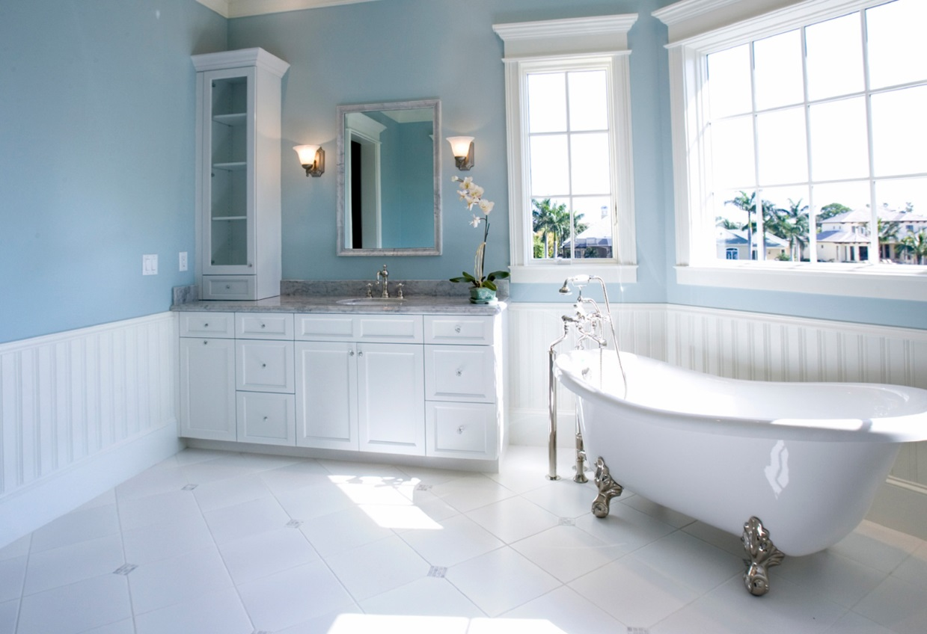
bathroom
a bathroom
the bathroom

Slide 9
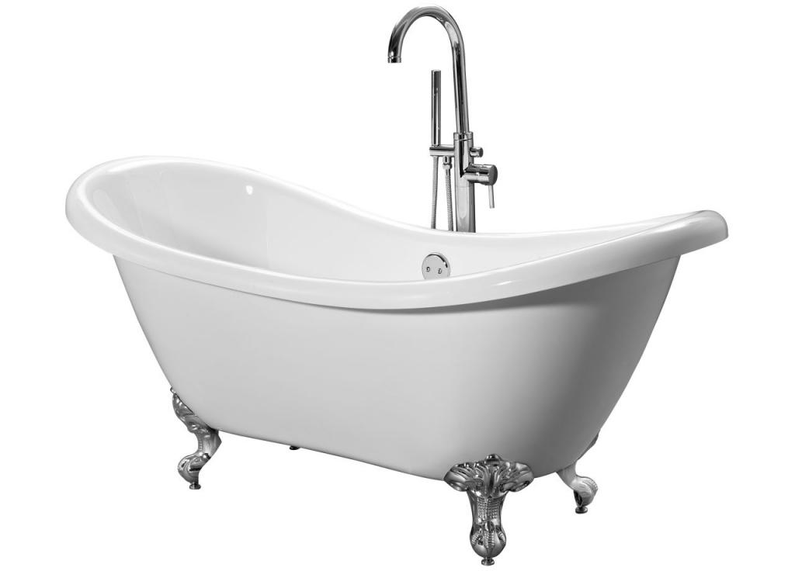
bath
a bath
the bath

Slide 10



the bath
a living room
bathroom

Slide 11



Slide 12



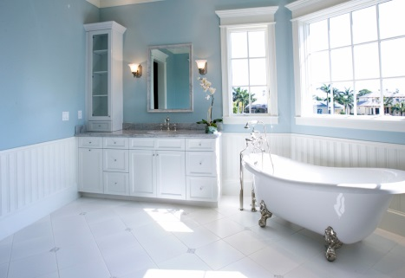

the house
a kitchen
bedroom
the garden
the bath
bathroom
a living room

Slide 13






