Slide 1
My things

Slide 2
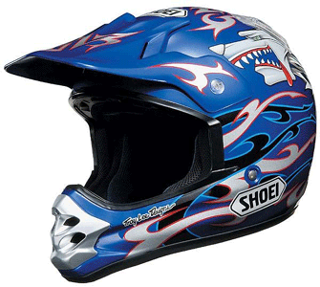
helmet

Slide 3
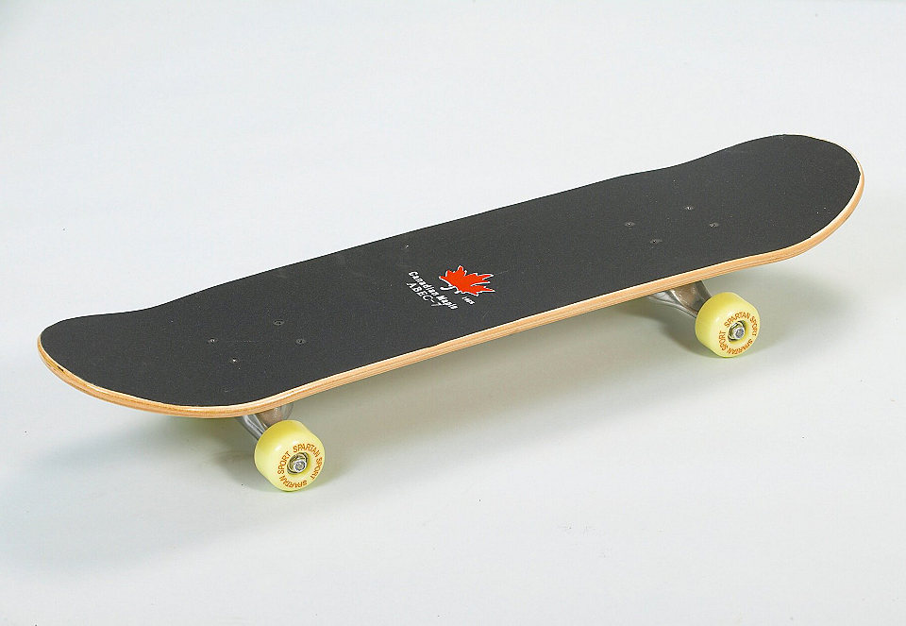
skateboard

Slide 4
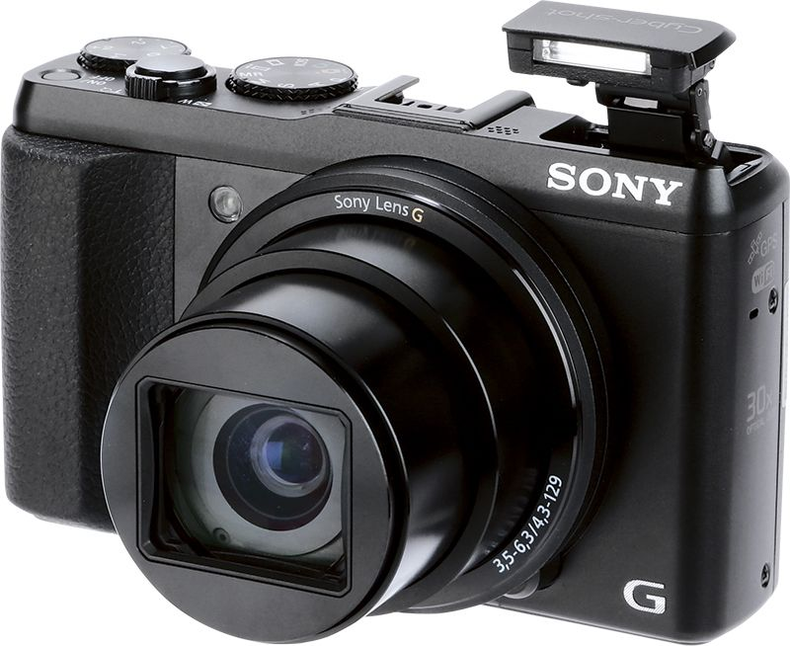
digital camera

Slide 5
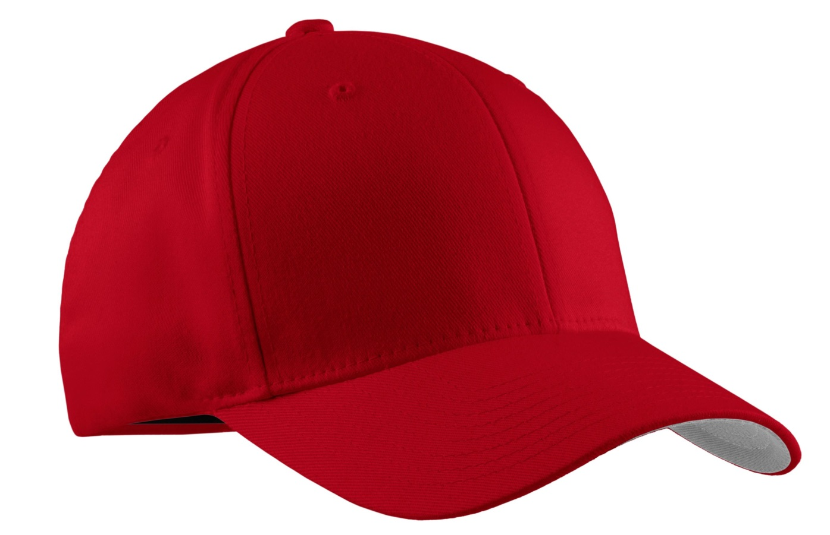
cap

Slide 6
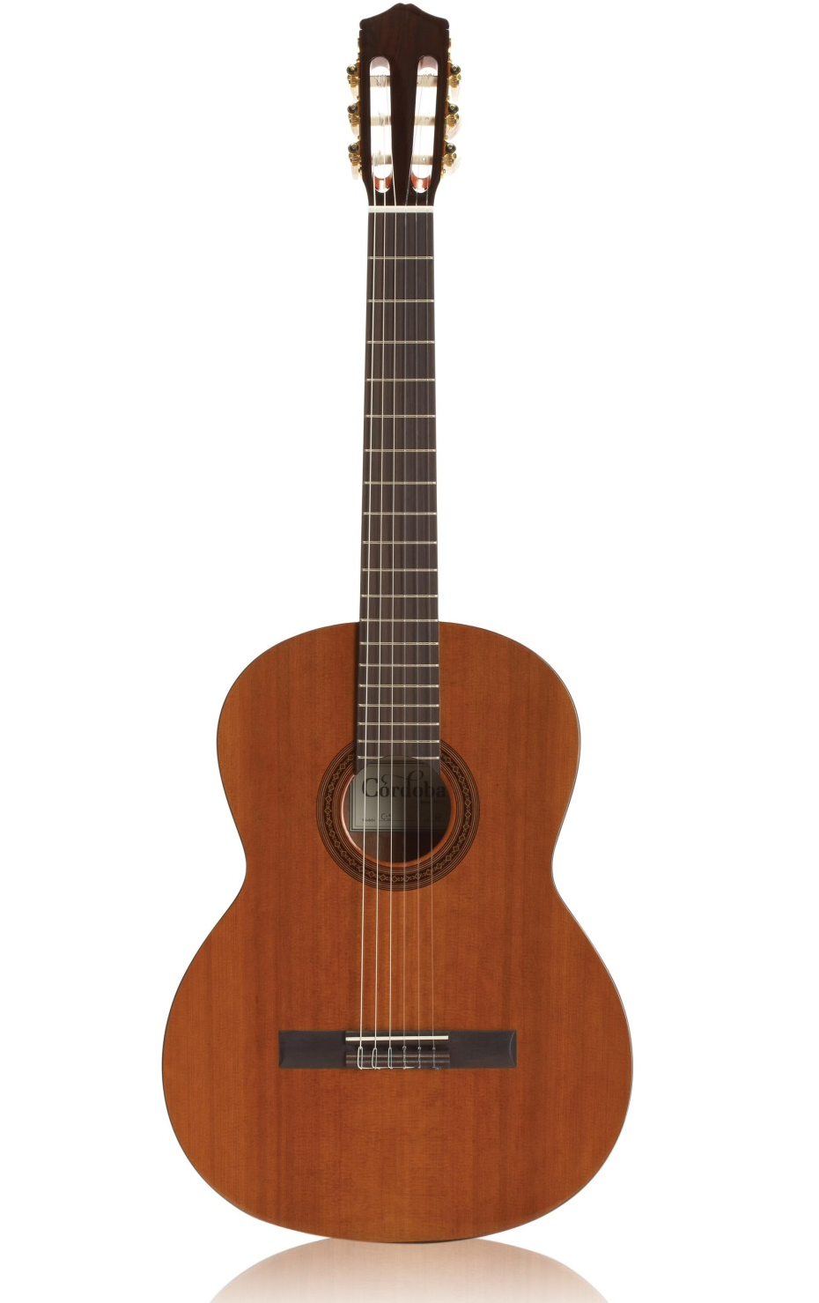
guitar

Slide 7
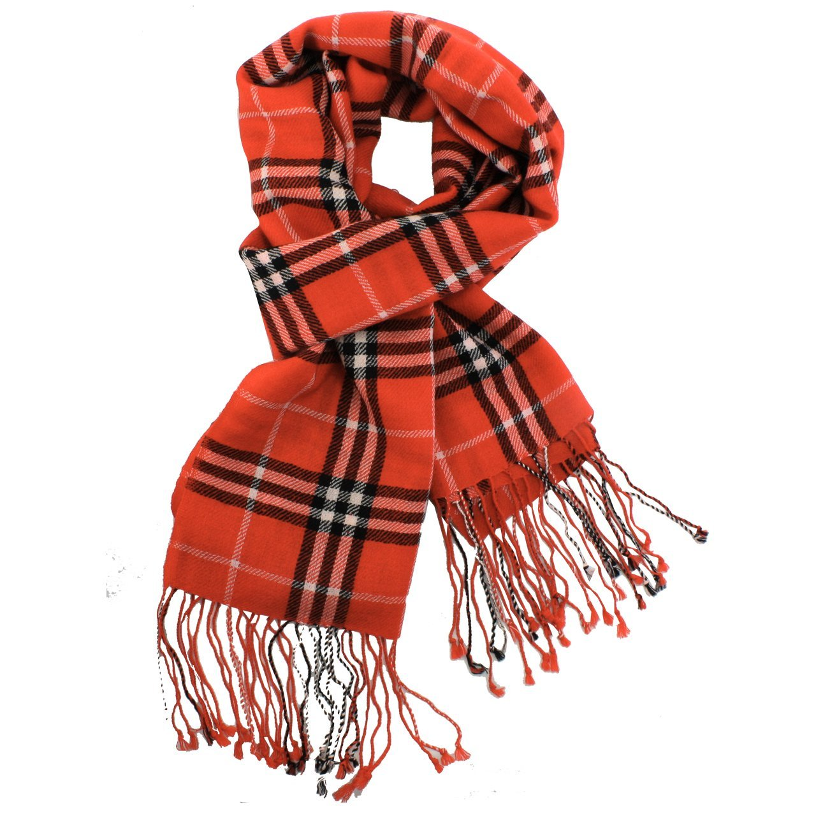
scarf

Slide 8

basketball

Slide 9
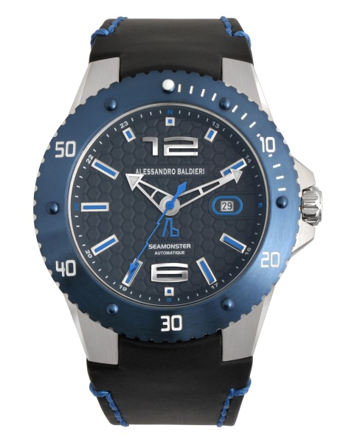
watch

Slide 10
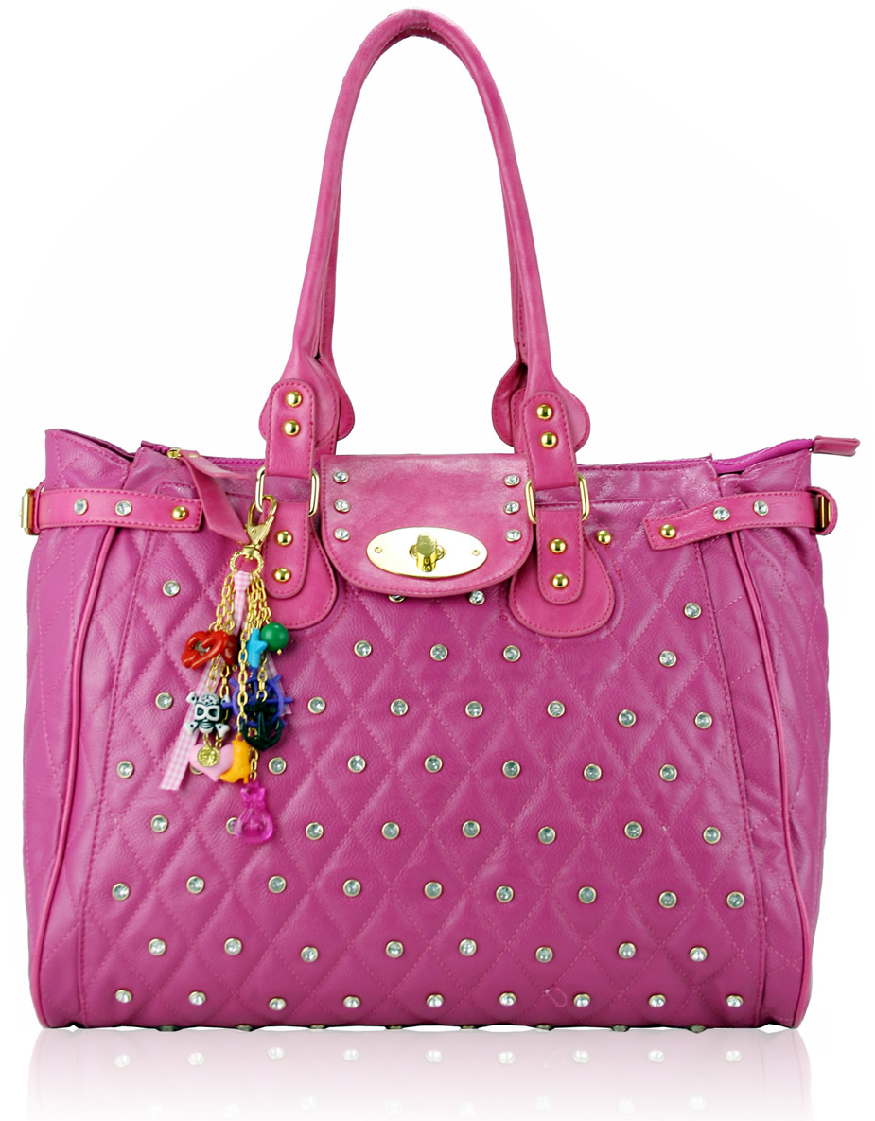
handbag

Slide 11
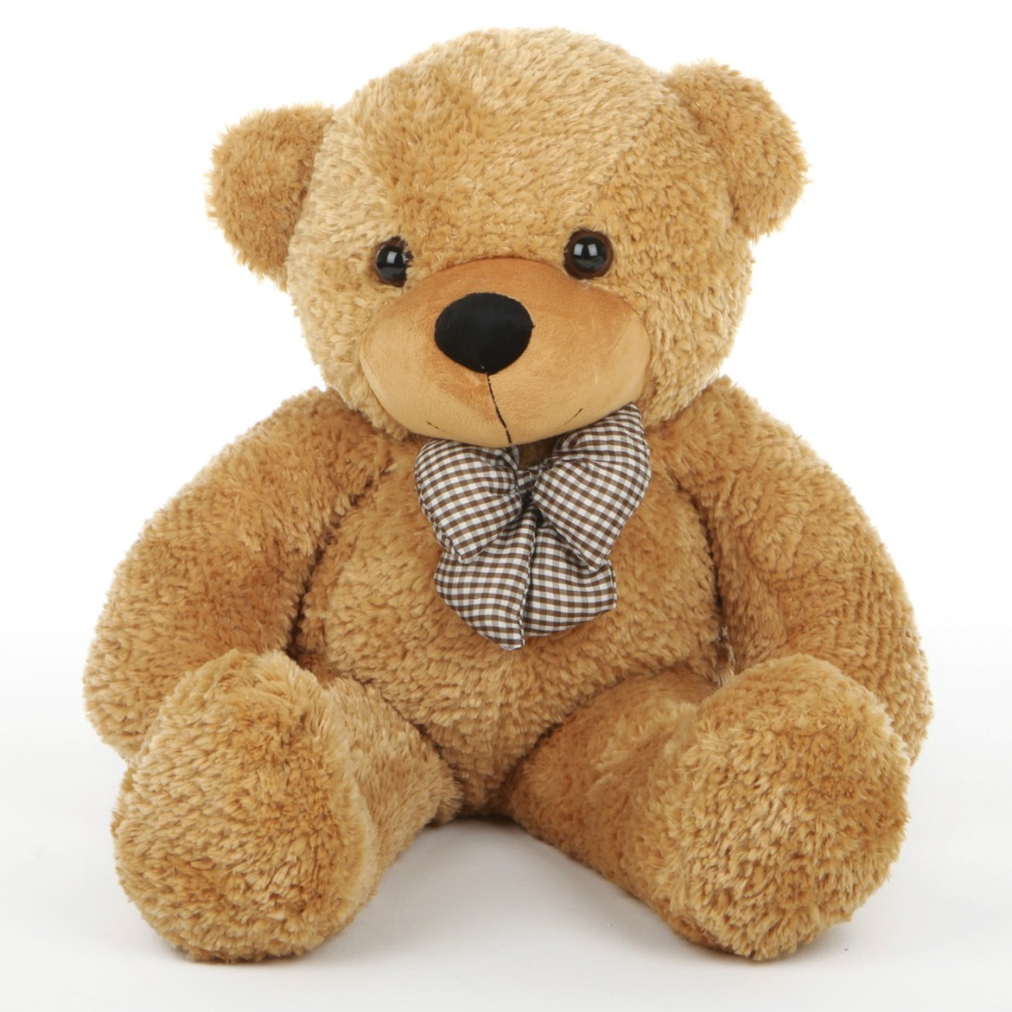
teddy bear

Slide 12
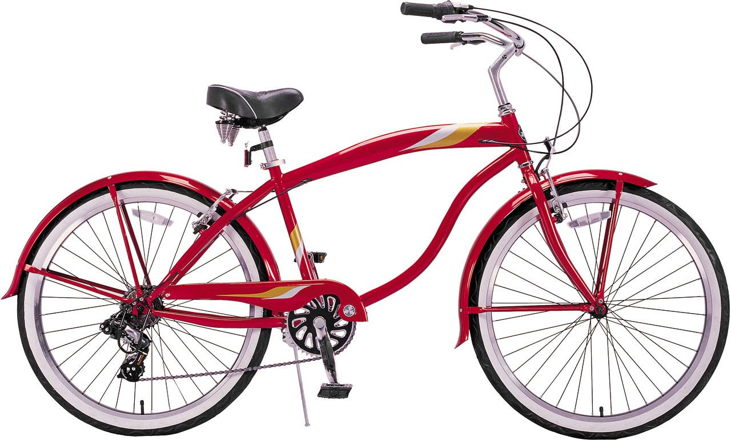
bicycle

Slide 13
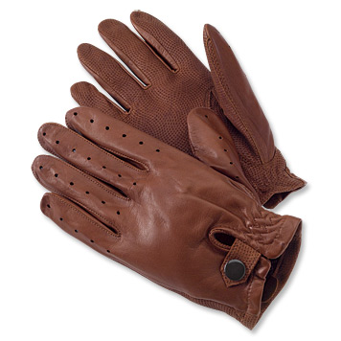
gloves

Slide 14
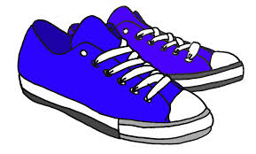
trainers

Slide 15
basketball

Slide 16
scarf

Slide 17
digital camera

Slide 18
handbag

Slide 19
helmet

Slide 20
cap

Slide 21
skateboard

Slide 22
guitar

Slide 23
trainers

Slide 24
watch

Slide 25
teddy bear

Slide 26
gloves

Slide 27
bicycle

Slide 28
