Slide 1
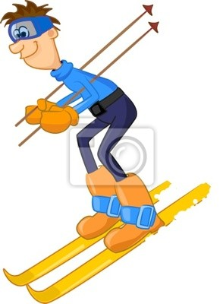
ski

Slide 2
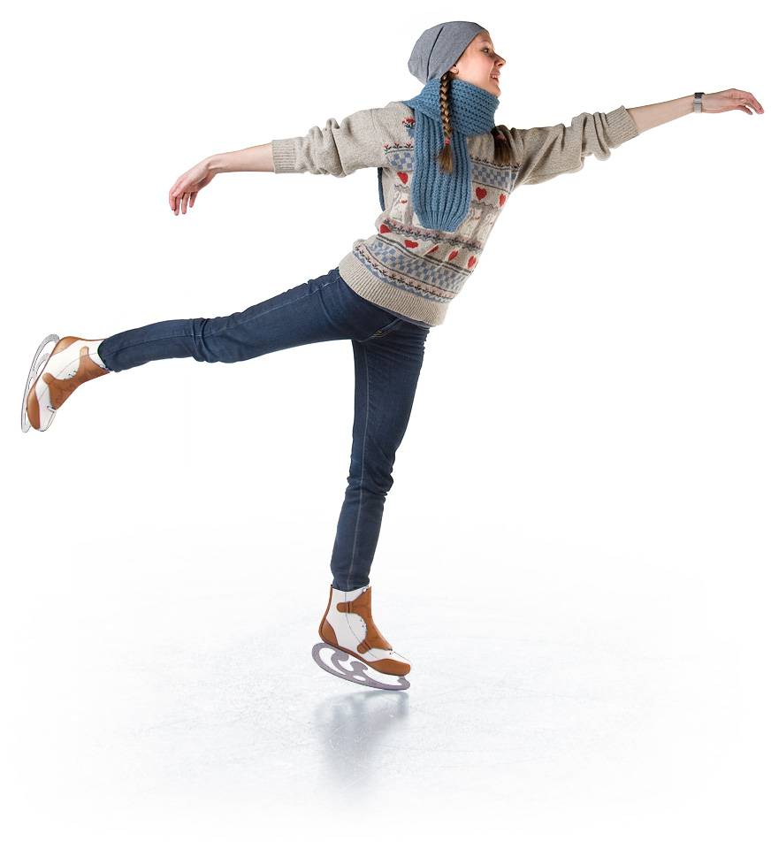
skate

Slide 3

play
the violin

Slide 4

surf

Slide 5

dive

Slide 6

sail

Slide 7




Slide 8
surf

Slide 9
skate

Slide 10
dive

Slide 11

play
the violin

Slide 12
sail

Slide 13
ski

Slide 14
skate
She is skating
She can skate.

Slide 15
sail
He is sailing
He can sail

Slide 16
surf
He is surfing
He can surf.

Slide 17
ski
He is skiing
He can ski

Slide 18
play
the violin
She is playing the violin
She can play the violin

Slide 19
dive
They are diving
They can dive.

