Slide 1
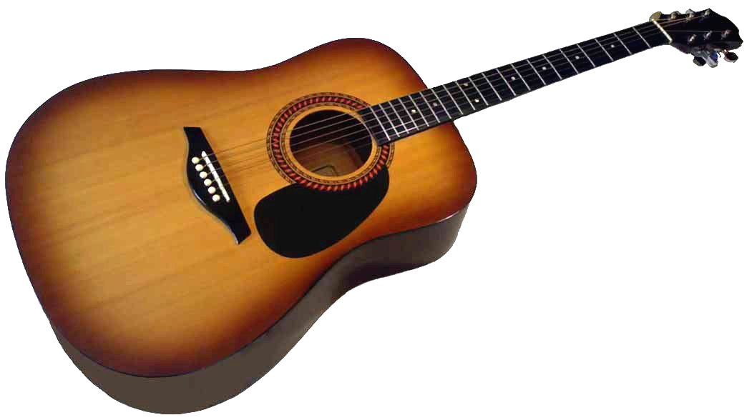
guitar

Slide 2
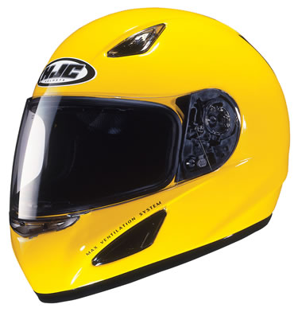
helmet

Slide 3
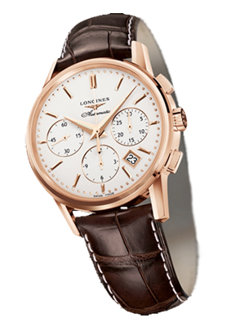
watch

Slide 4
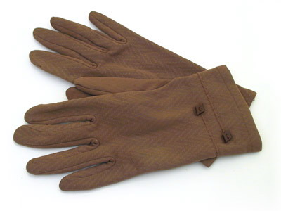
gloves

Slide 5
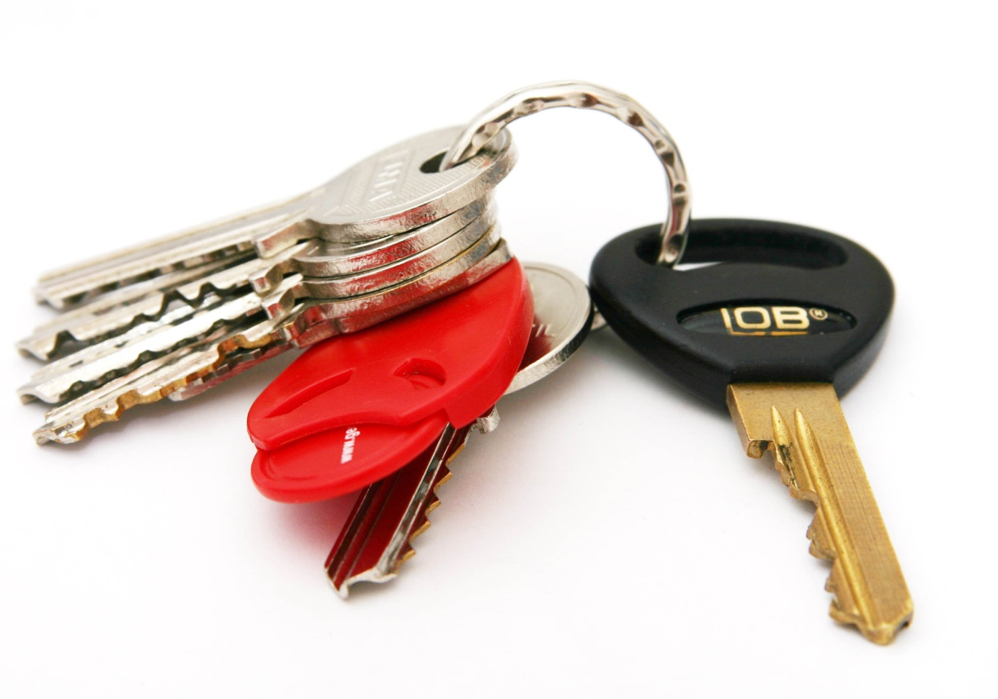
keys

Slide 6
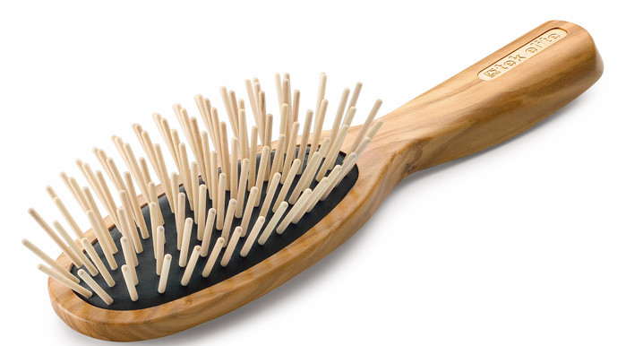
hairbrush

Slide 7
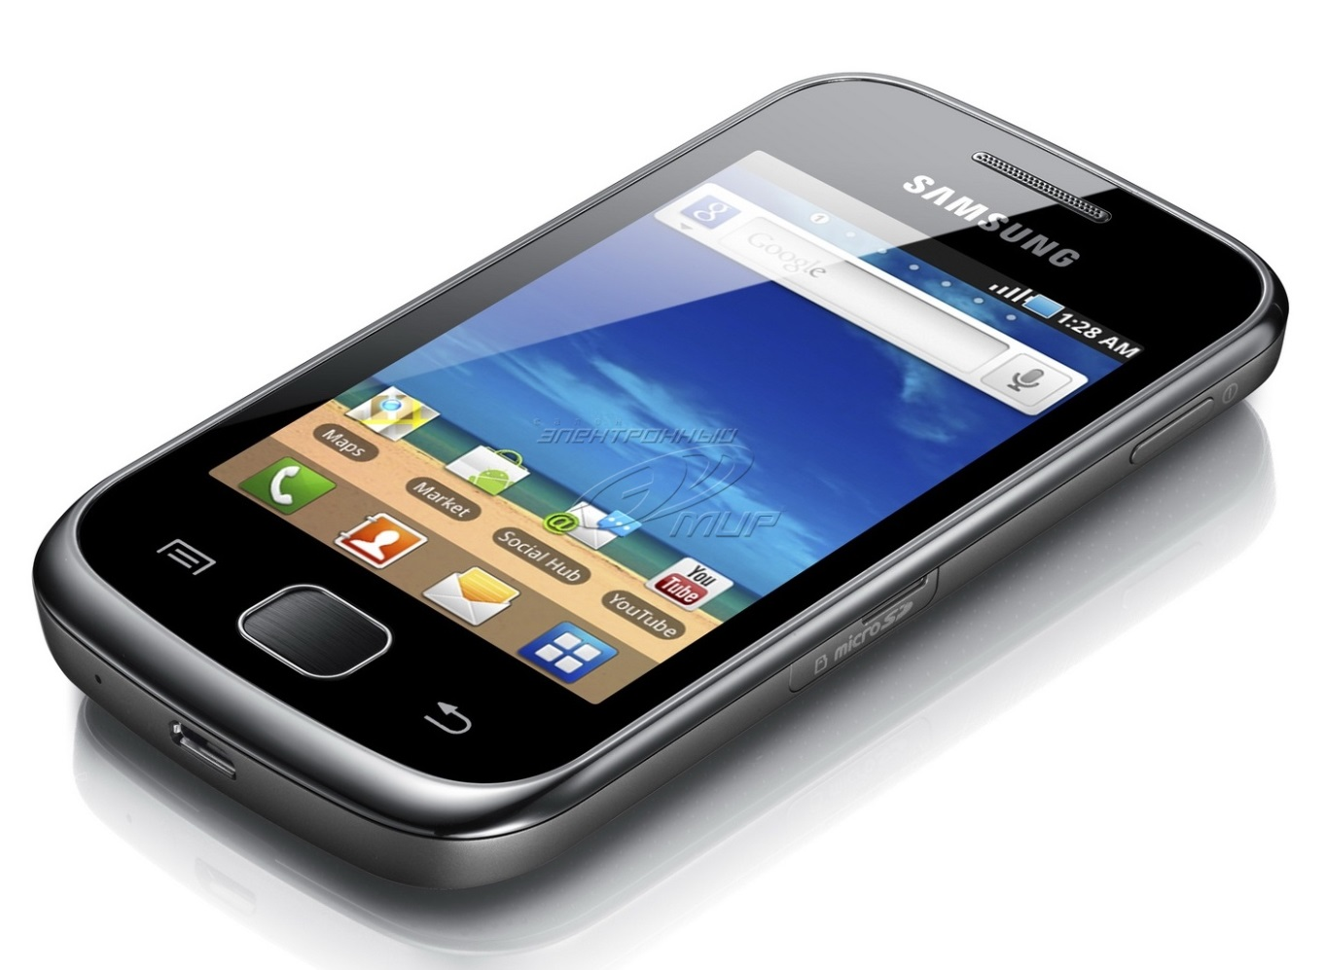
mobile phone

Slide 8
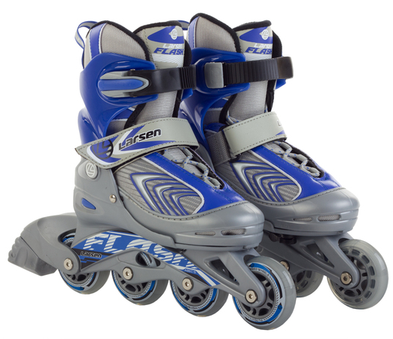
roller blades

Slide 9
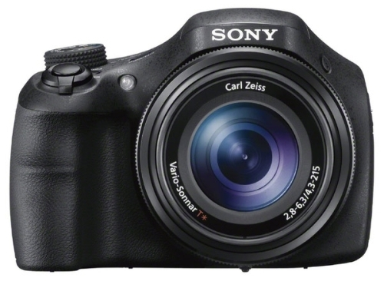
camera

Slide 10
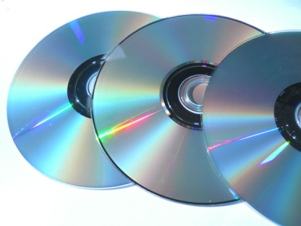
CDs

Slide 11



Slide 12
guitar

Slide 13
helmet

Slide 14
watch

Slide 15
gloves

Slide 16
keys

Slide 17
hairbrush

Slide 18
mobile phone

Slide 19
roller blades

Slide 20
camera

Slide 21
CDs

