Slide 1
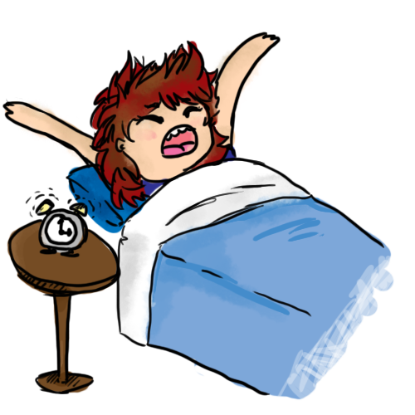
In the morning
get up

Slide 2

In the morning
have
a shower

Slide 3

In the morning
have breakfast

Slide 4

In the morning
go to school

Slide 5
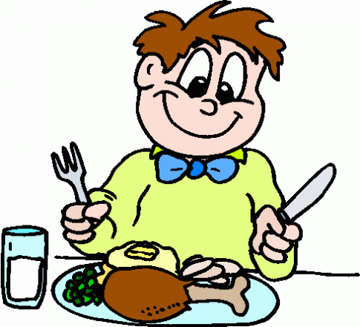
In the afternoon
have lunch

Slide 6
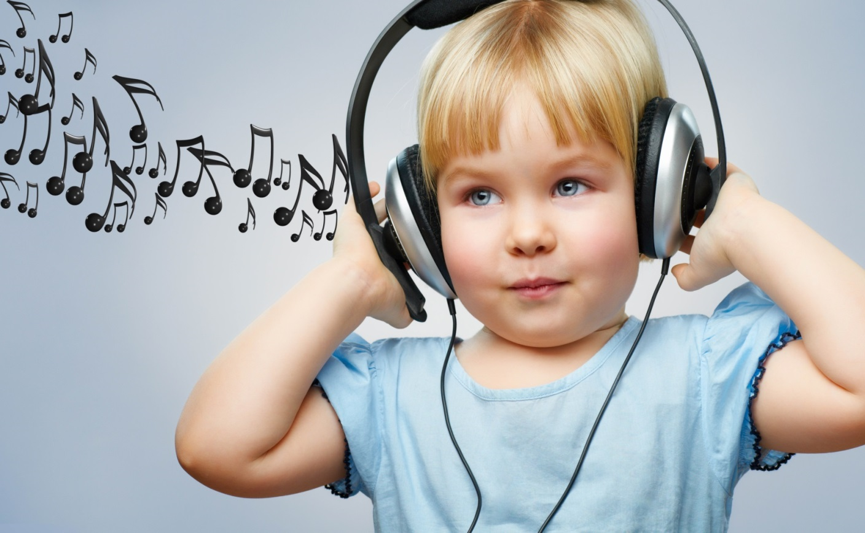
In the afternoon
listen to music

Slide 7
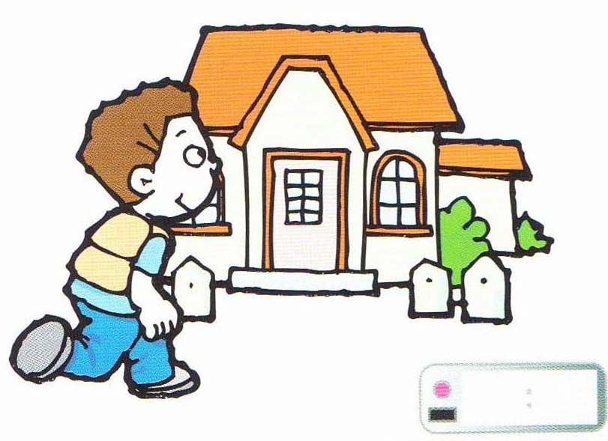
In the afternoon
come home

Slide 8
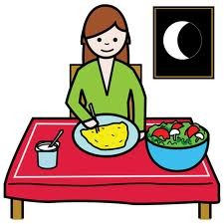
In the evening
have supper

Slide 9

In the evening
visit friends

Slide 10
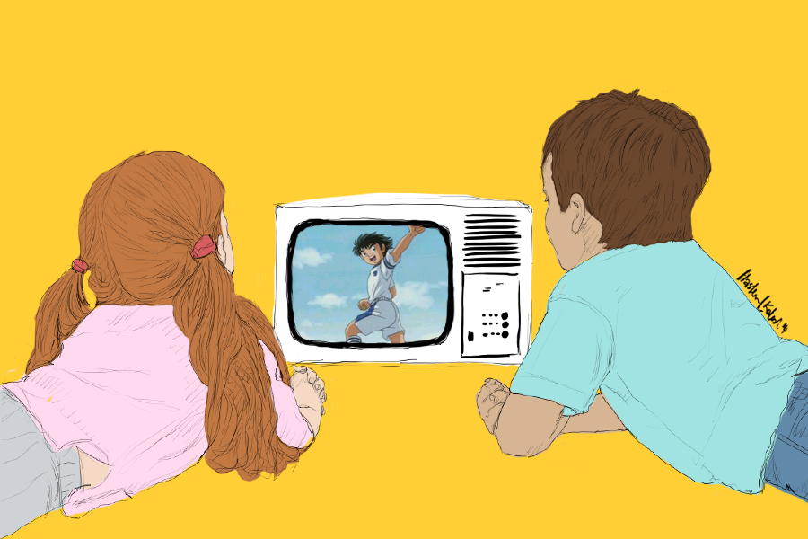
In the evening
watch TV

Slide 11
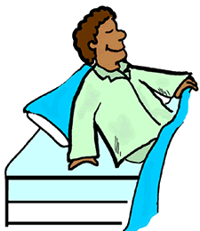
At night
go to bed

Slide 12
In the afternoon
listen to music

Slide 13
In the morning
have
a shower

Slide 14
In the morning
have breakfast

Slide 15
In the evening
have supper

Slide 16
In the morning
get up

Slide 17
In the afternoon
have lunch

Slide 18
In the afternoon
come home

Slide 19
At night
go to bed

Slide 20
In the morning
go to school

Slide 21
In the evening
visit friends

Slide 22
In the evening
watch TV

Slide 23
