Slide 1
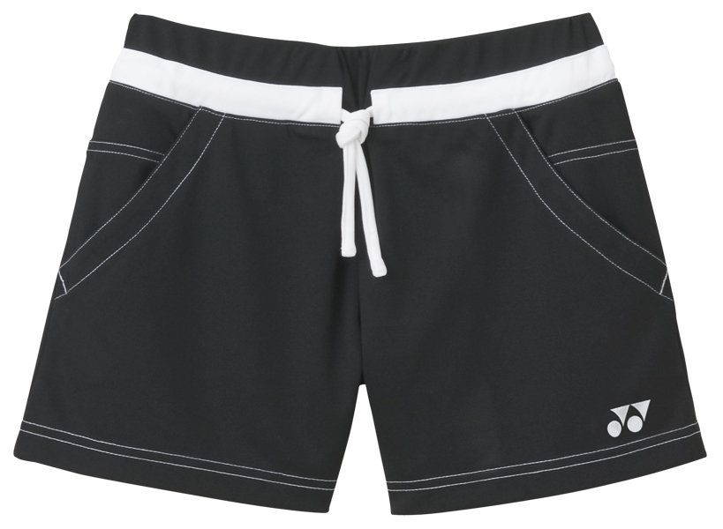
Shorts
black shorts
Your shorts

Slide 2
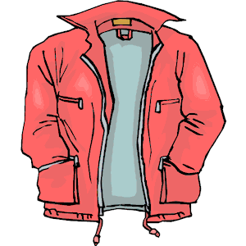
Jacket
my jacket
your jacket

Slide 3
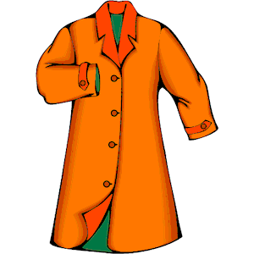
Coat
The coat
the orange coat

Slide 4

Hat
A hat
a red hat
Your hat

Slide 5
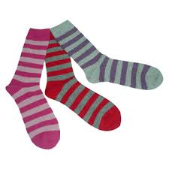
Socks
The socks

Slide 6
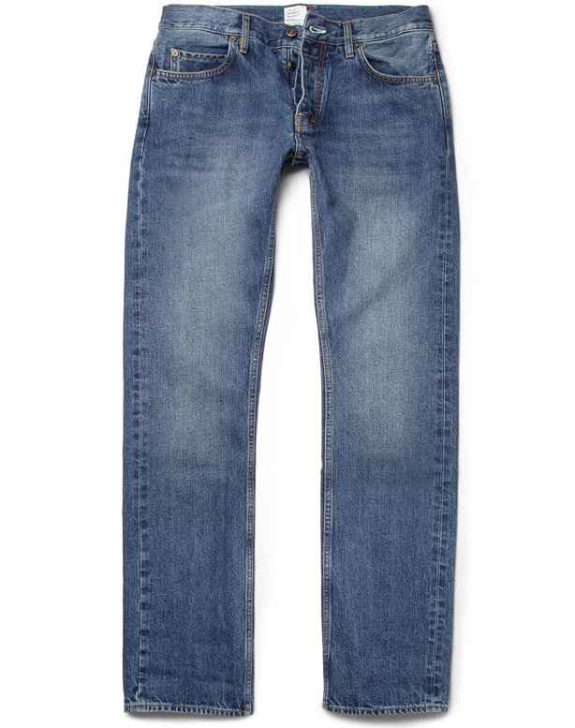
Jeans
My jeans
Your jeans

Slide 7
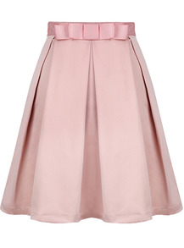
Skirt
A pink skirt

Slide 8
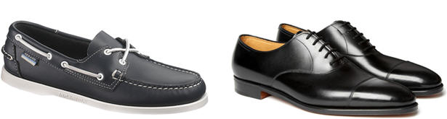
Shoes
Black shoes

Slide 9
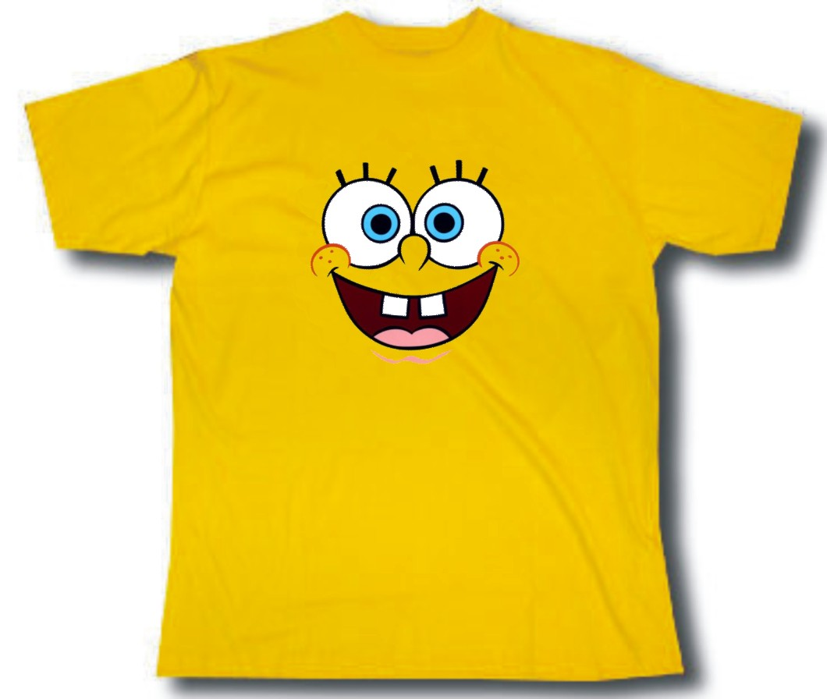
T–shirt
my T–shirt
Your T-shirt

Slide 10

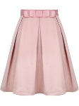

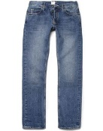
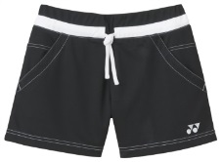

T-shirt
Socks
A skirt
Your shoes
Jeans
The shorts
Your hat
Jacket
my coat

Slide 11


