Slide 1
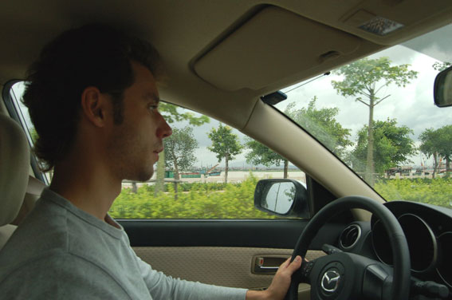
drive a car

Slide 2
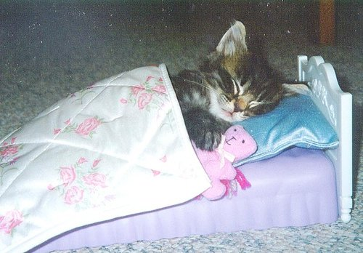
sleep

Slide 3
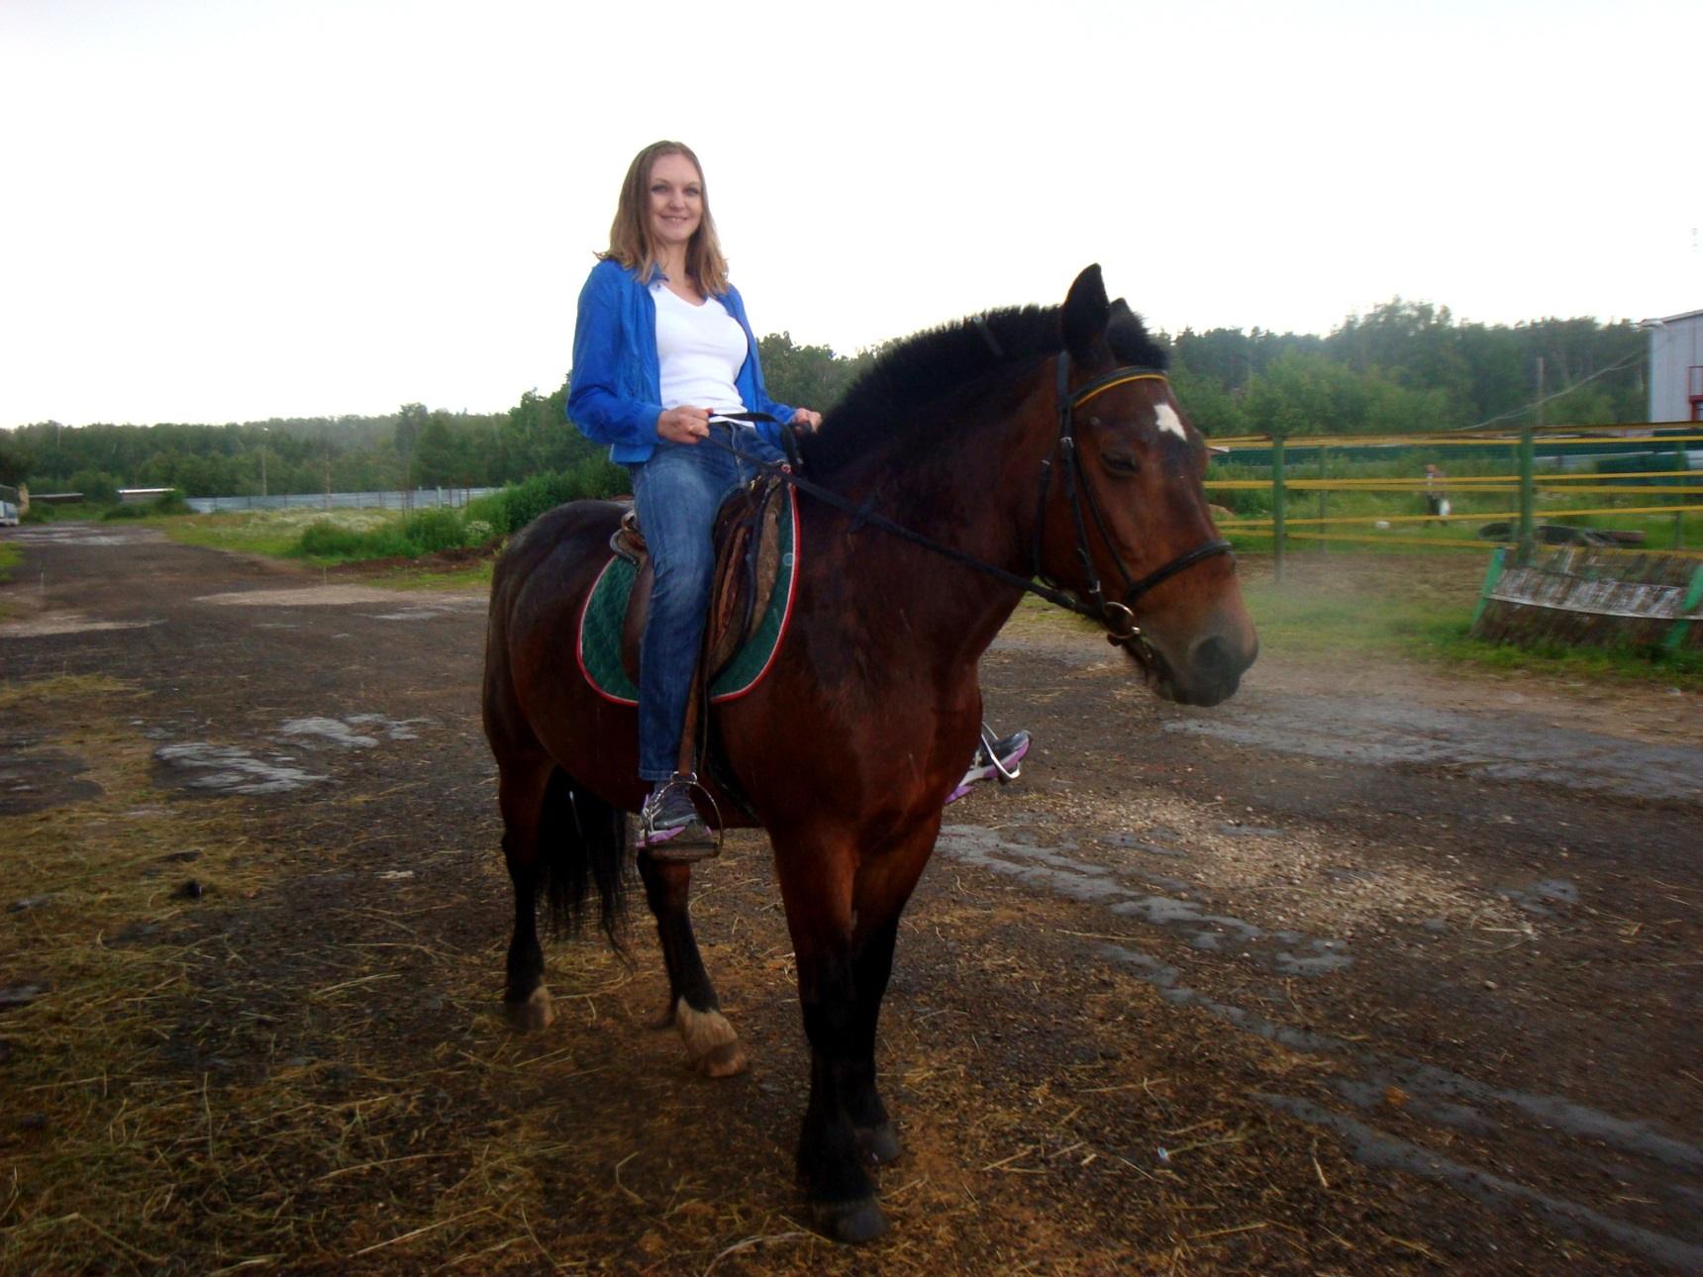
ride a horse

Slide 4

fly a kite

Slide 5
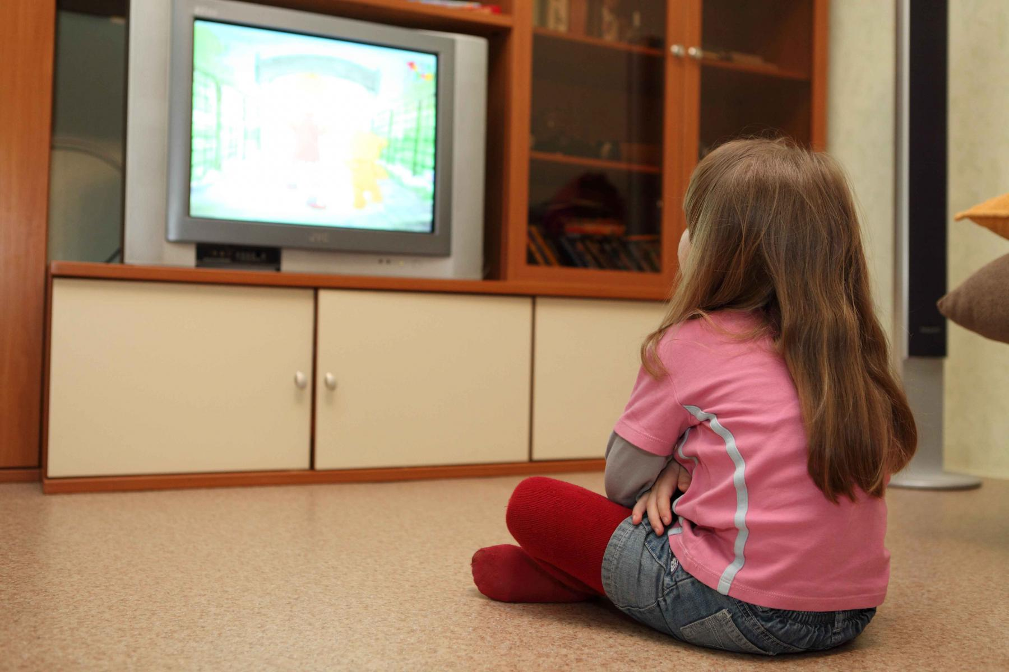
watch TV

Slide 6
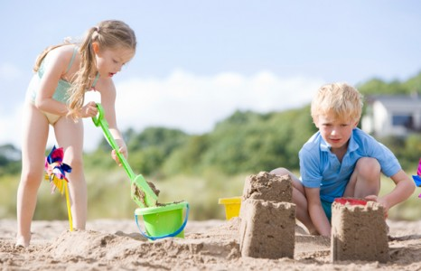
make a sandcastle

Slide 7

sing

Slide 8

swim

Slide 9
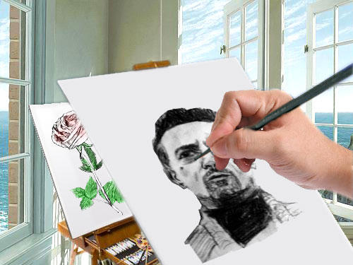
paint

Slide 10
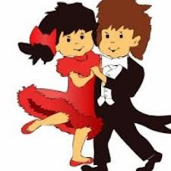
dance

Slide 11
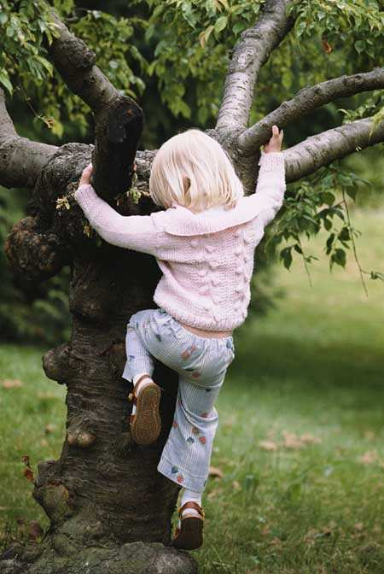
climb

Slide 12
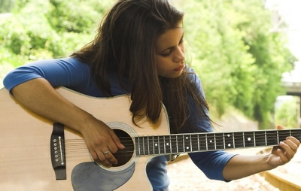
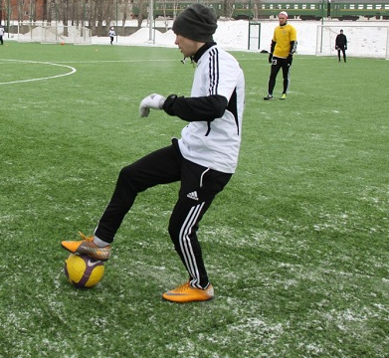

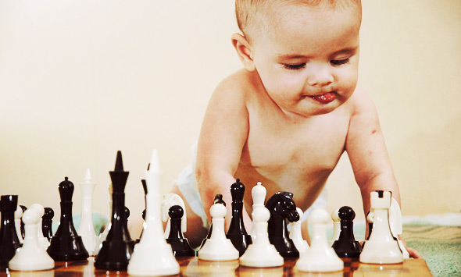
play

Slide 13

read

Slide 14

listen to music

Slide 15




Slide 16
drive a car

Slide 17
sleep

Slide 18
ride a horse

Slide 19
fly a kite

Slide 20
watch TV

Slide 21
make sandcastle

Slide 22
sing

Slide 23
swim

Slide 24
paint

Slide 25
dance

Slide 26
climb

Slide 27
play

Slide 28
read

Slide 29
listen to music

Slide 30
Present Continuous
I am
he is
she is
we are
you are
they are
ing

