Slide 1
Weather
What is the weather like today?

Slide 2

Sunny
It’s sunny.
It is not sunny.

Slide 3
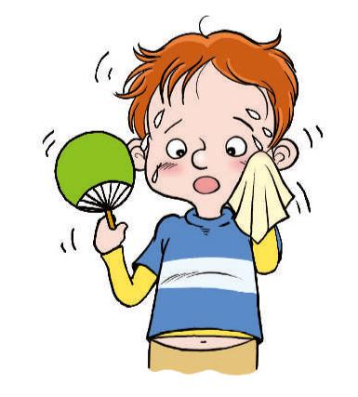
Hot
It’s hot.
It is not hot.

Slide 4
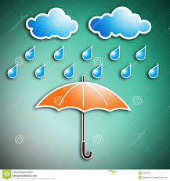
Rainy
It’s raining.
It is not raining.

Slide 5
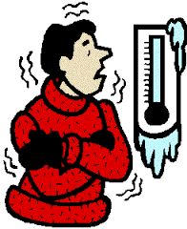
Cold
It’s cold.
It is not cold.

Slide 6
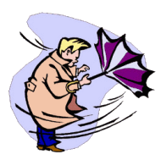
Windy
It’s windy.
It is not windy..

Slide 7

Hot
Raining
Sunny
Windy
Cold

Slide 8


