Slide 1
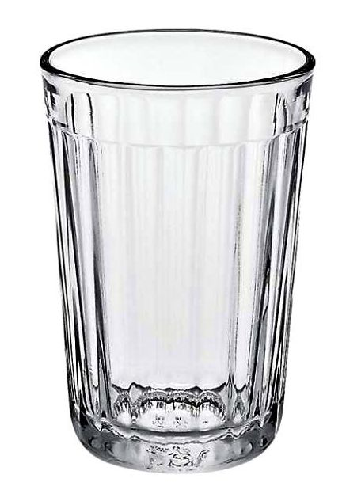
glass

Slide 2
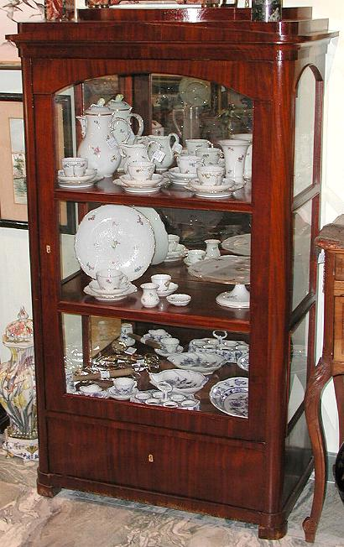
cupboard

Slide 3
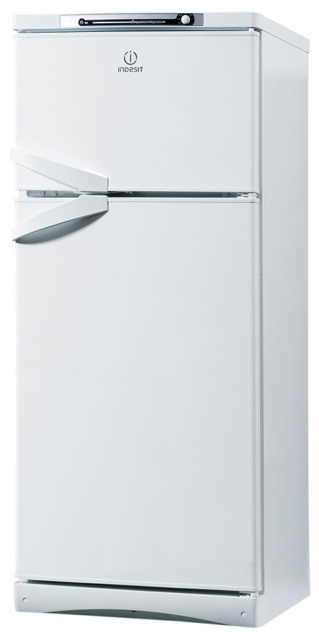
fridge

Slide 4
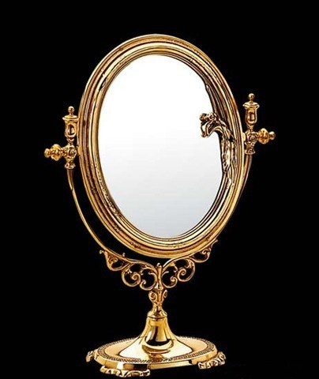
mirror

Slide 5
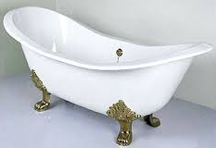
bath

Slide 6
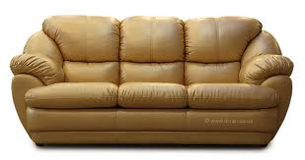
sofa

Slide 7
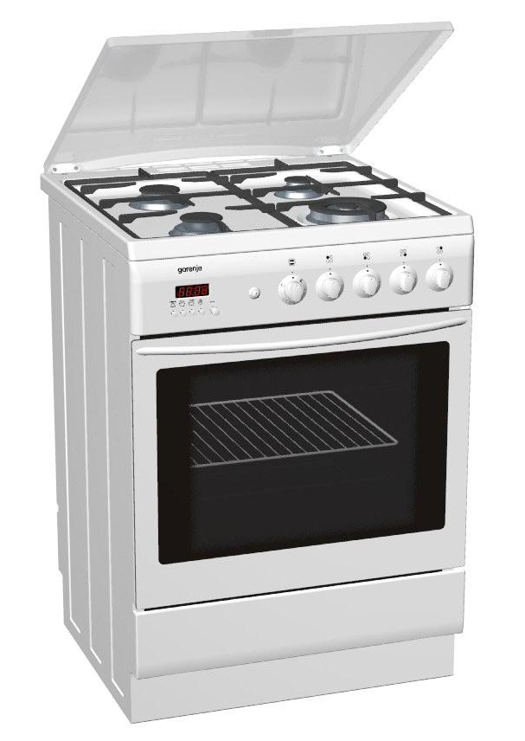
cooker

Slide 8
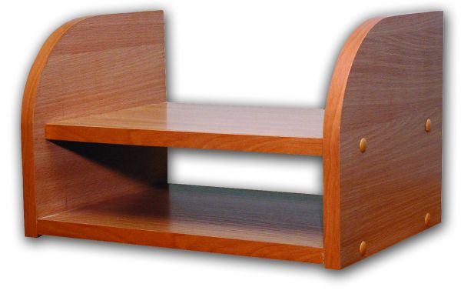
shelf

Slide 9
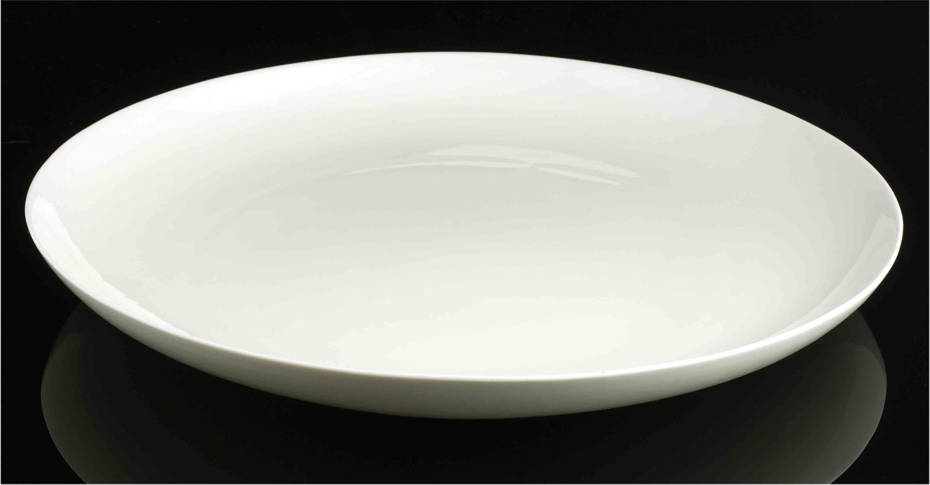
dish

Slide 10

box

Slide 11
glass

Slide 12
fridge

Slide 13
mirror

Slide 14
bath

Slide 15
cupboard

Slide 16
sofa

Slide 17
cooker

Slide 18
shelf

Slide 19
dish

Slide 20
box

Slide 21


