Slide 1

sad

Slide 2
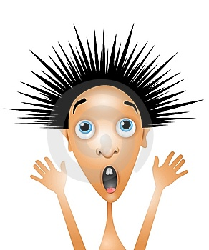
scared

Slide 3
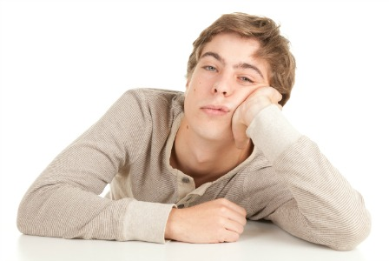
bored

Slide 4

tired

Slide 5

angry

Slide 6

hungry

Slide 7




bored
tired
angry
hungry
scared
sad

Slide 8



